Slide 1
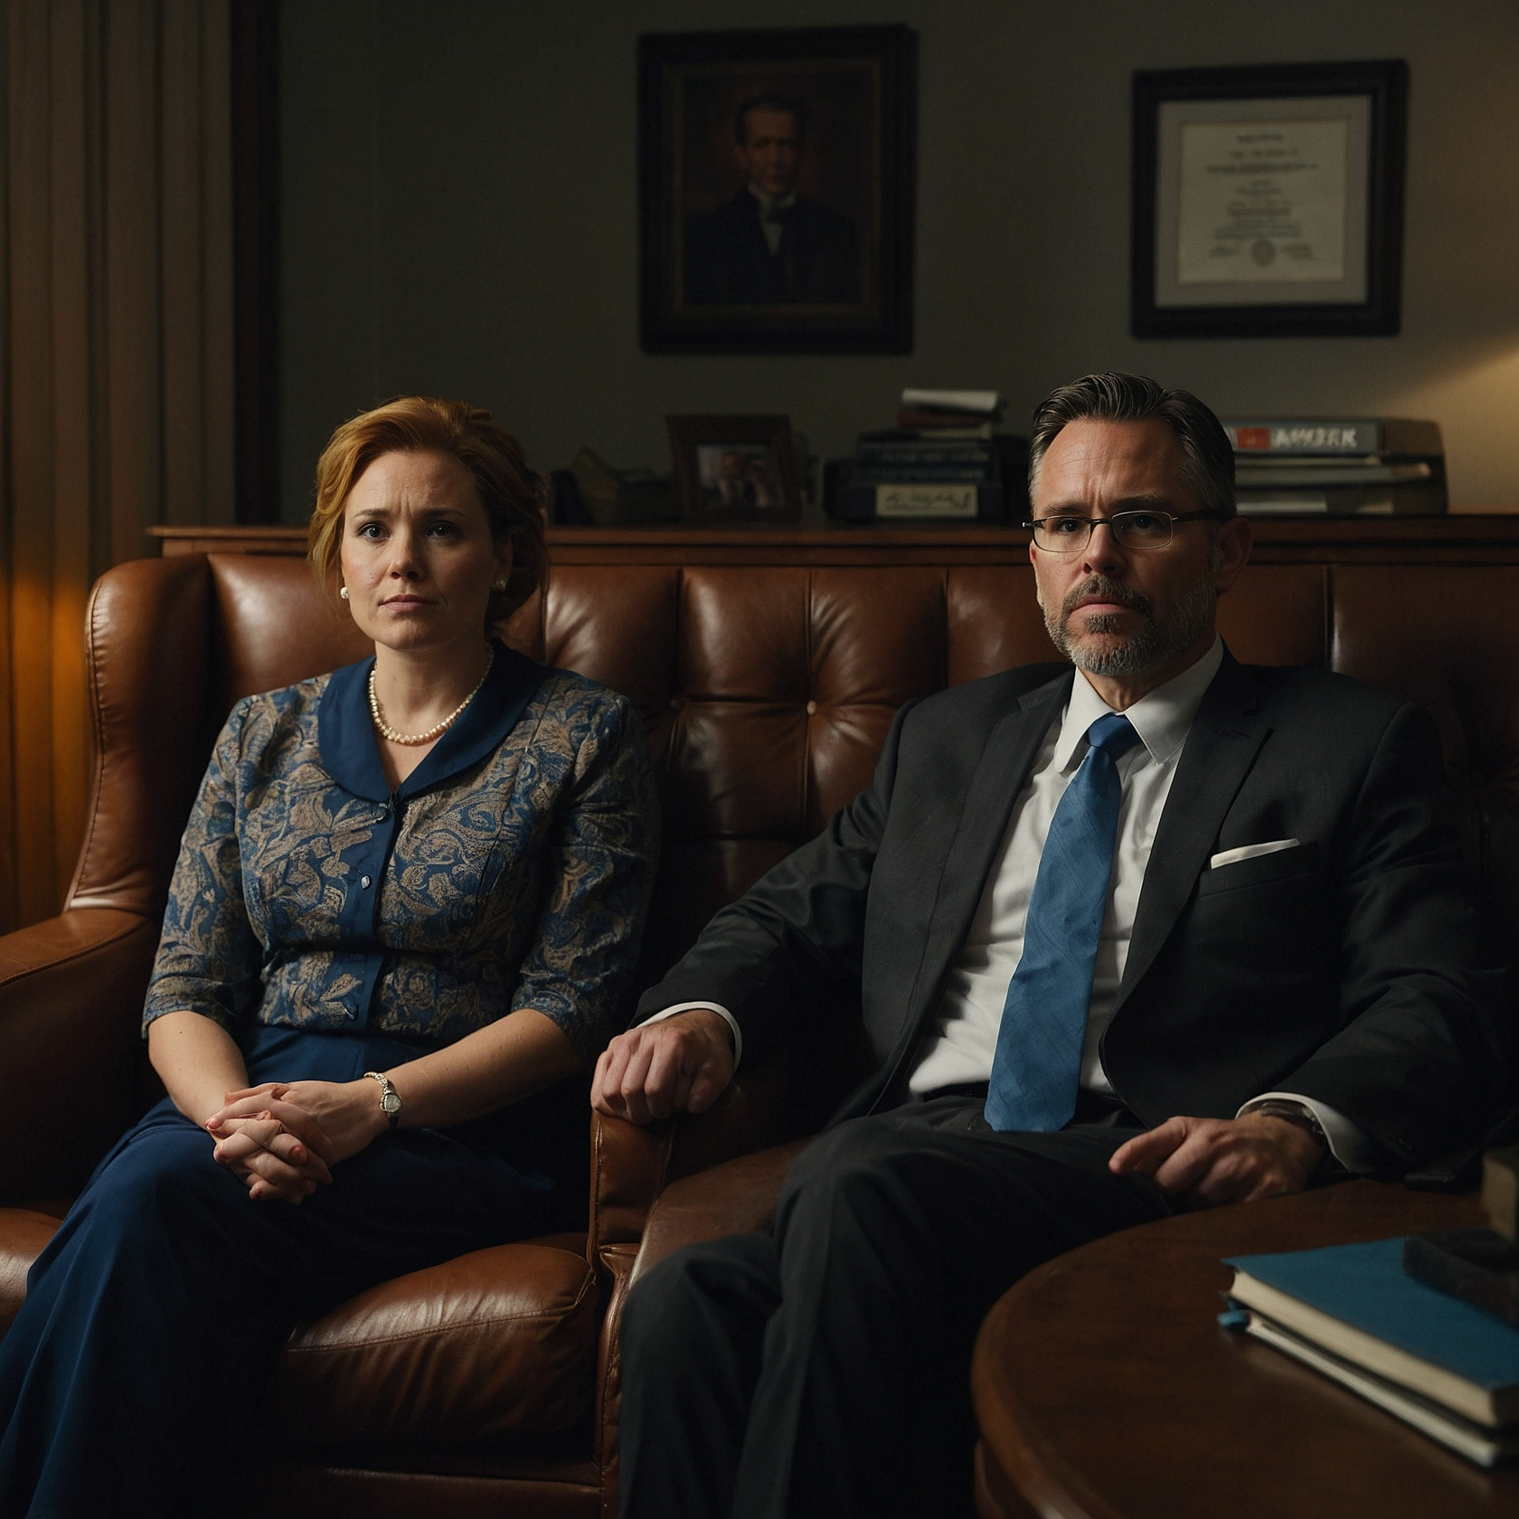
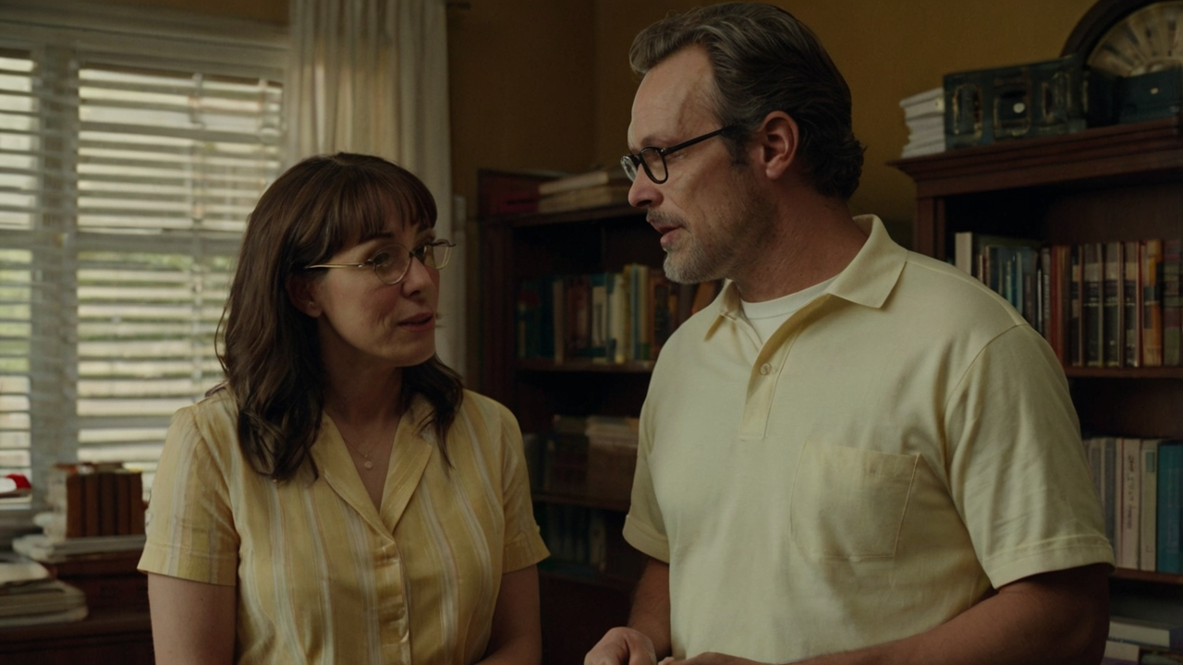
THINKING ON MARRIAGE
BIBLICAL DIALOGUE BY
DR. DANIEL DEIDA
WWW.SANGERNAZ.COM

Slide 2
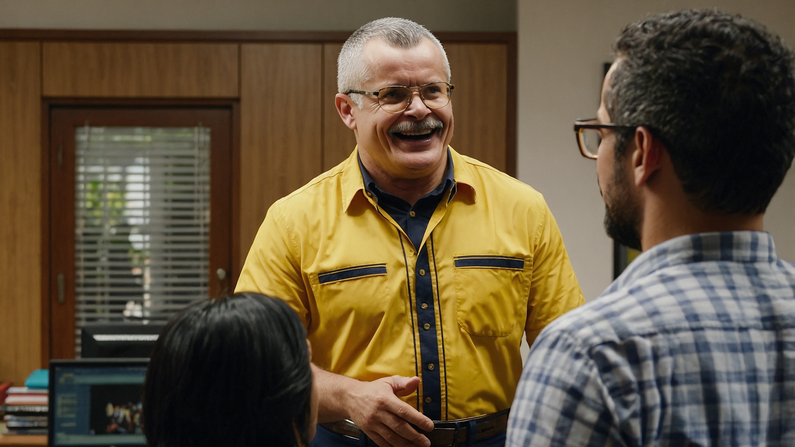

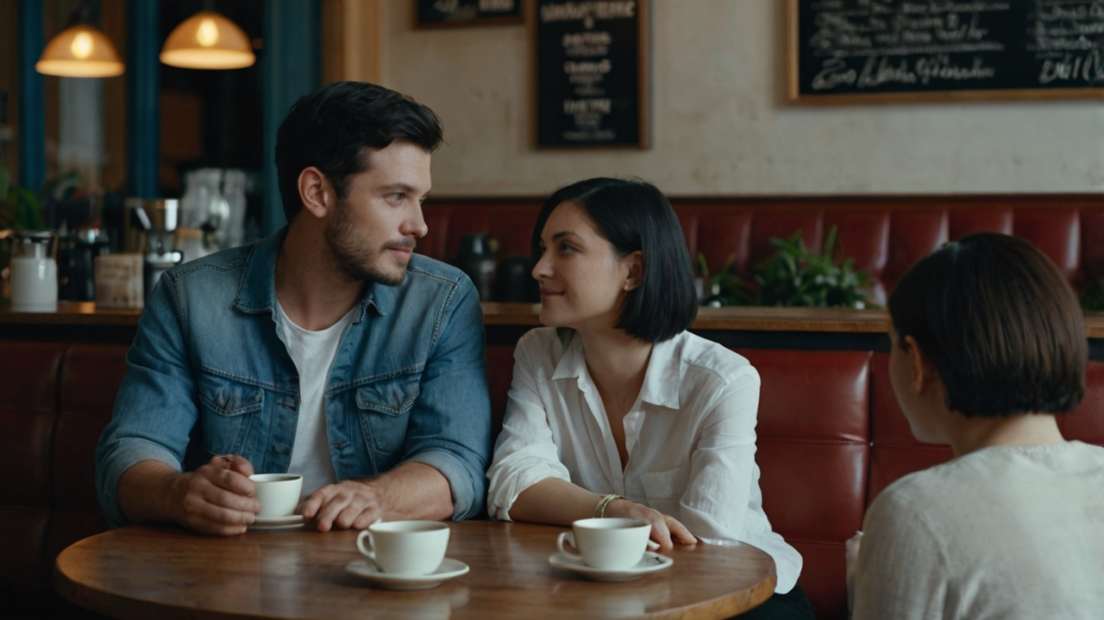

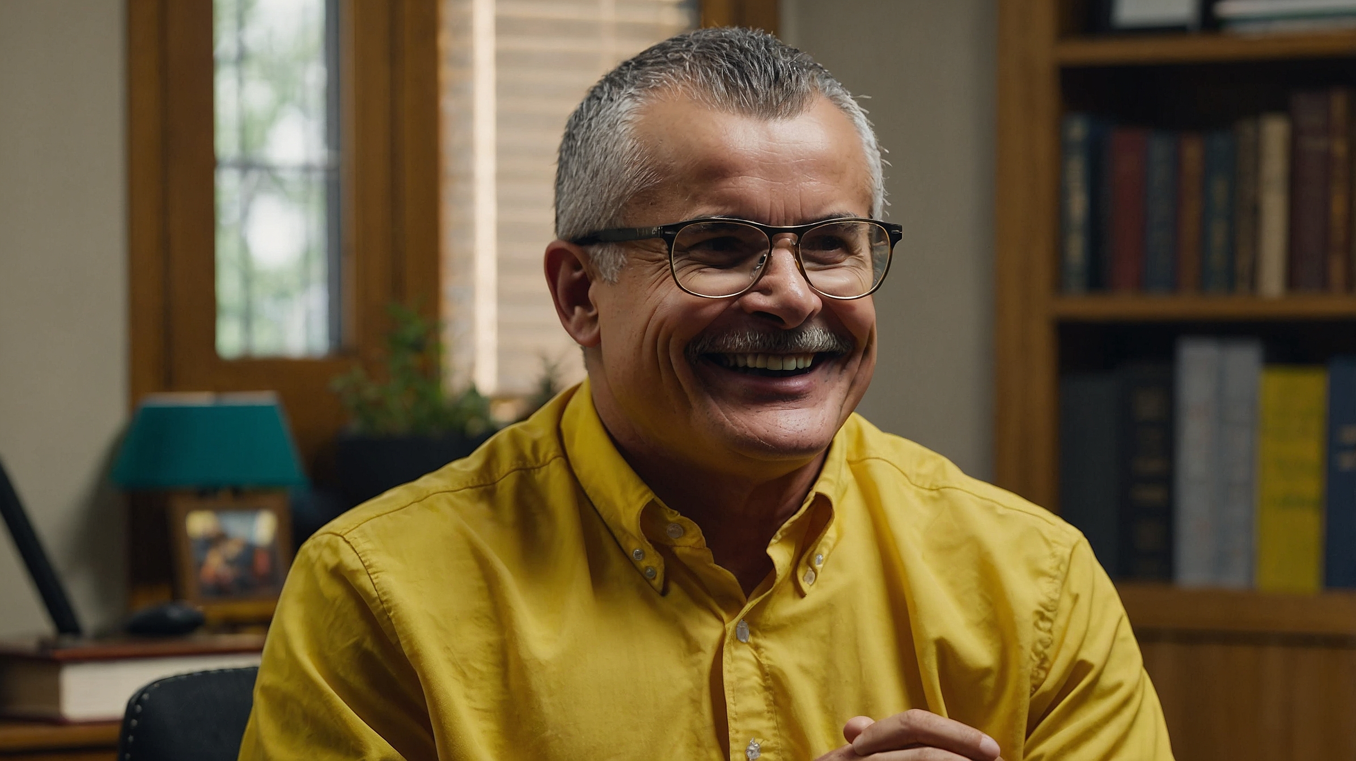
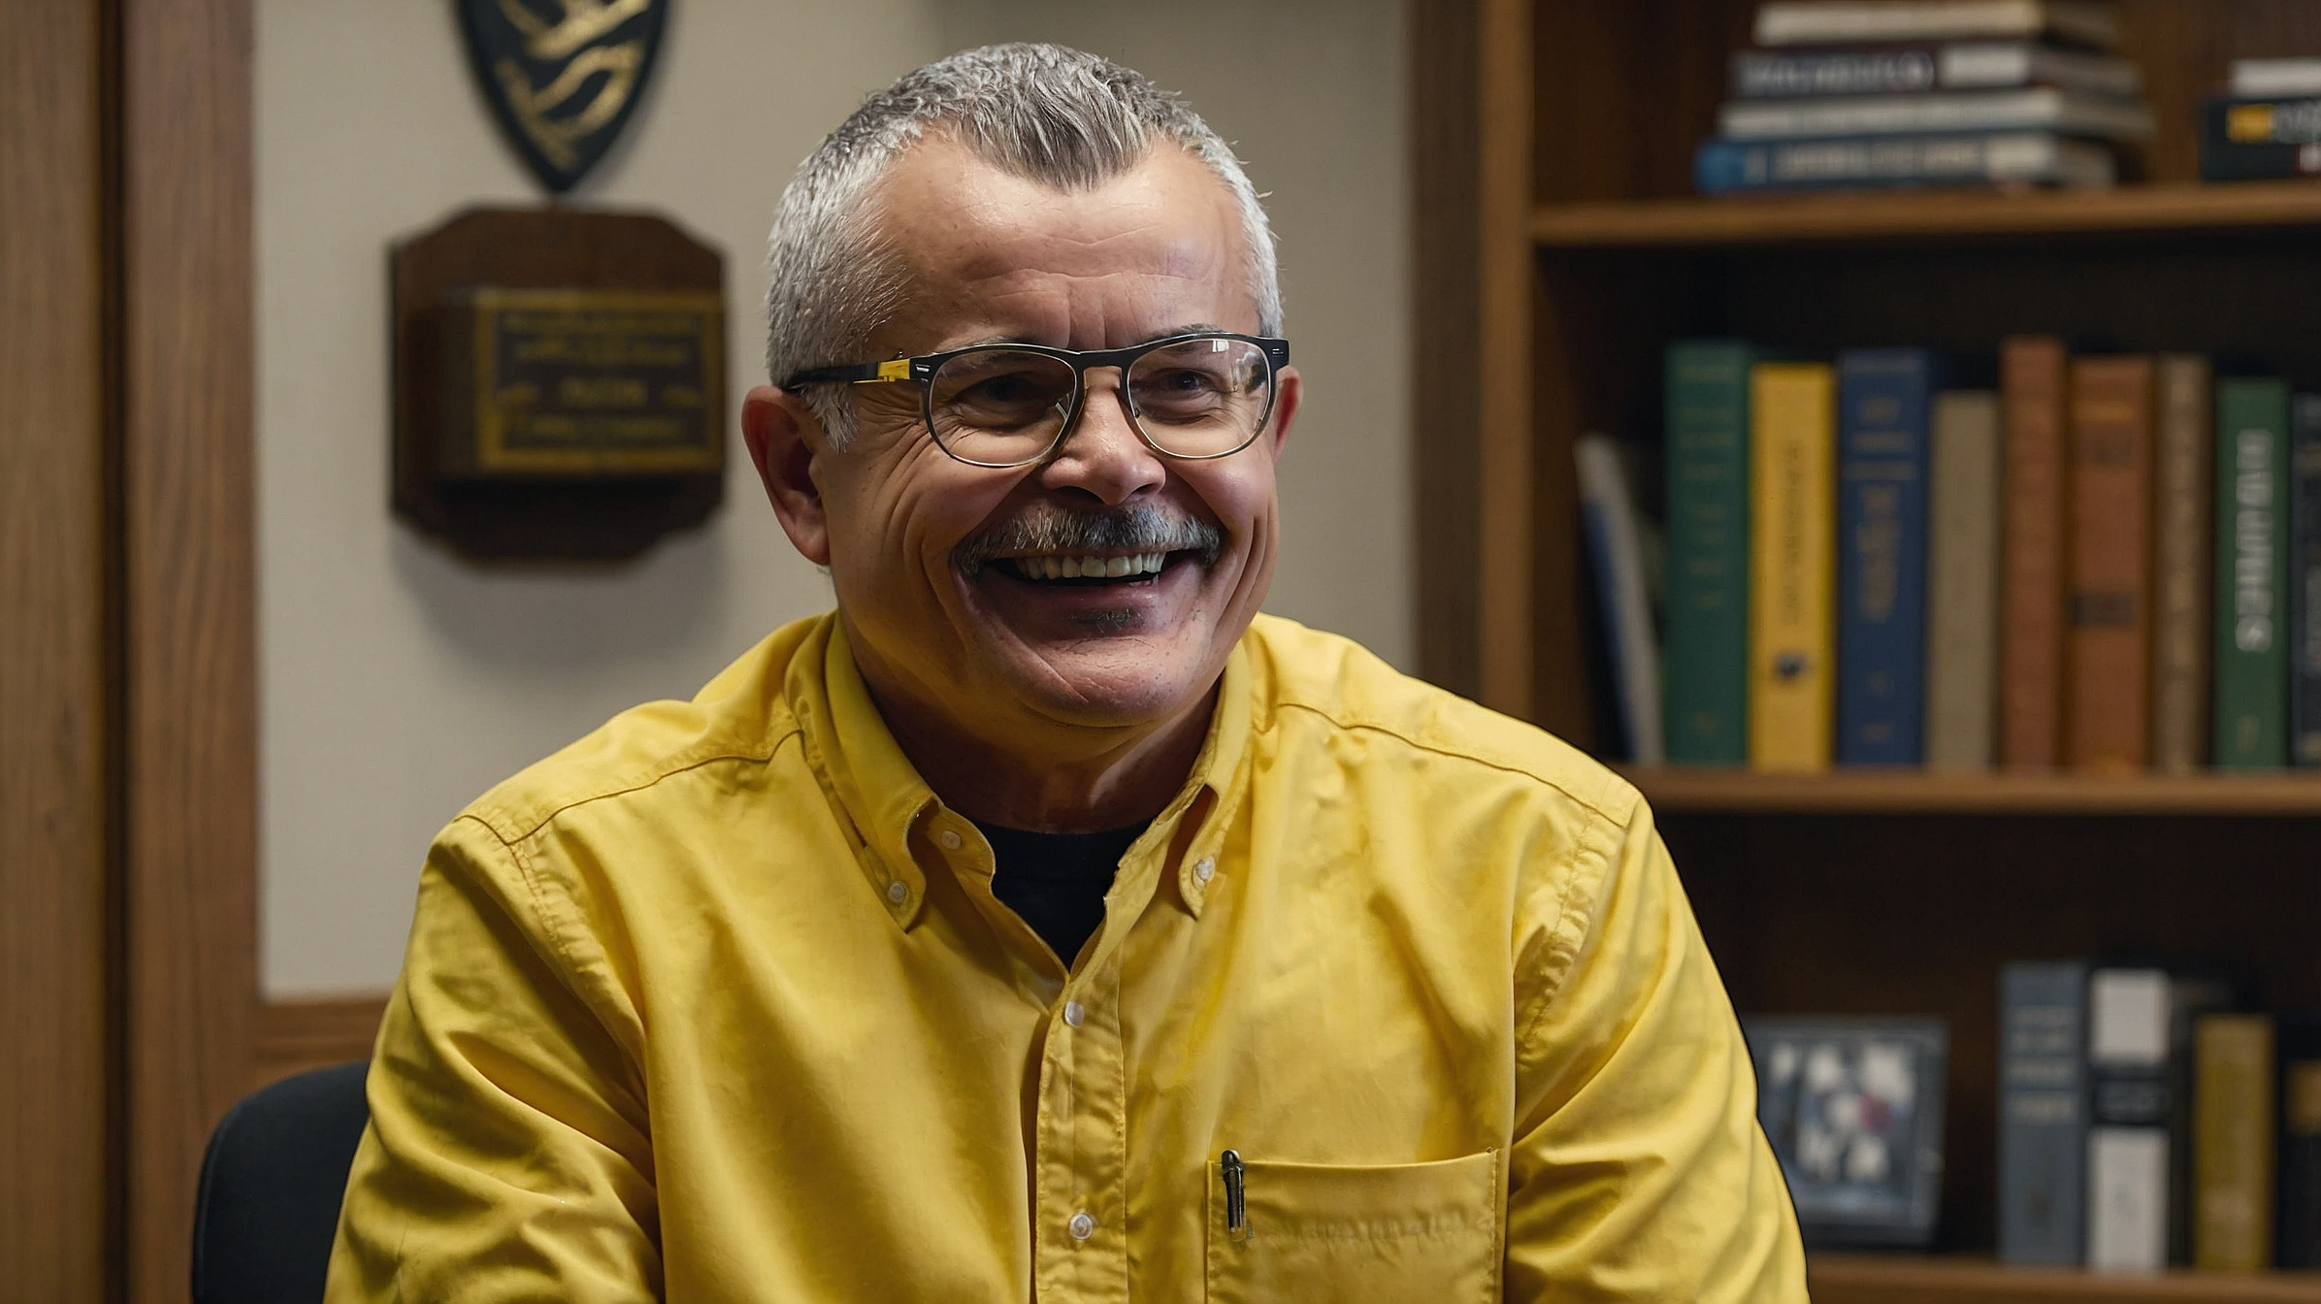
Welcome, I understand you're here for help with your marriage. How can I support you today?
Pastor, we're really struggling. We love each other, but lately, it feels like we're drifting apart. We fight more often, and it just seems like we don't understand each other anymore.
Yeah, it's been tough. Sometimes I think our problems are too big to fix. We want to make it work, but we don’t know how.
I appreciate you both for coming. The fact that you’re here shows that you’re willing to work on your marriage, and that’s a great start. You see, marriage is a beautiful relationship, but it also requires preparation and understanding of its purpose.

Slide 3
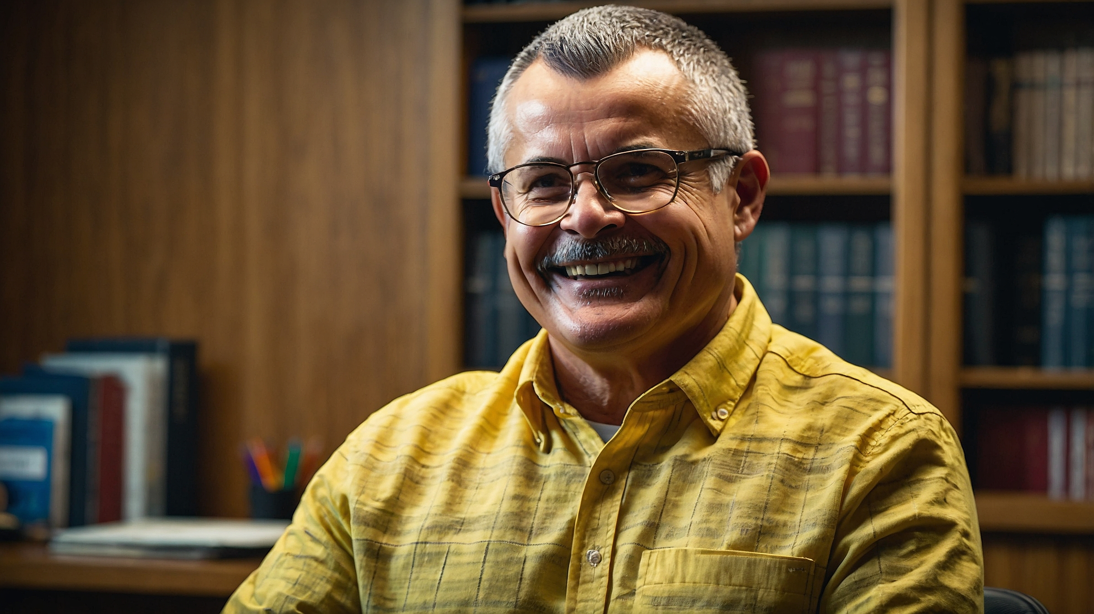
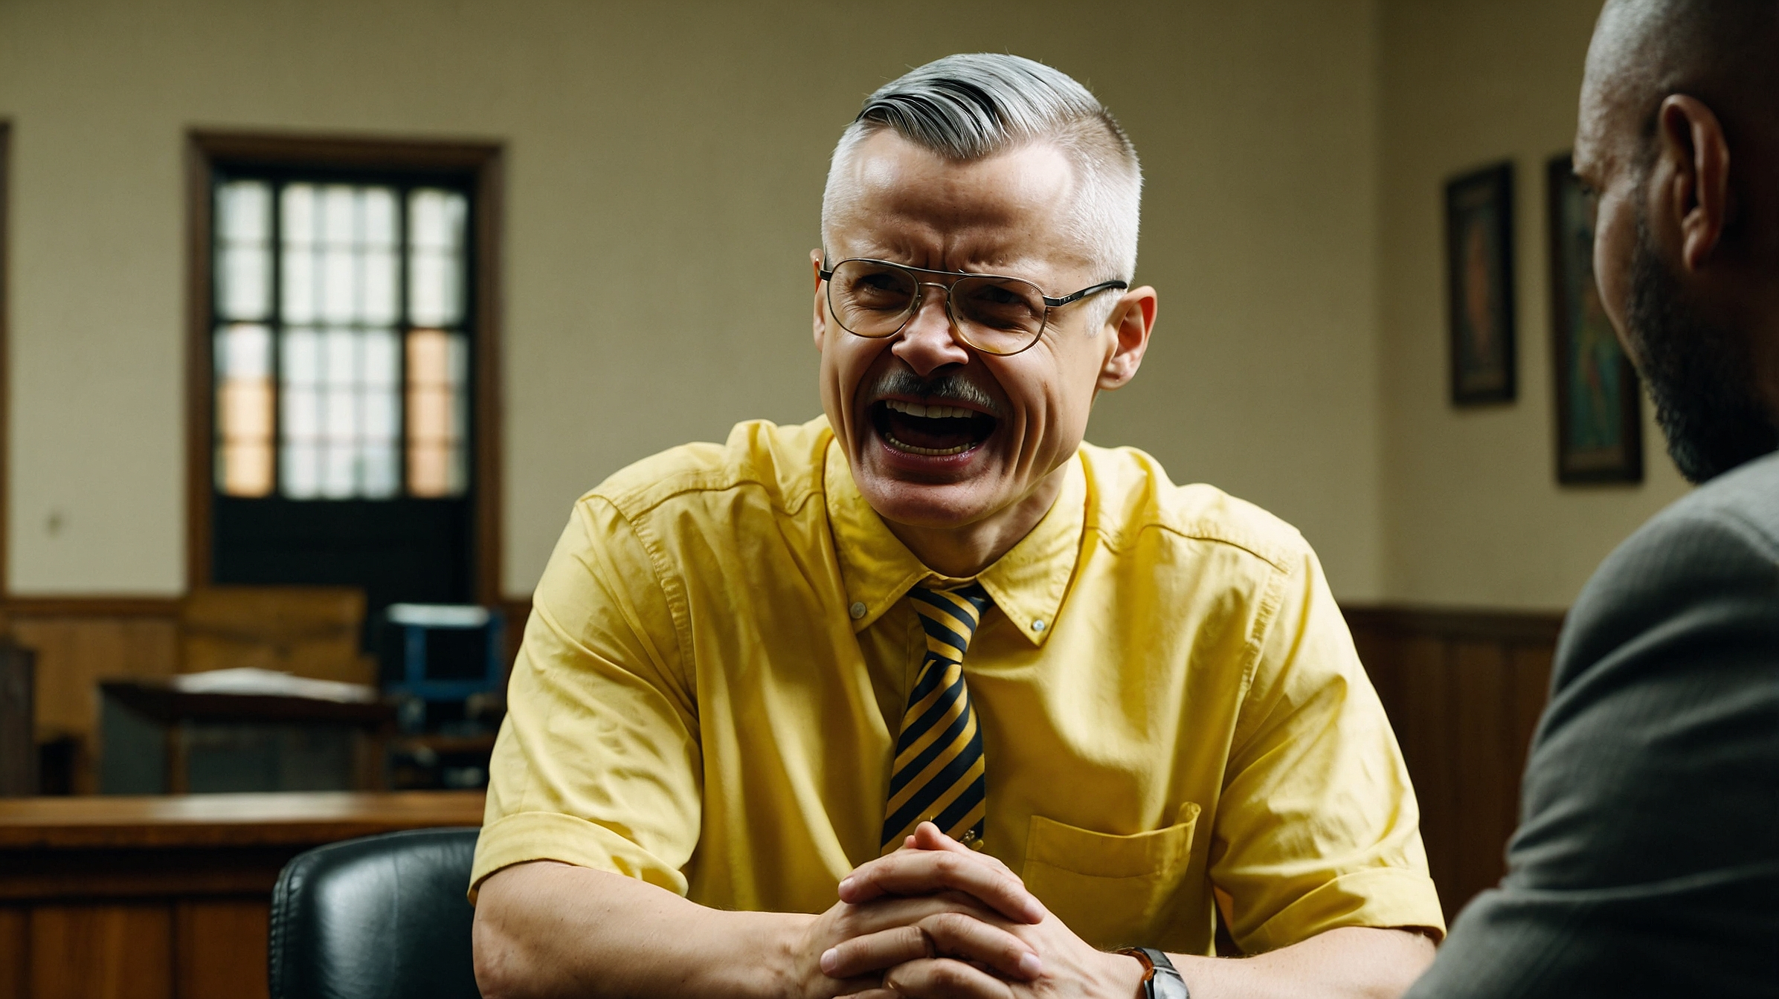
Marriage was designed for two people who love each other to come together, face life's challenges, and enjoy the good moments together.
But many couples, like you, enter marriage without fully understanding the principles that make it work. That's why it's not uncommon to experience difficulties, especially if past wounds remain unresolved.
I think a lot of my issues come from my childhood. I didn’t have a good relationship with my father. He made me feel worthless, and I married Manuel because I wanted to escape from that. But now, it feels like those old wounds are affecting our marriage.

Slide 4
Marriage was designed for two people who love each other to come together, face life's challenges, and enjoy the good moments together. But many couples, like you, enter marriage without fully understanding the principles that make it work. That's why it's not uncommon to experience difficulties, especially if past wounds remain unresolved.
I think a lot of my issues come from my childhood. I didn’t have a good relationship with my father. He made me feel worthless, and I married Manuel because I wanted to escape from that. But now, it feels like those old wounds are affecting our marriage.

Slide 5
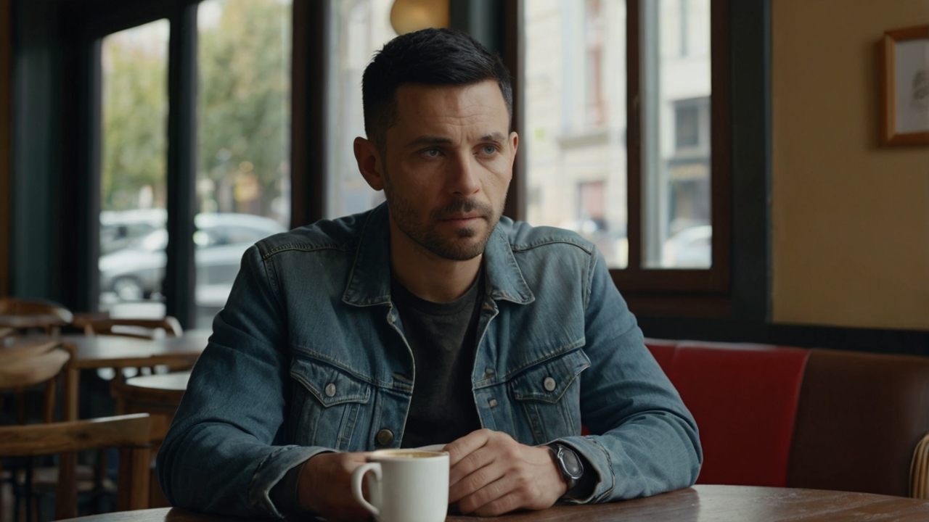
Thank you for sharing that, Norma. It’s important to recognize how past experiences can affect our present relationships. Many people, like yourself, come into marriage with emotional wounds.
If those wounds are not healed, they can create tension and hurt within the marriage. What often happens is that we project the pain from our past onto our spouse, even though they’re not the ones who caused it. This can lead to misunderstandings and distance, which is what I sense is happening between you and Manuel.

Slide 6
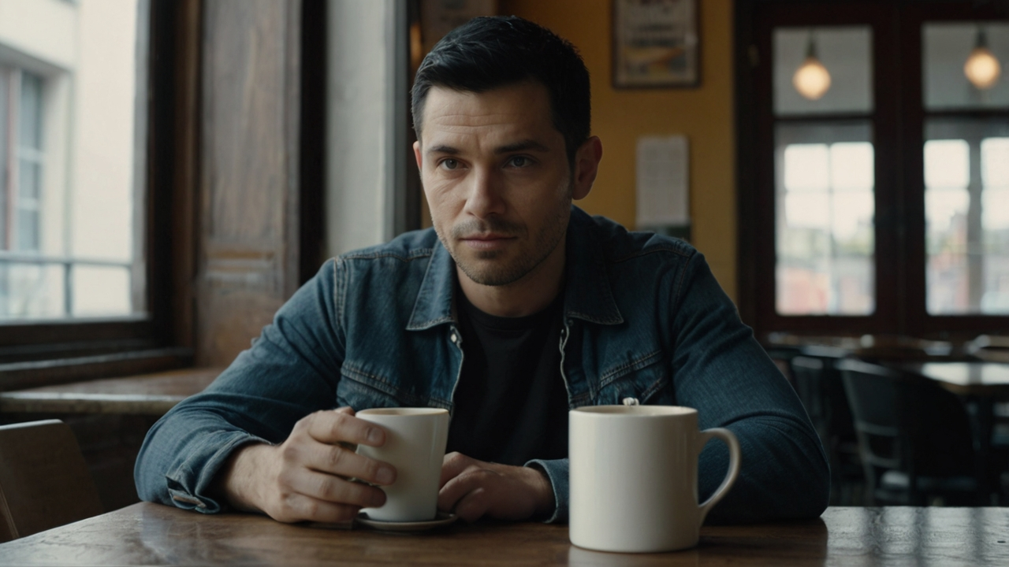
That’s exactly how I feel, Pastor. Sometimes I don’t even know what I did wrong. I just feel like there’s always something between us, and I don’t know how to fix it.
That’s a common feeling, Manuel, especially when unresolved emotional pain is involved. The key to healing is first acknowledging those wounds and then working together to heal them.
It’s normal for two people in such an intimate relationship to have conflicts. What’s important is learning how to handle those conflicts in a way that builds understanding rather than tearing each other down. In this case, it sounds like they need to focus on emotional healing for Norma and support from you, Manuel, in understanding her journey.

Slide 7
I know I’ve been carrying a lot of bitterness, and sometimes I don’t even realize I’m taking it out on Manuel.
That’s very insightful, Norma. Recognizing bitterness is the first step toward healing. The next step is working on forgiveness—both for the people who hurt you in the past and for yourself. Forgiveness doesn’t mean forgetting what happened, but it’s about letting go of the hold that pain has on you so that you can experience peace.
Me
Manuel, it’s also important for you to understand that healing is a process, and it will require patience and love on your part. Being there for Norma, even when it’s difficult, will make a huge difference in restoring your relationship.

Slide 8
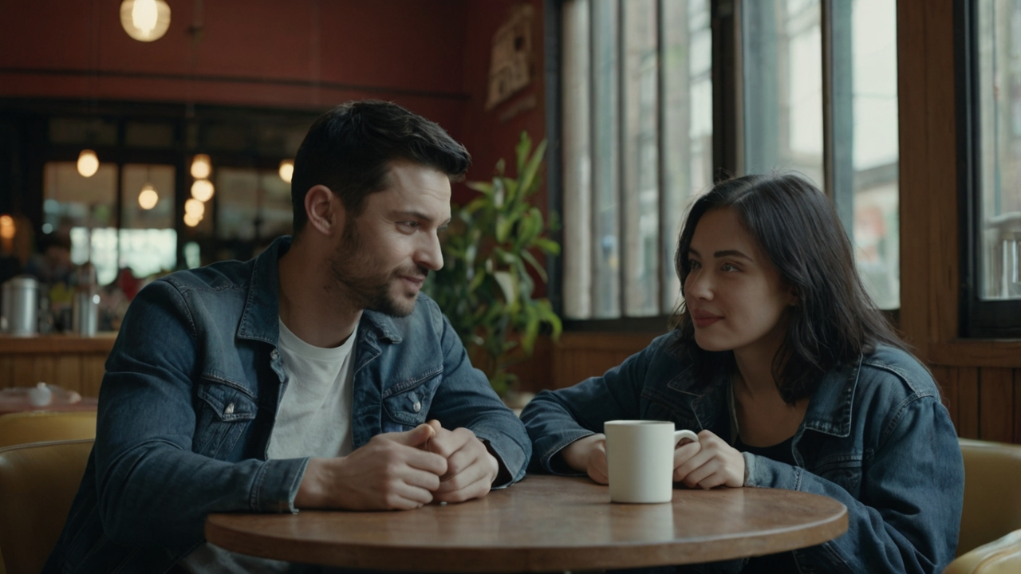
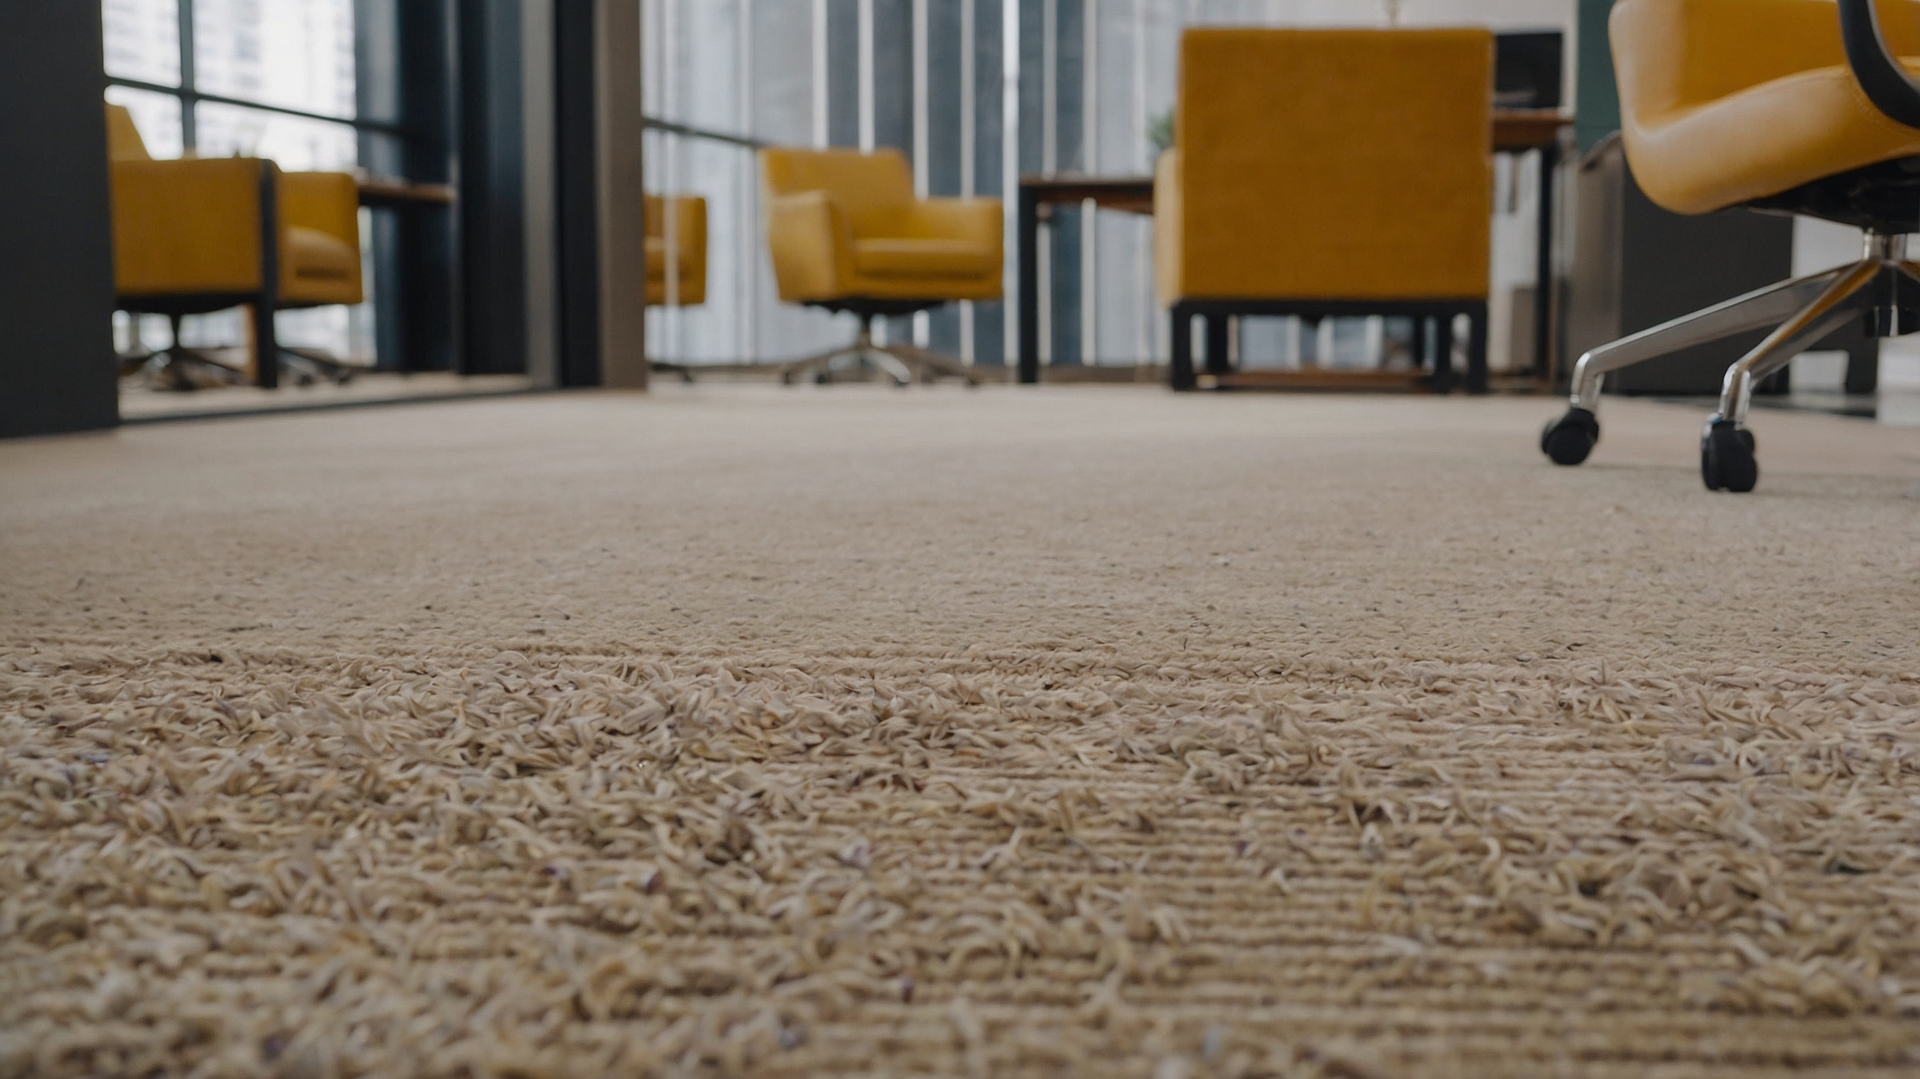
I want to help her, Pastor. I just don’t always know how. What should I do when things get tough?
Great question, Manuel. One of the most powerful things you can do is listen without trying to fix things right away. Often, when our spouse shares their pain, they just need us to be there, to listen and validate their feelings.
I think that would help a lot. Sometimes I just want Manuel to listen instead of trying to solve everything.
Also, reminding each other that you’re a team in this—working together toward healing—can strengthen your bond.

Slide 9
I’ll work on that. I really want us to be happy together.
That’s the spirit, Manuel. And it is possible for you both to be happy together, no matter how broken things might feel right now. Many couples have been where you are and have found healing and joy in their marriage again. But it takes work, forgiveness, and a willingness to learn.

Slide 10
As we continue, we’ll talk about the importance of forgiveness in more detail and how to communicate better to handle conflicts without hurting each other.
I like that, thank you
Like many couples, Norma and Manuel have encountered challenges in their marriage, but with guidance, patience, and a commitment to healing, they are beginning the journey to restore their relationship and live in peace and unity as God intended.
Pastor. Thank you.

Slide 11
We’ll also discuss the expectations you bring into the marriage, which are often shaped by our upbringing and can cause friction if not understood. Does that sound like a good plan?
Yes
Like
Visit Sanger Naz 815 Jensen Ave. Sanger, CA. 93657
More dialogues
www.sangernaz.com
Call us: (559) 349-2590

