Slide 1
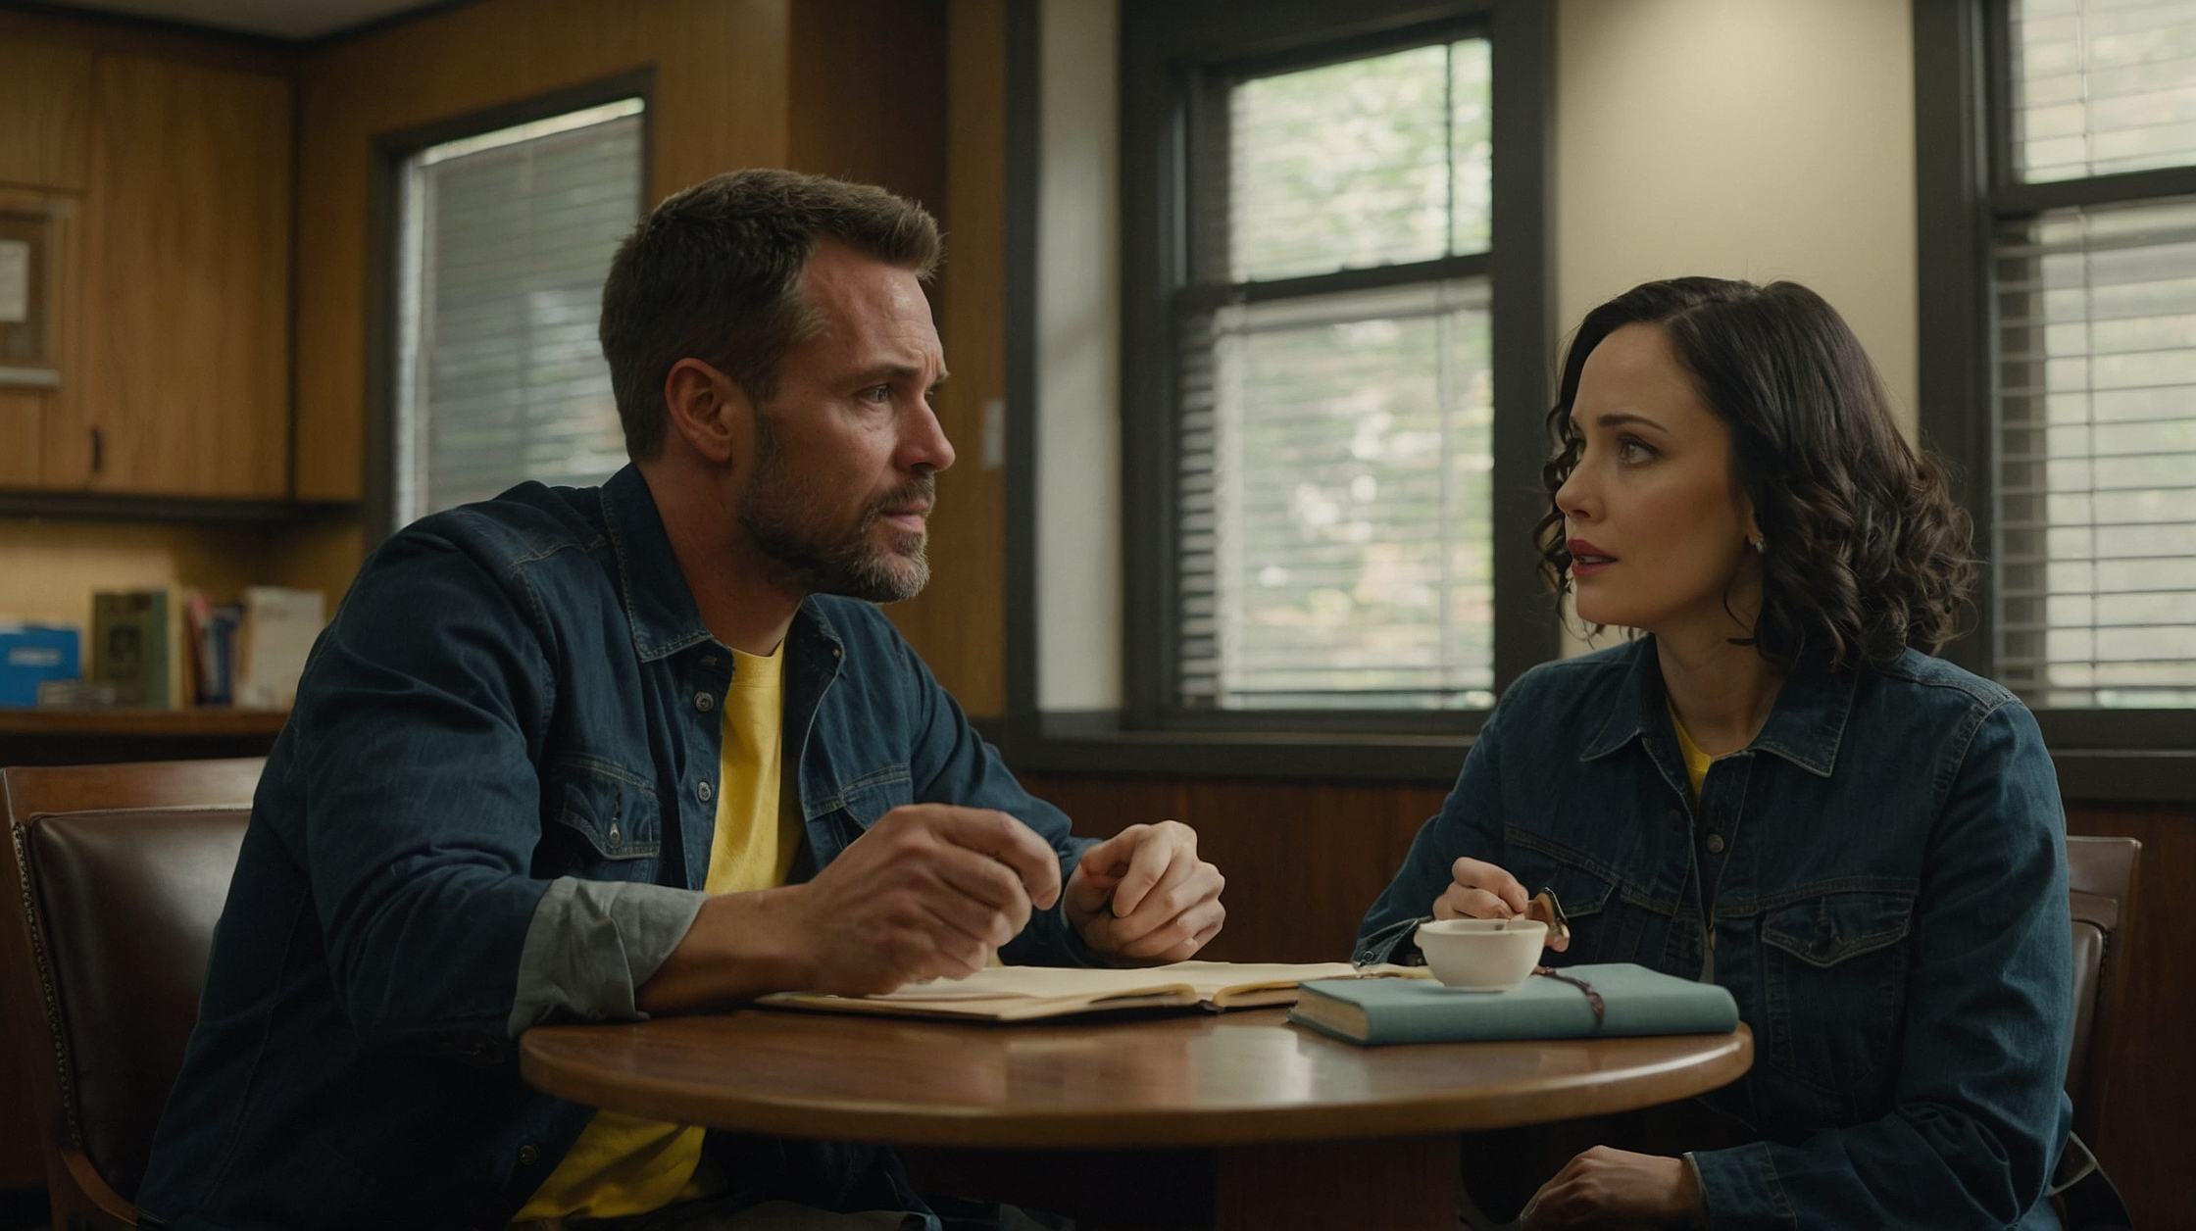

THREE PILLARS OF MARRIAGE
BIBLICAL DIALOGUE BY
DR. DANIEL DEIDA
WWW.SANGERNAZ.COM

Slide 2
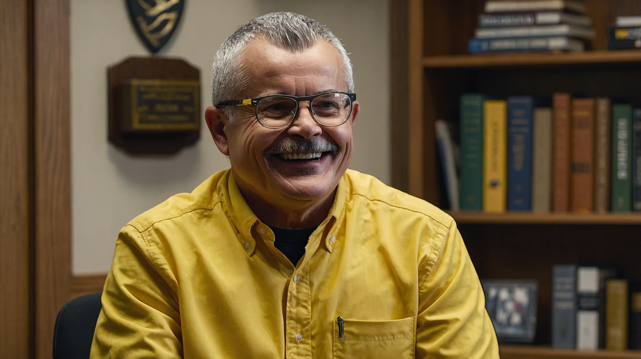



Alright, today I want to talk with you both about something very important: the foundation of marriage. The Bible teaches us that marriage is built on three basic pillars—spiritual, emotional, and physical. And they need to be in that order. Do you know why?
Hmm... I'm not sure. Is it because the spiritual part is more important?
Exactly. The spiritual part is what holds everything together. If you don’t have a strong spiritual connection, it’s harder to stay together. It’s like having a strong foundation for a building. If you don’t have that, everything else starts to fall apart.
So, you’re saying that if we pray together and trust God, it helps our marriage in the other areas?

Slide 3
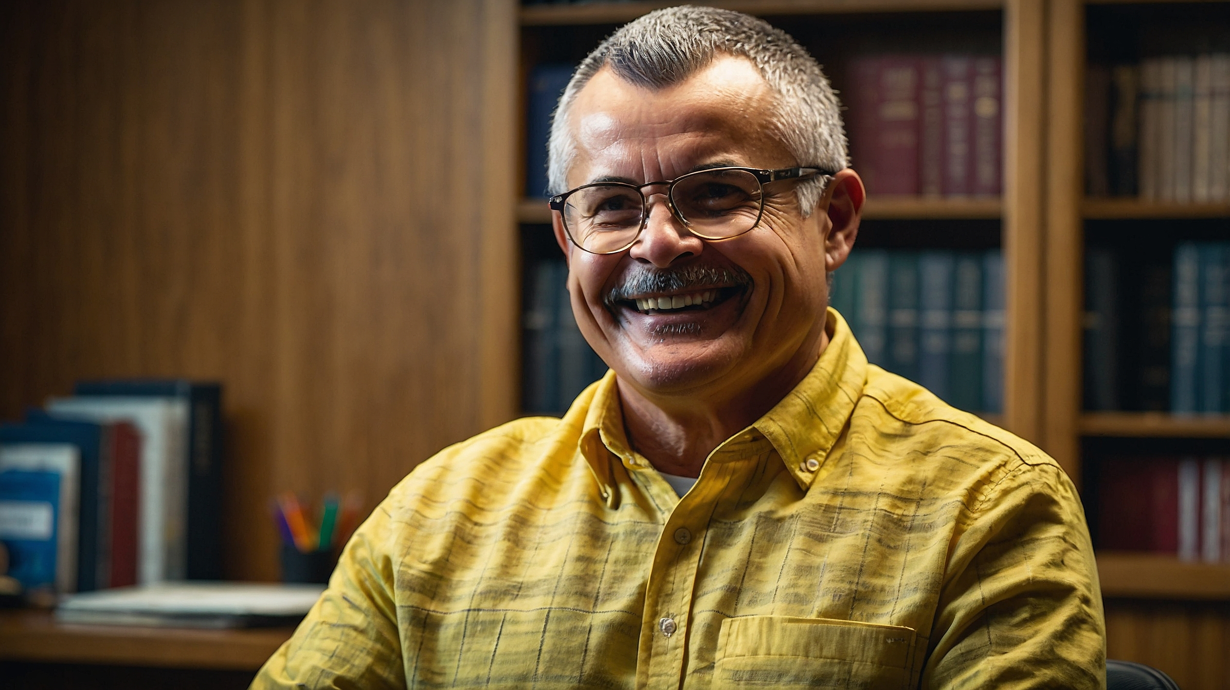
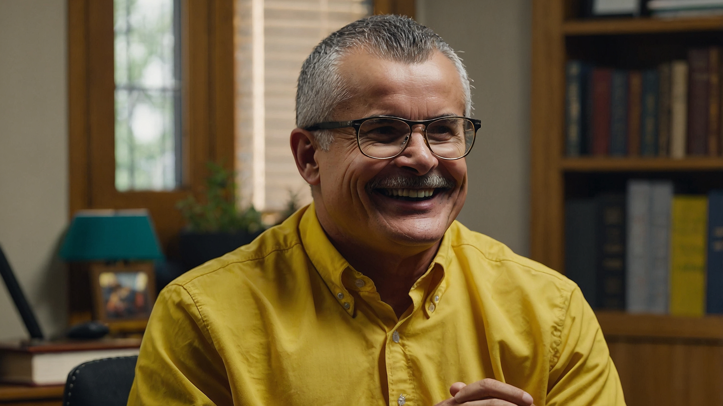
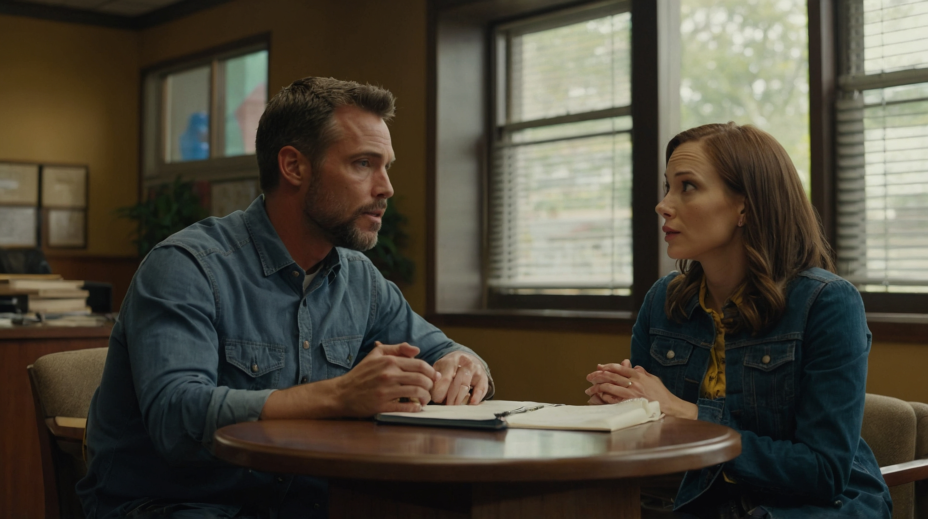

Yes, that’s right. Psalm 1:1-3 talks about the person who delights in God’s Word. It says that a person will be like a tree planted by streams of water. They’ll bear fruit in season, and whatever they do will prosper. When you trust in God and live by His Word, He gives you the strength to stay firm, even when things get hard.
I get that. But what about when we argue or get upset? Sometimes it feels like no matter what, we can’t see eye to eye.
That’s normal in every relationship. But when you have that spiritual unity, it helps you control emotions like anger and pride. The stronger your spiritual life is, the easier it is to handle emotional challenges because you’re both growing in patience, tolerance, and love.
So, it’s not just about praying, but also how we treat each other emotionally, right?

Slide 4
Exactly. When your spiritual foundation is strong, it naturally flows into the emotional part of your relationship. You start to care more about each other’s needs than your own. It’s about letting go of pride and selfishness. You communicate better, and you avoid saying things that hurt each other.
That makes sense. But what about the physical part of the relationship? I feel like people usually focus on that first.
That’s true, but it shouldn’t be the first priority. Physical intimacy is a gift from God, but it’s meant to be enjoyed fully when the spiritual and emotional parts are strong. When those are in place, the physical side becomes something deeper and more meaningful, not just something superficial.

Slide 5
So, if we’re strong spiritually and emotionally, the physical part will come naturally?
Yes, exactly. It’s like a reward for building a strong foundation. If a marriage only focuses on the emotional and physical, it’s like walking on quicksand. But when you build on the spiritual, you have a firm foundation that can support everything else. Does that make sense?
Me neither. I think we need to work on our spiritual connection first.
Yeah, it does. I never thought about it like that.

Slide 6
That’s a great start. Remember, it’s about growing together in God, and as you do, everything else will fall into place. Keep seeking Him, and your marriage will be stronger because of it.
In our next session we will talk about love as a decision
More biblical dialogues www.sangernaz.com or Call us:
(559) 349-2590 Visit Sanger Naz 815 Jensen Ave. Sanger, CA. 93657

