Slide 1
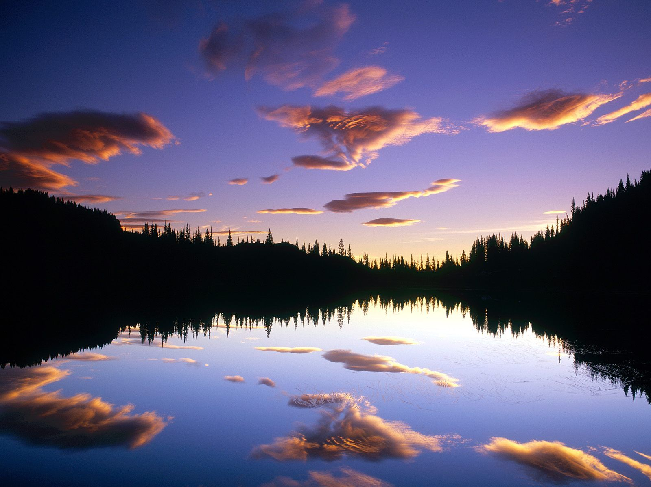
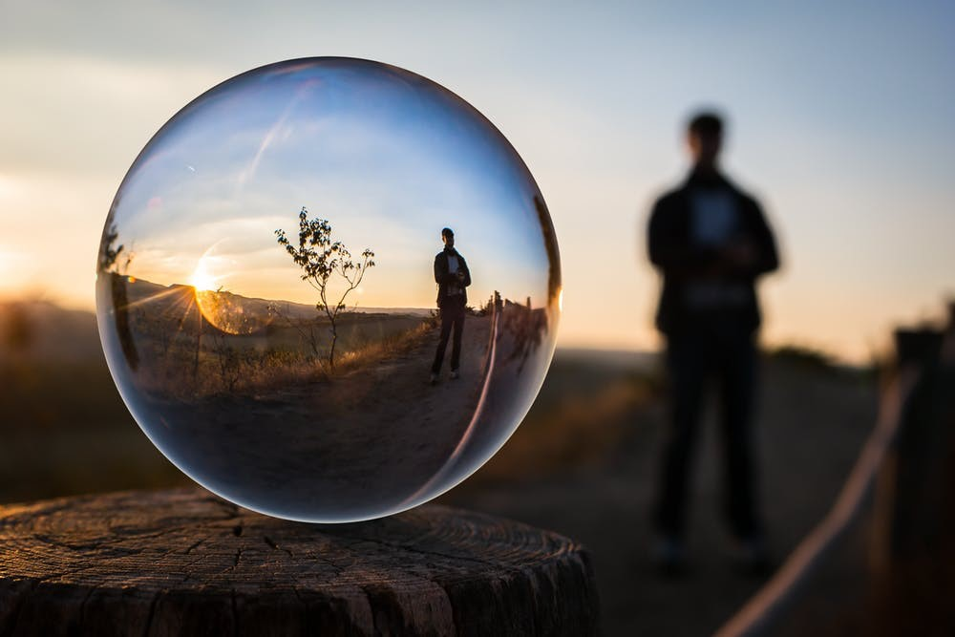
REFLECTING WHAT'S INSIDE
BIBLICAL DIALOGUES BY THE
DR. DANIEL DEIDA
WWW.SANGERNAZ.COM

Slide 2

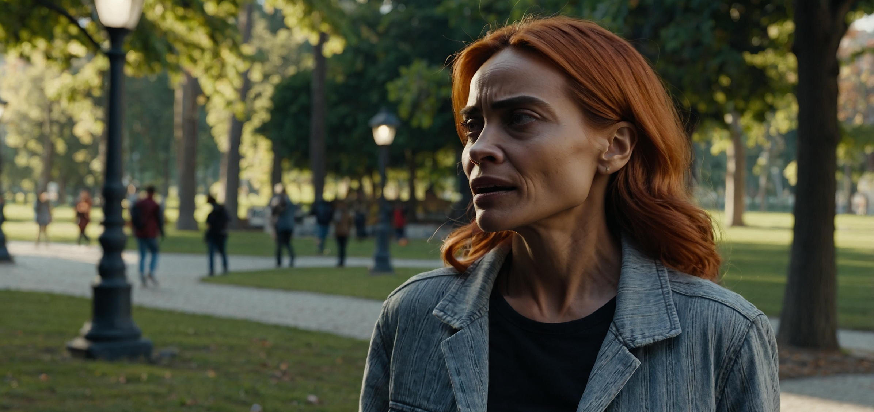


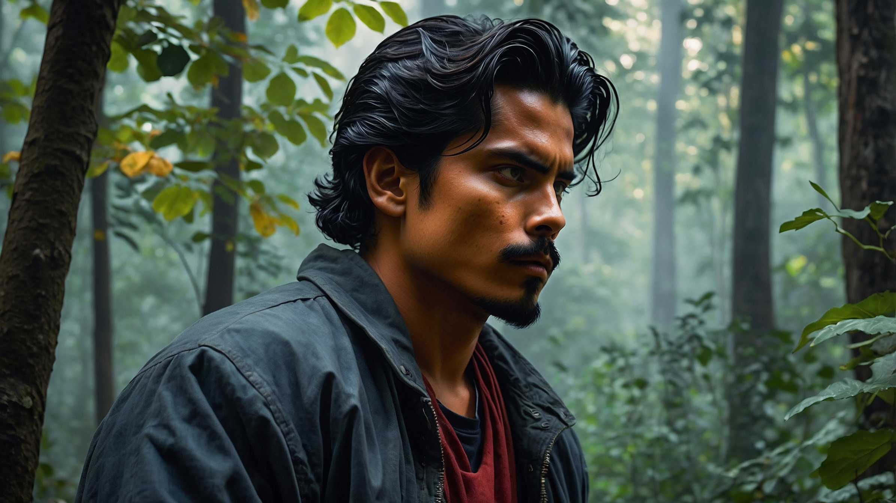
I was thinking about what we've been talking about the grace of God. It's amazing how, despite our faults, God is the one who always takes the initiative in our lives.
It’s true, God always comes first. As it says in Philippians 1:6, "He who began a good work in you will complete it until the day of Jesus Christ." It's something that gives us a lot of confidence, isn't it?

Slide 3
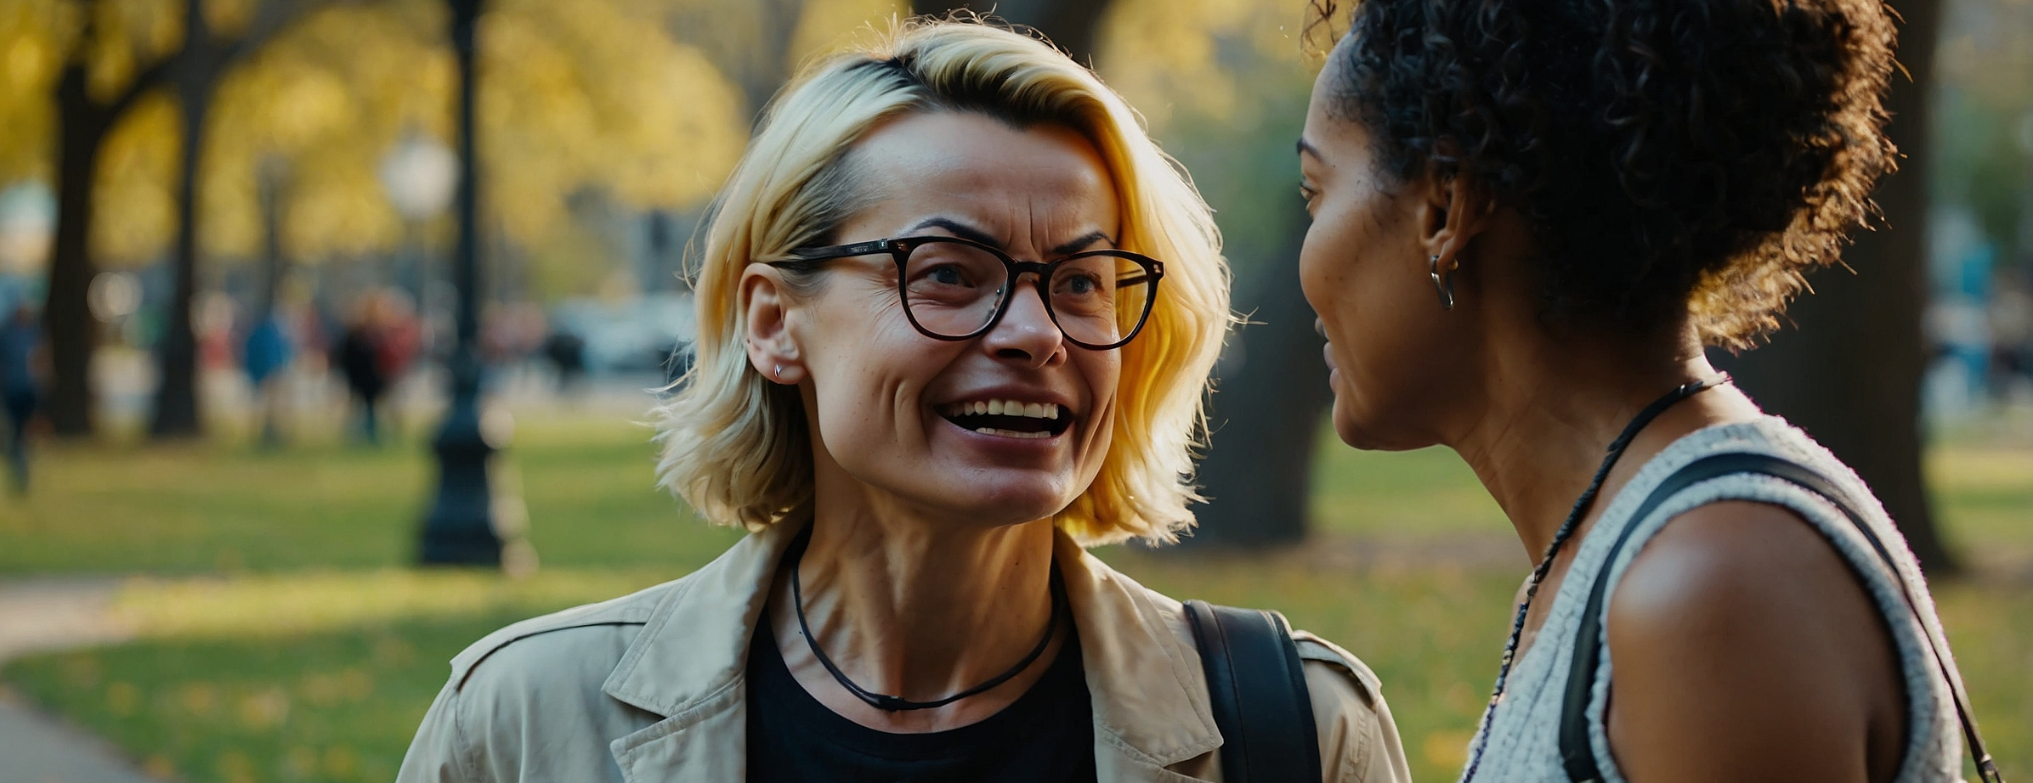
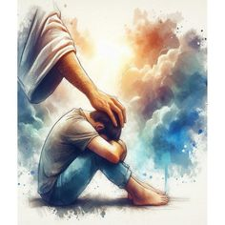
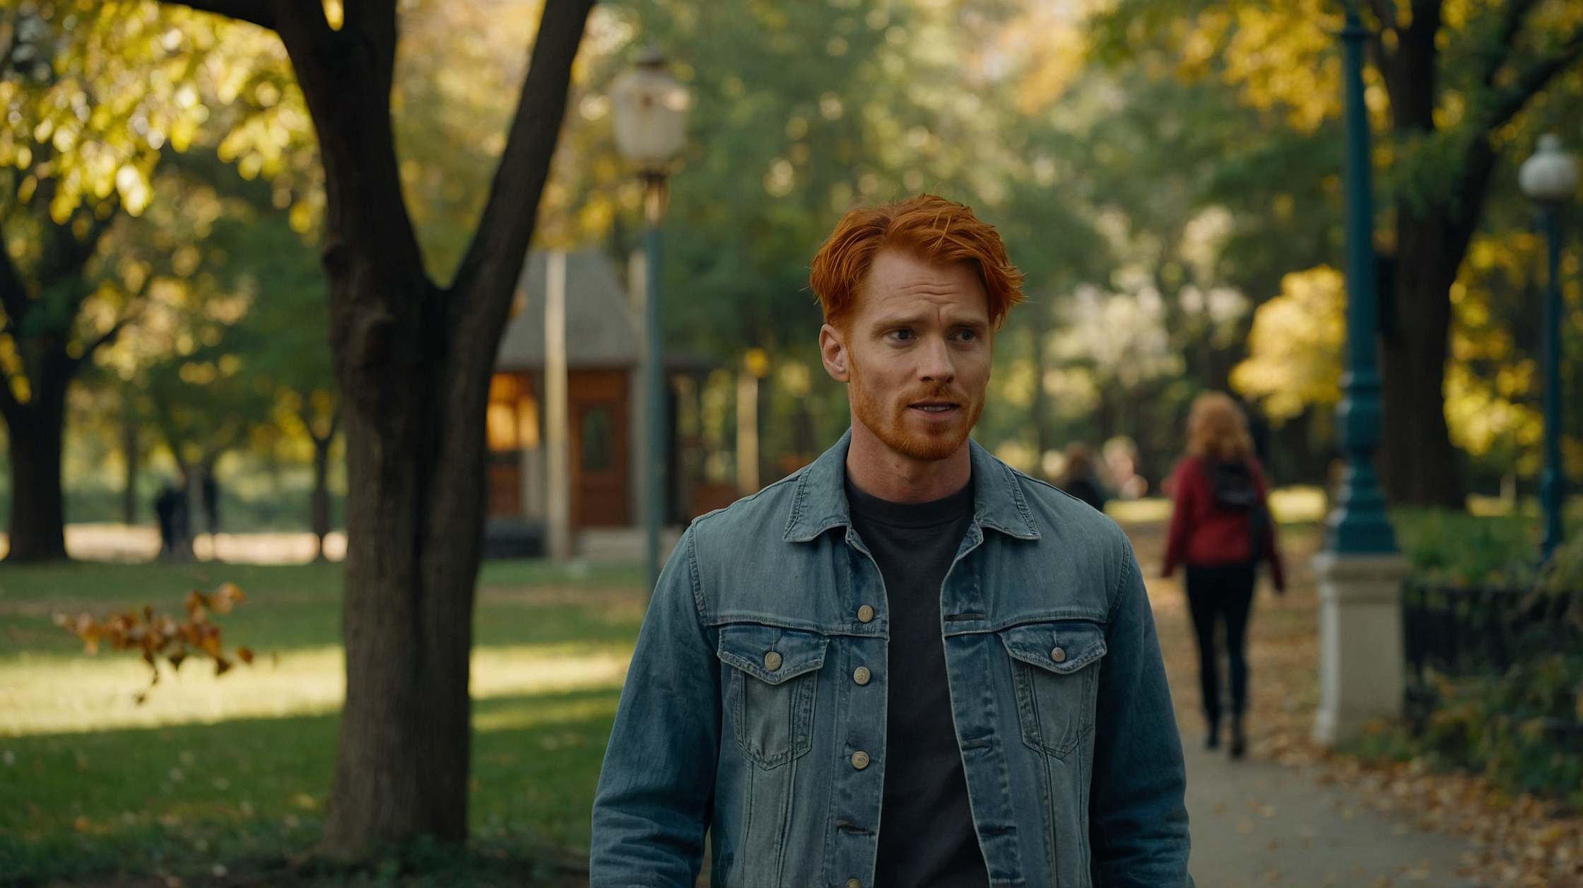
Exactly. But we also have a role to play. Even though God begins the work, we must cooperate and reflect what He is doing in us.
Like Abraham, who when God called him, had to respond with obedience for the blessing to be manifested.

Slide 4
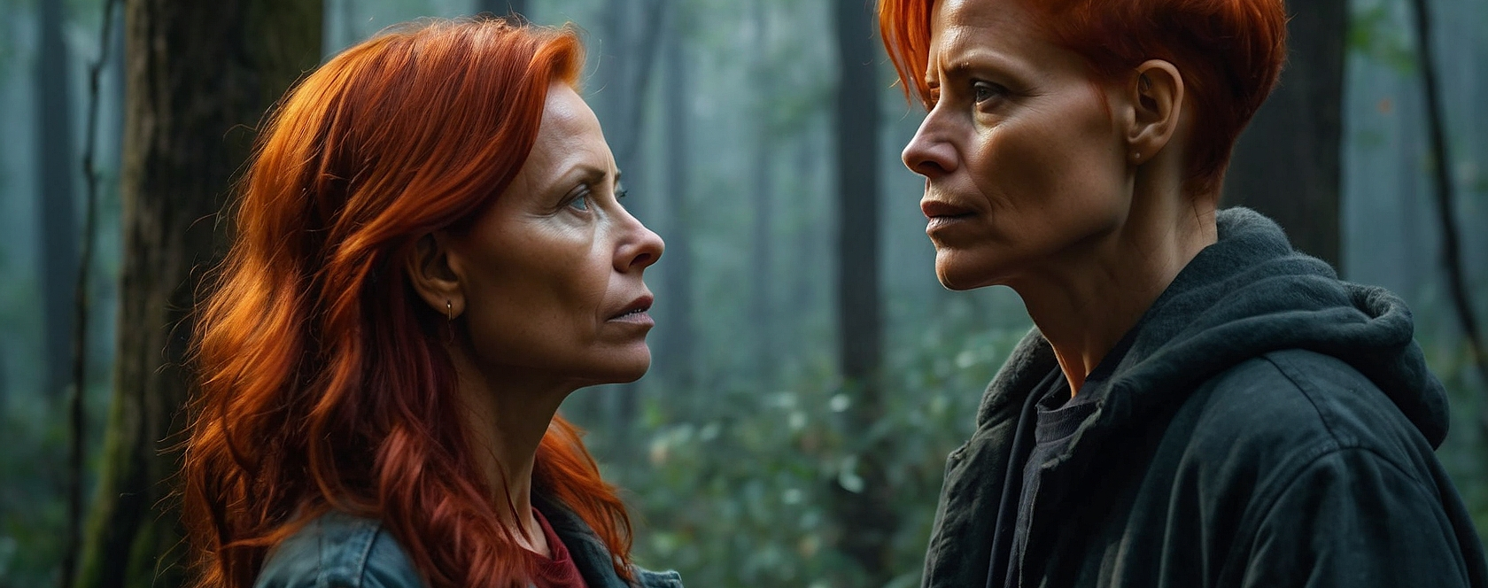
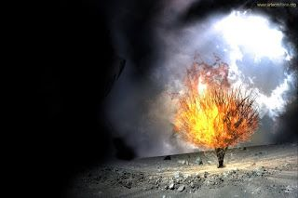
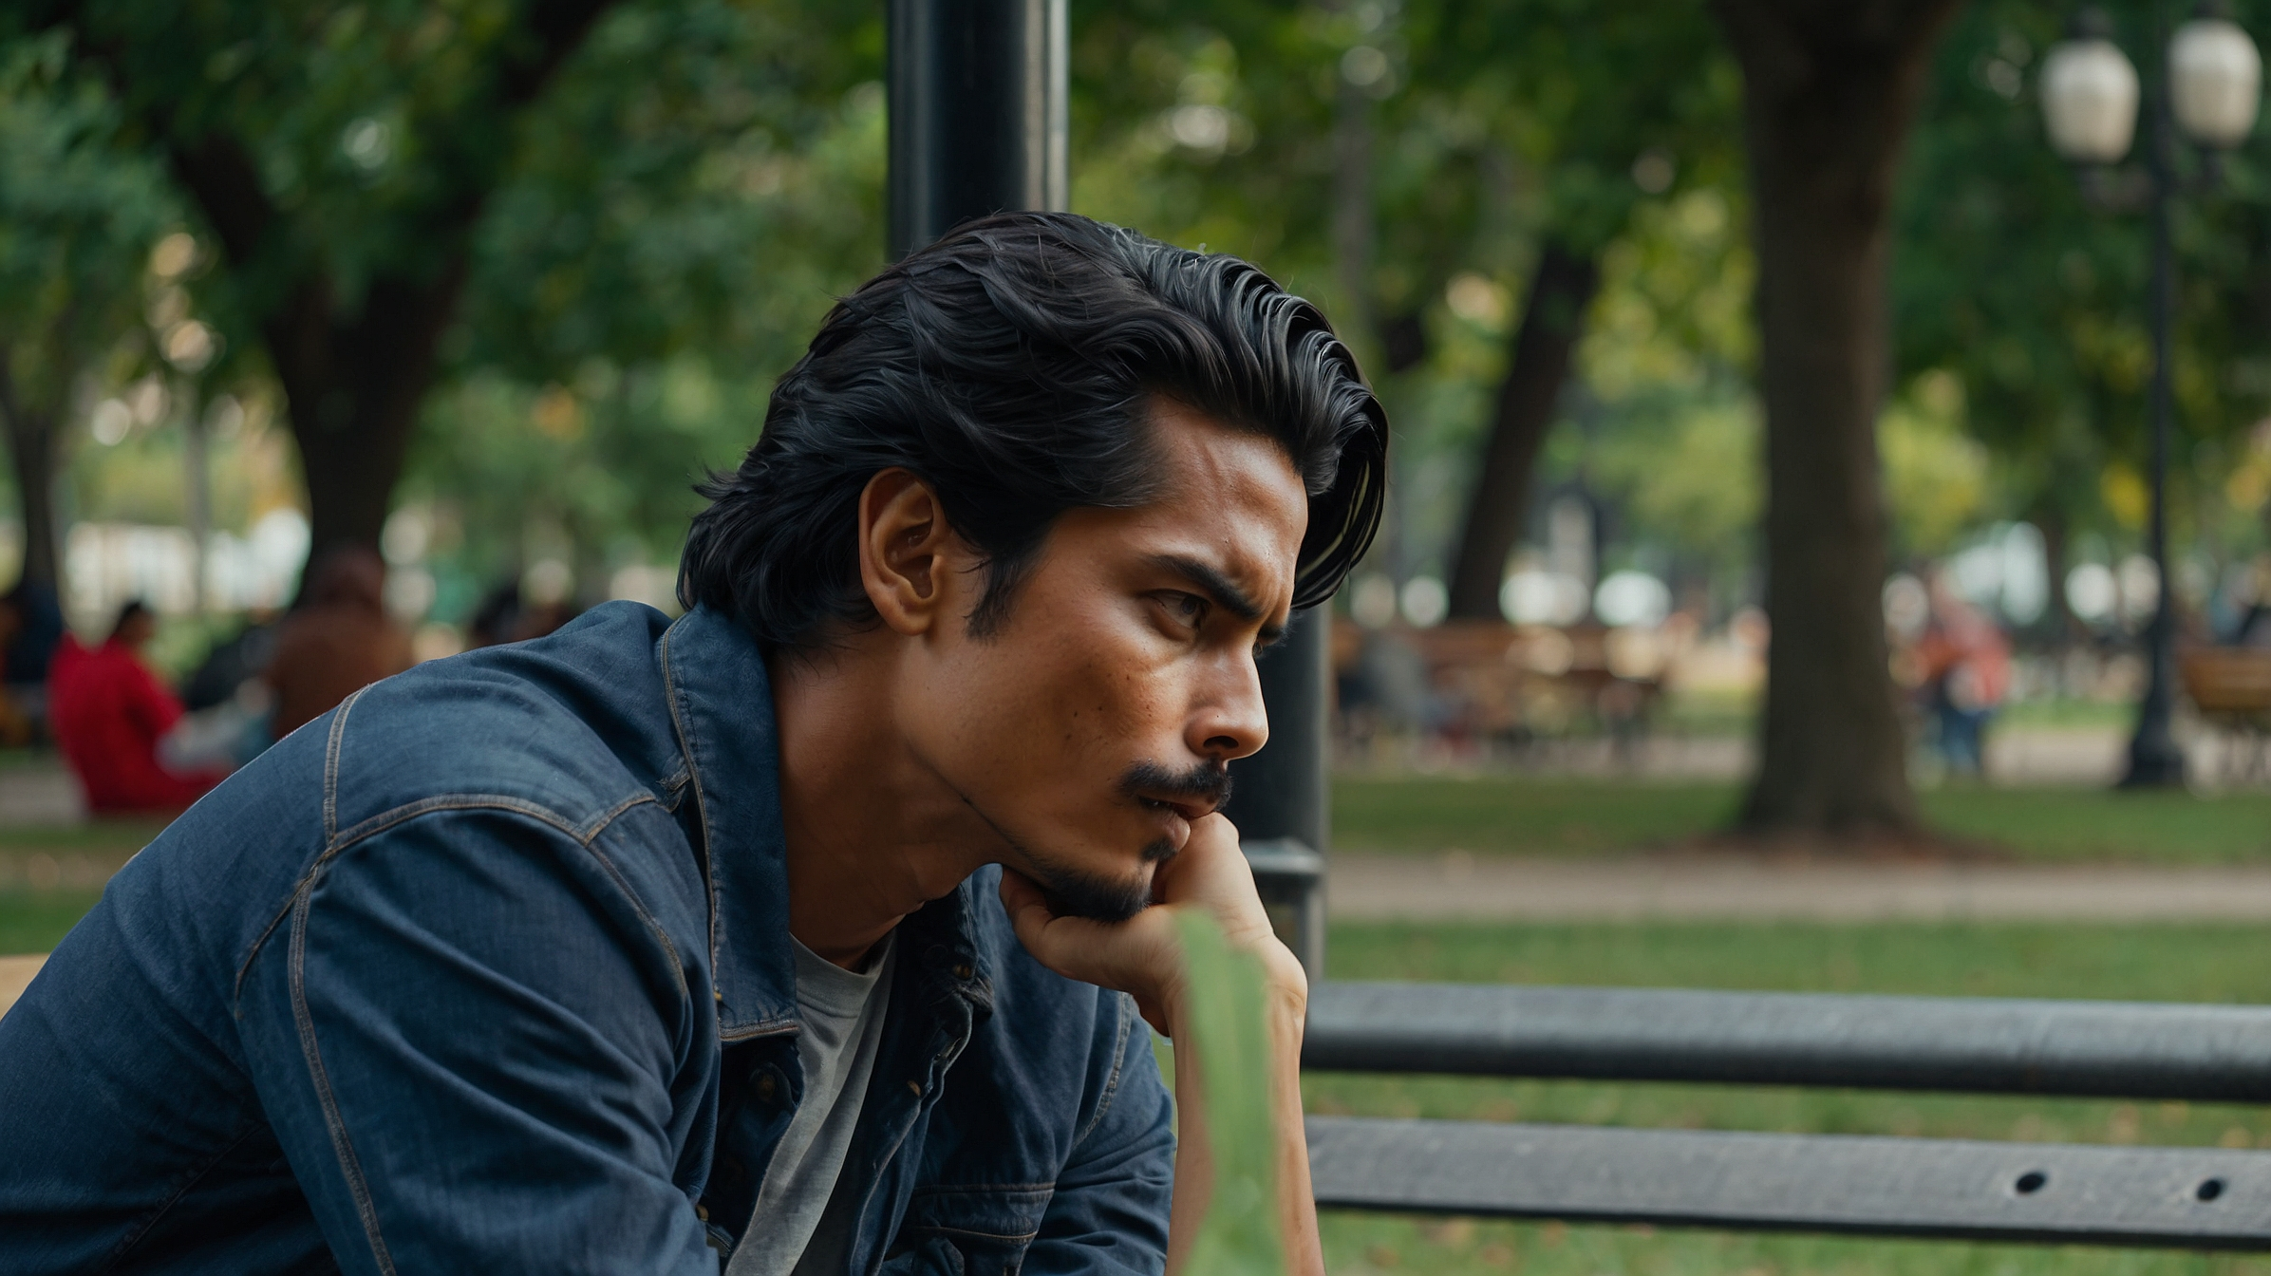
That reminds me of what happened with Moses. He was alone in the wilderness, and God appeared to him in the burning bush. But Moses had to make the decision to obey, go to Egypt, and deliver his people.
If it hadn't reflected the work God was doing within you, history would have been different.

Slide 5
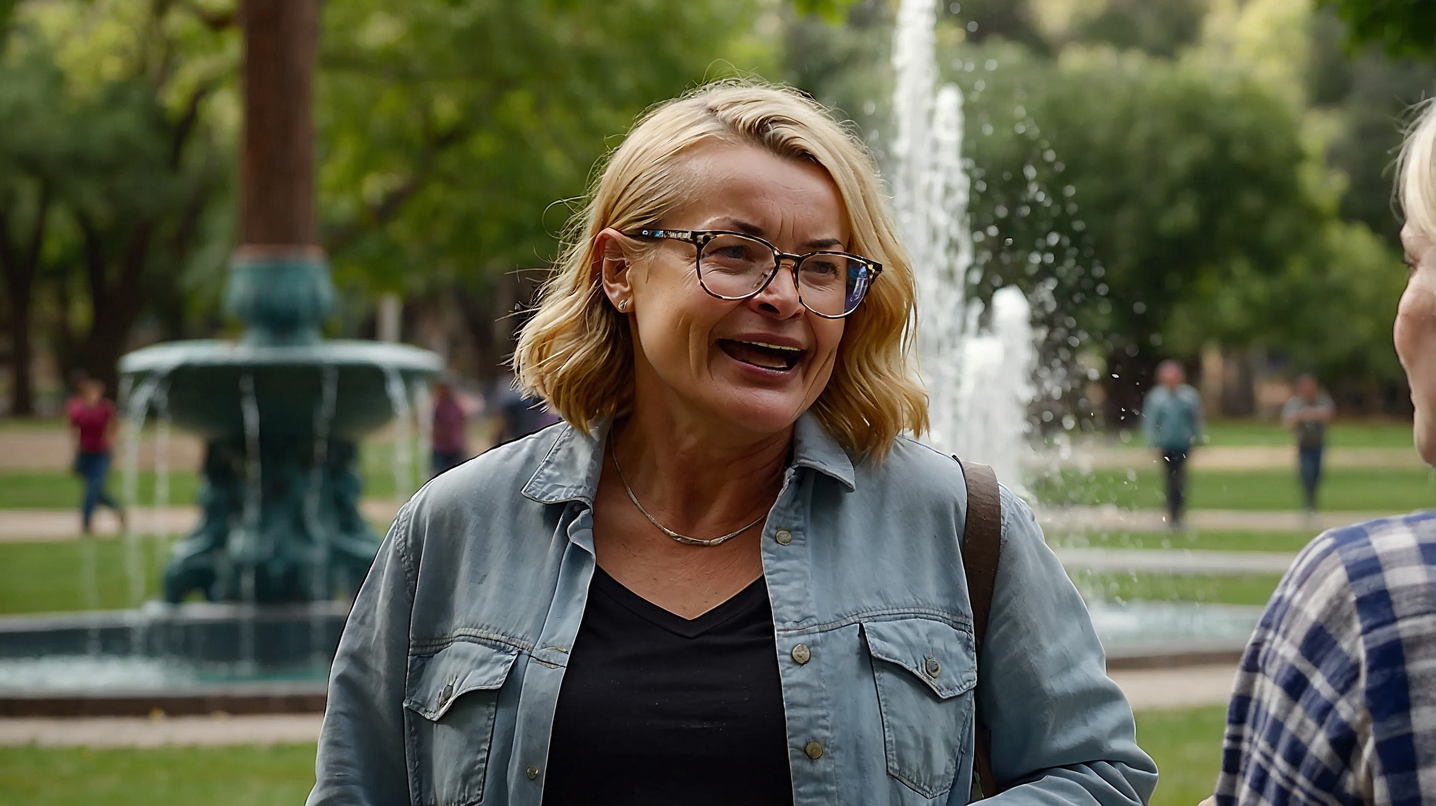
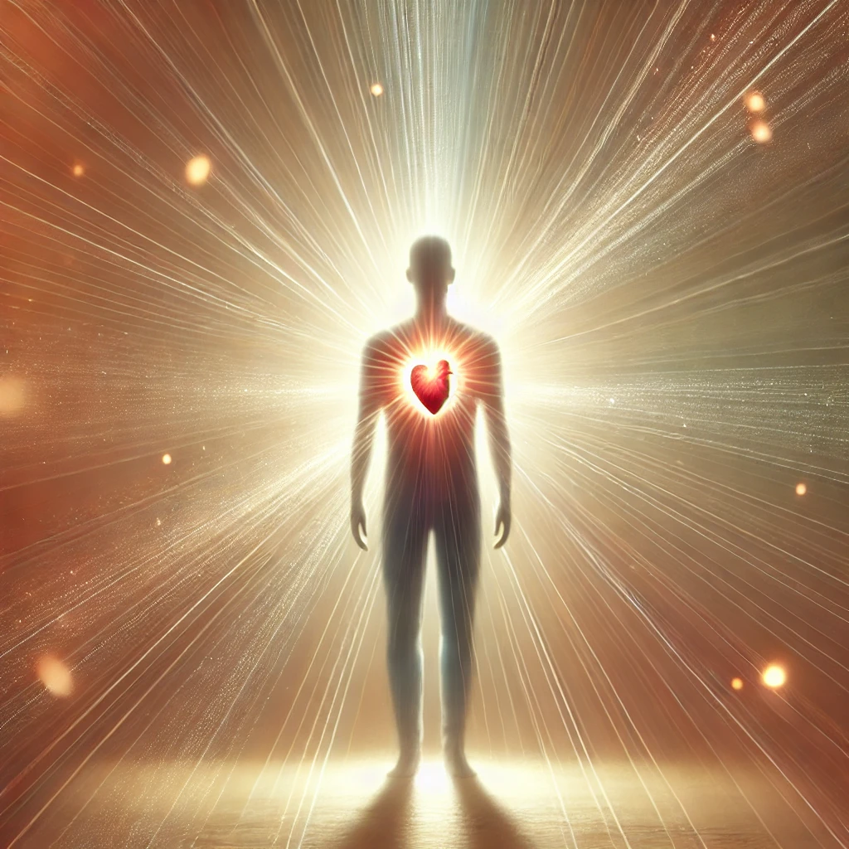
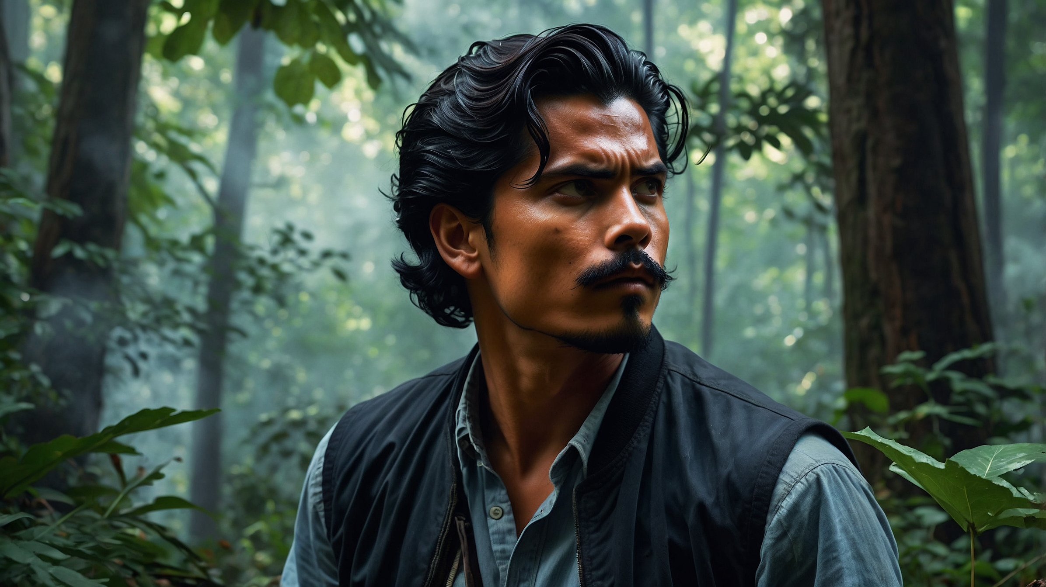
Exactly! All those examples, such as Abraham, Jacob, Moses, Paul... it is always God who arrives first, but it is our response that allows the world to see that transformation.
God works deep within us, and then we show Him to the world.

Slide 6
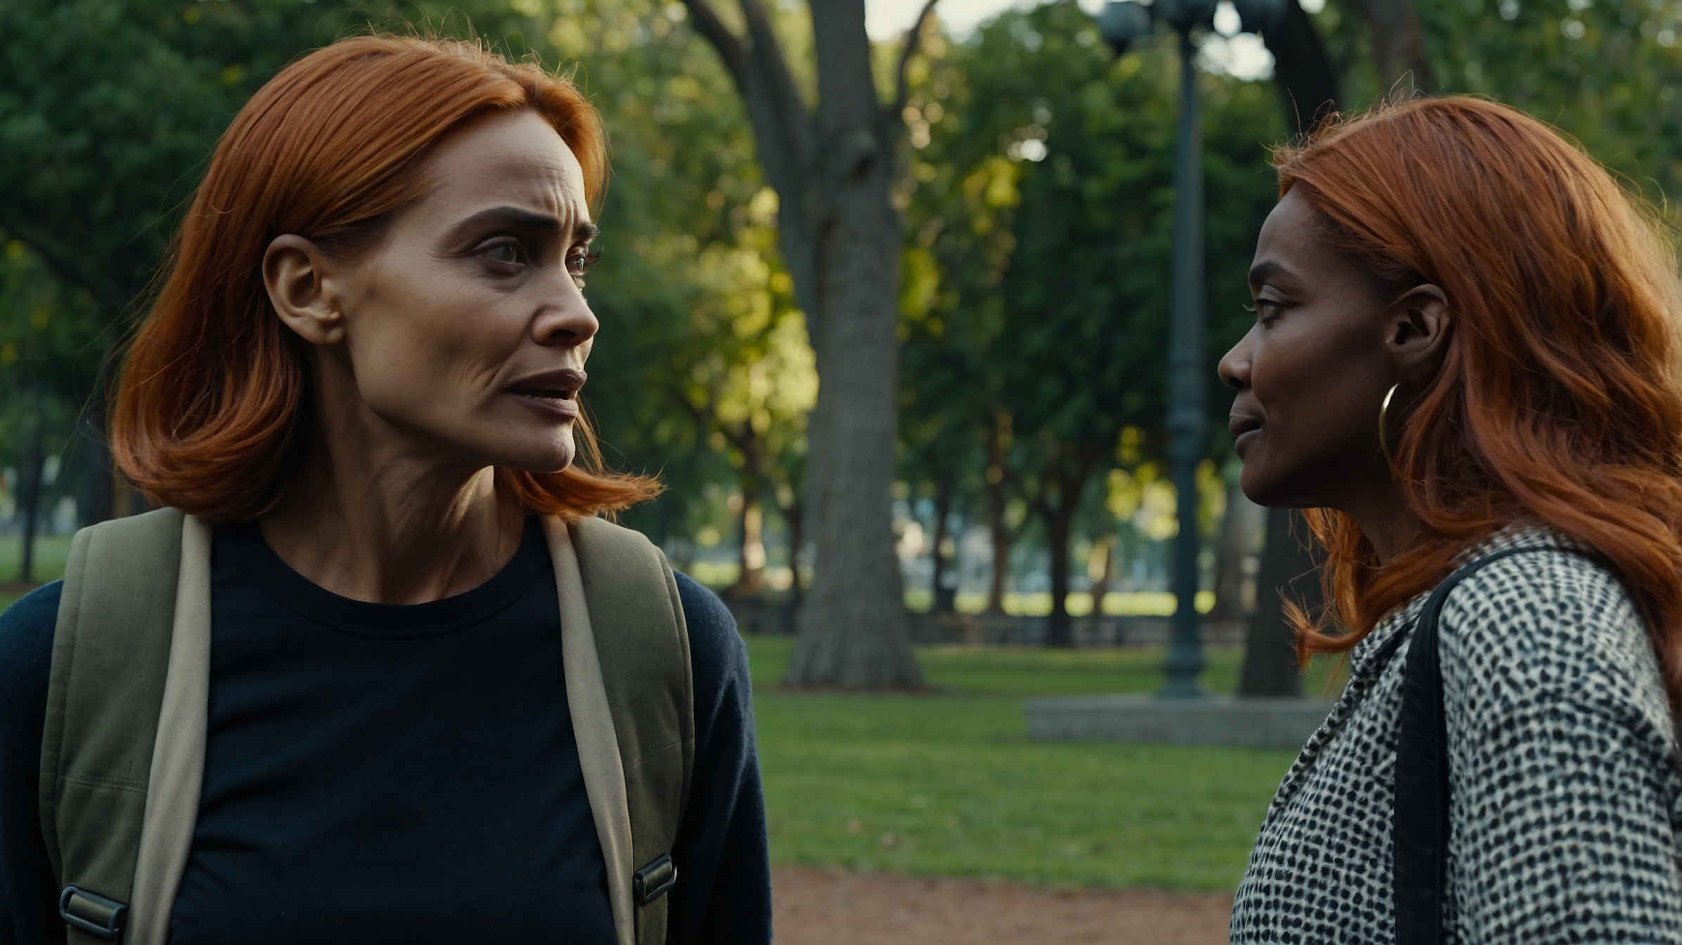
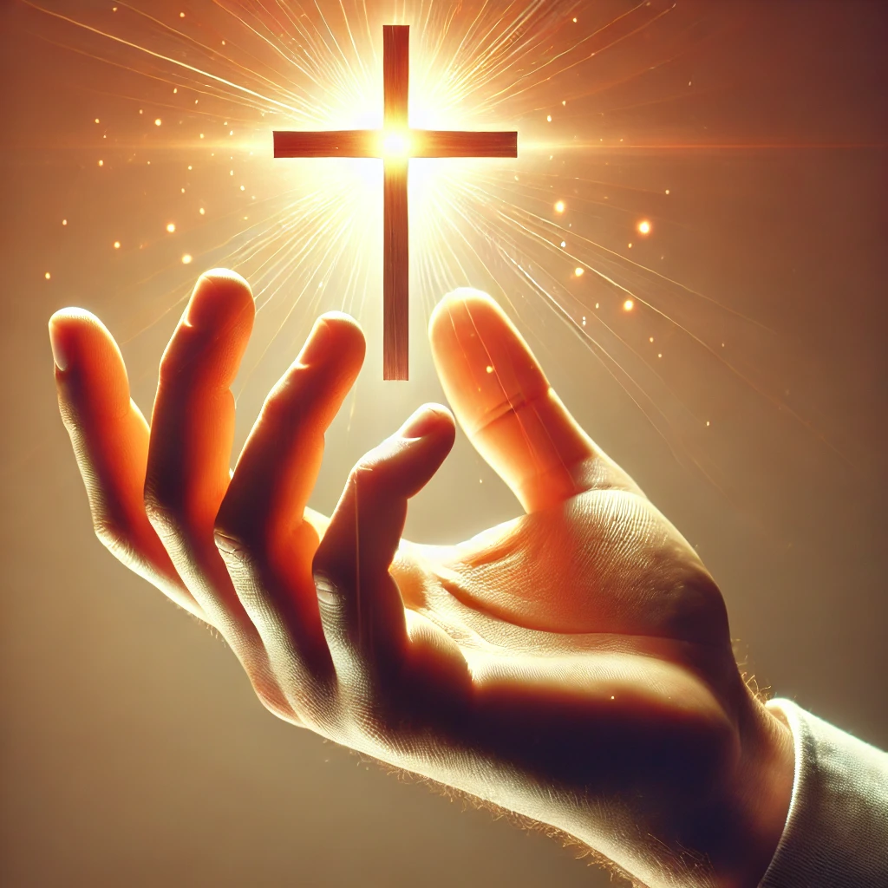
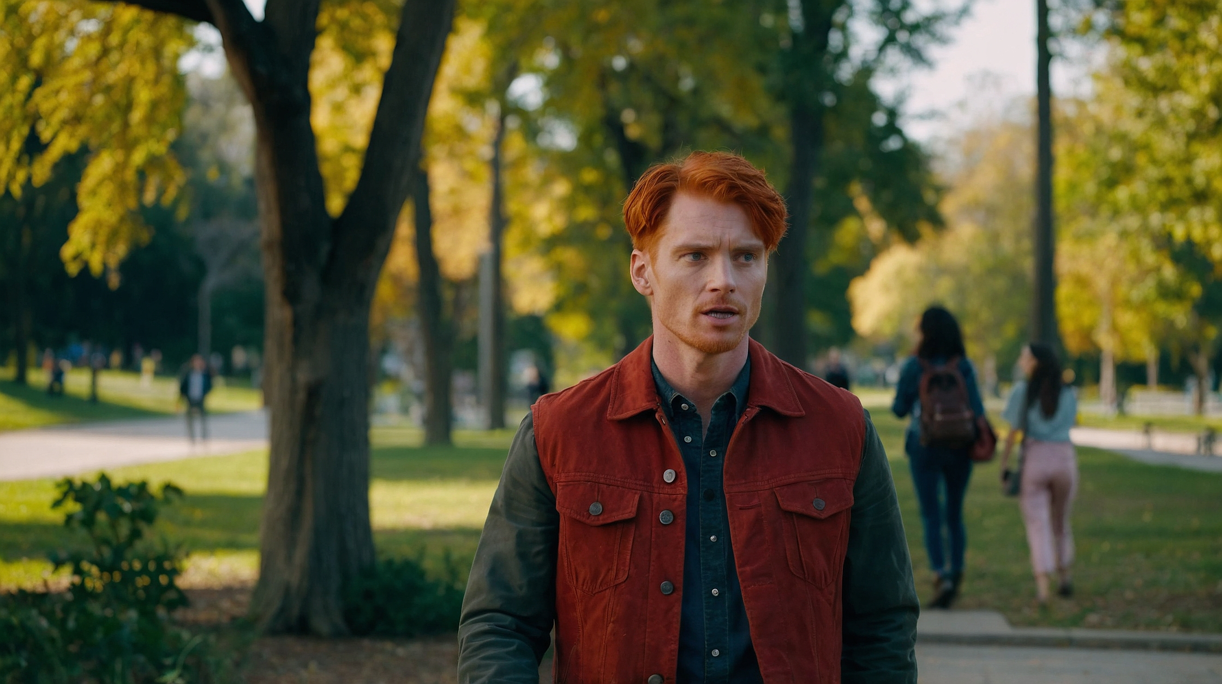
I love how everything is related to faith. It's like what the missiologist Lesslie Newbigin said: "Faith is the hand that holds fast to the work Christ has already completed and makes it his own."
It's not that God does everything without our participation, but He always gives us the first step.

Slide 7
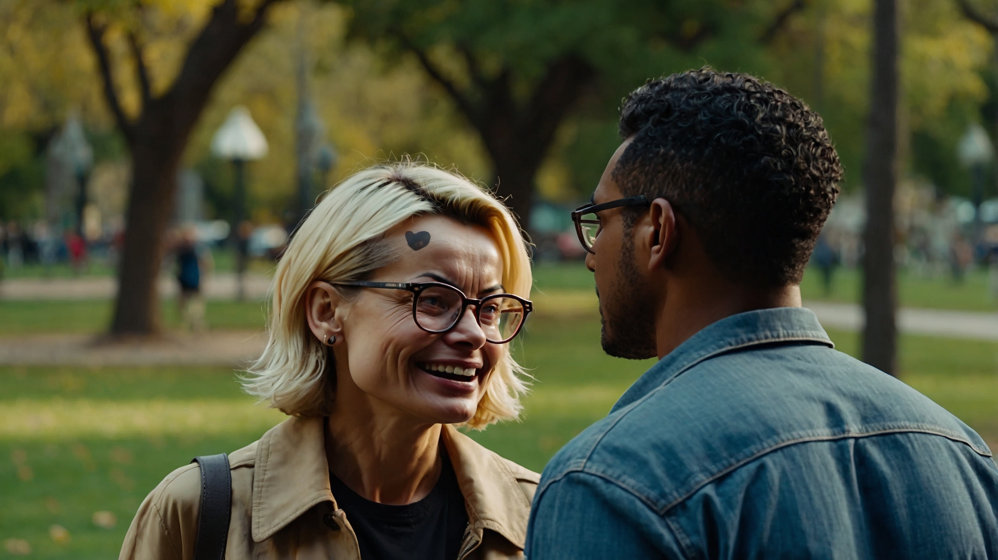
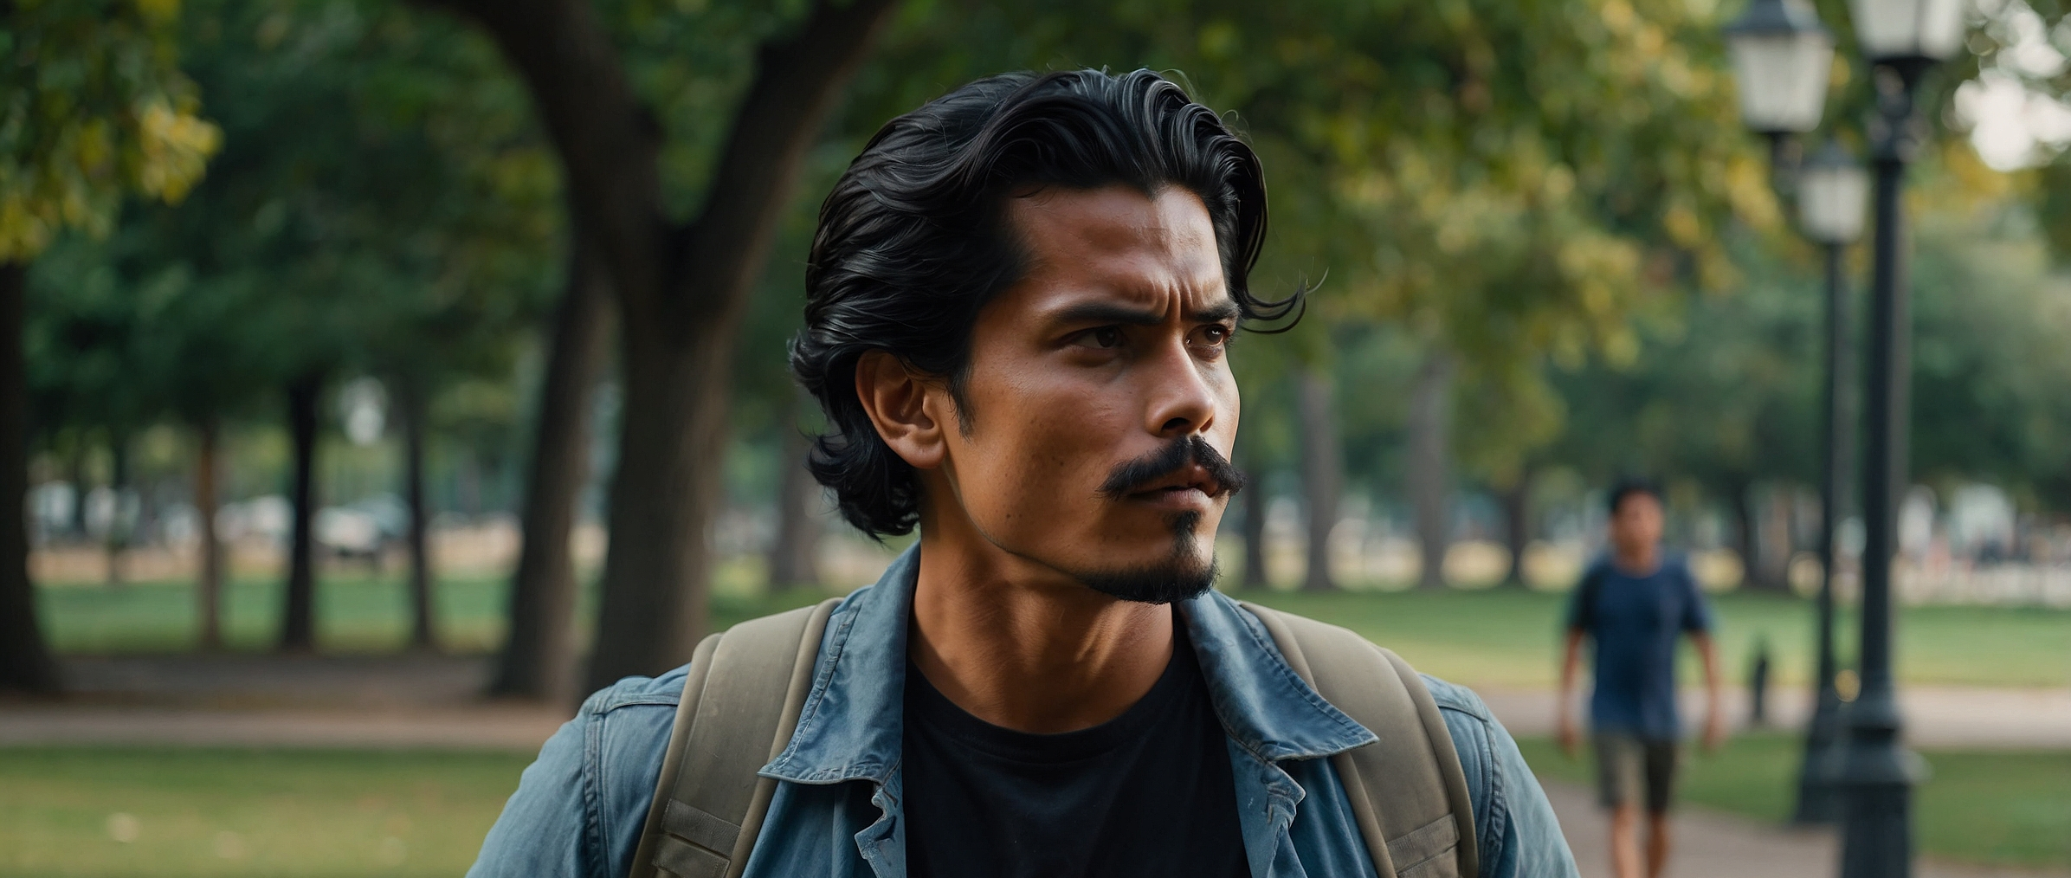
Yes, and that also teaches us that God's grace is not an excuse to do nothing. On the contrary, because God has already done so much for us, our response should be to live in a way that reflects His work!
What impresses me is that even though we fail and fall many times, God continues to perfect that work. It is like a constant invitation to return to Him and continue to reflect His grace. He never abandons us.

Slide 8
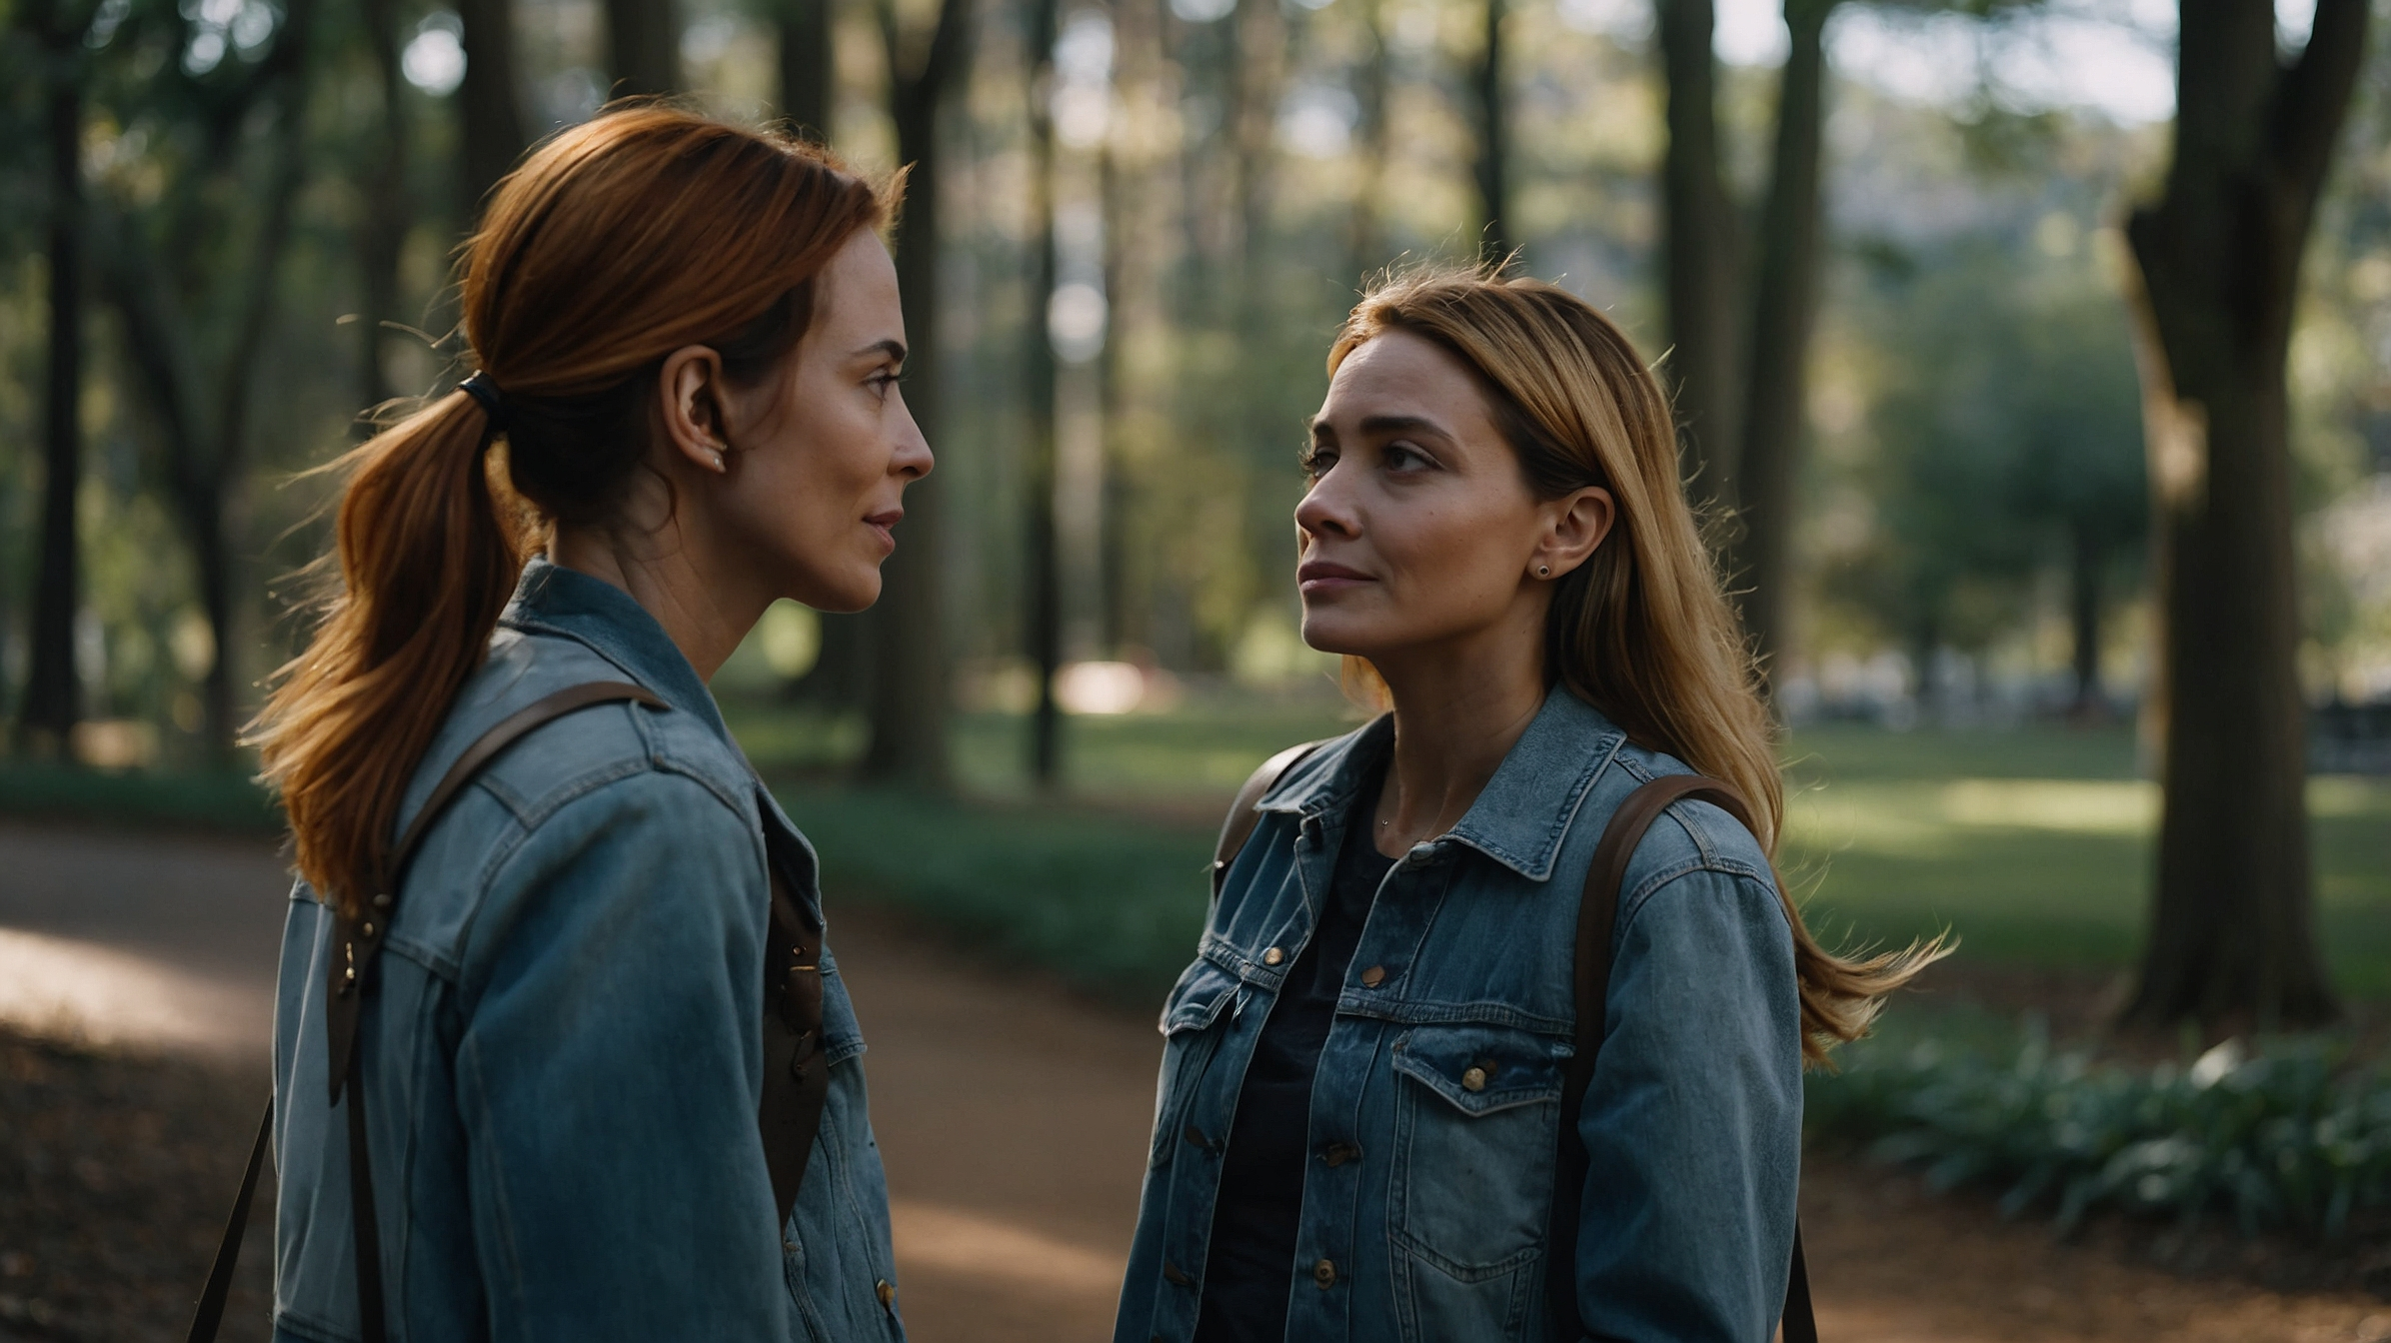
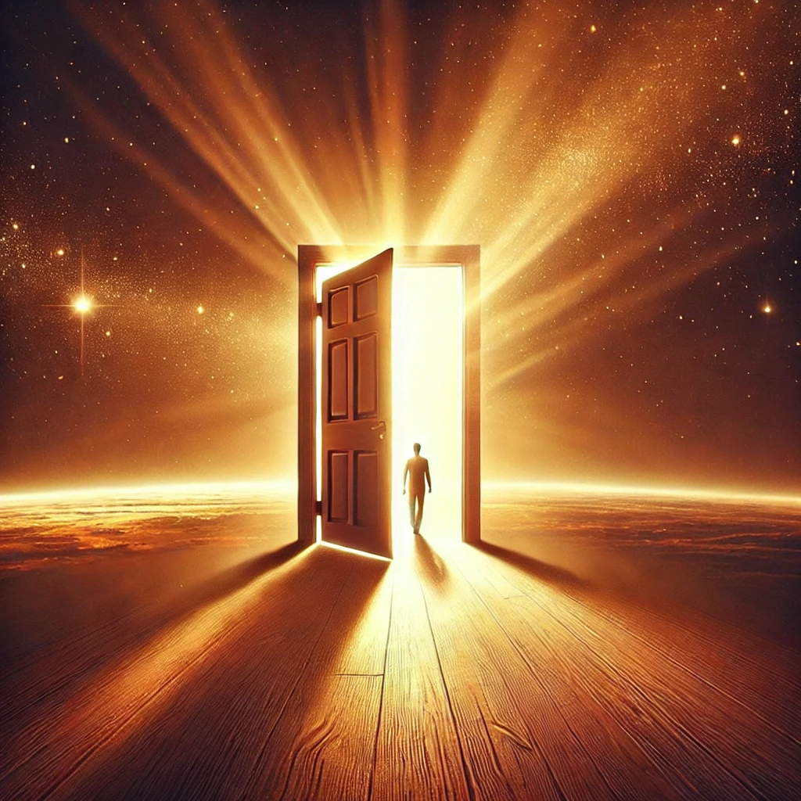
That's right! Our lives should be a constant reflection of God's work. Everything He does in us is not just for us, but for others to see who God is and how He acts.
Of course. And that is the beauty of grace: that it is not only for us, but for the world to see through our lives who God is.

Slide 9
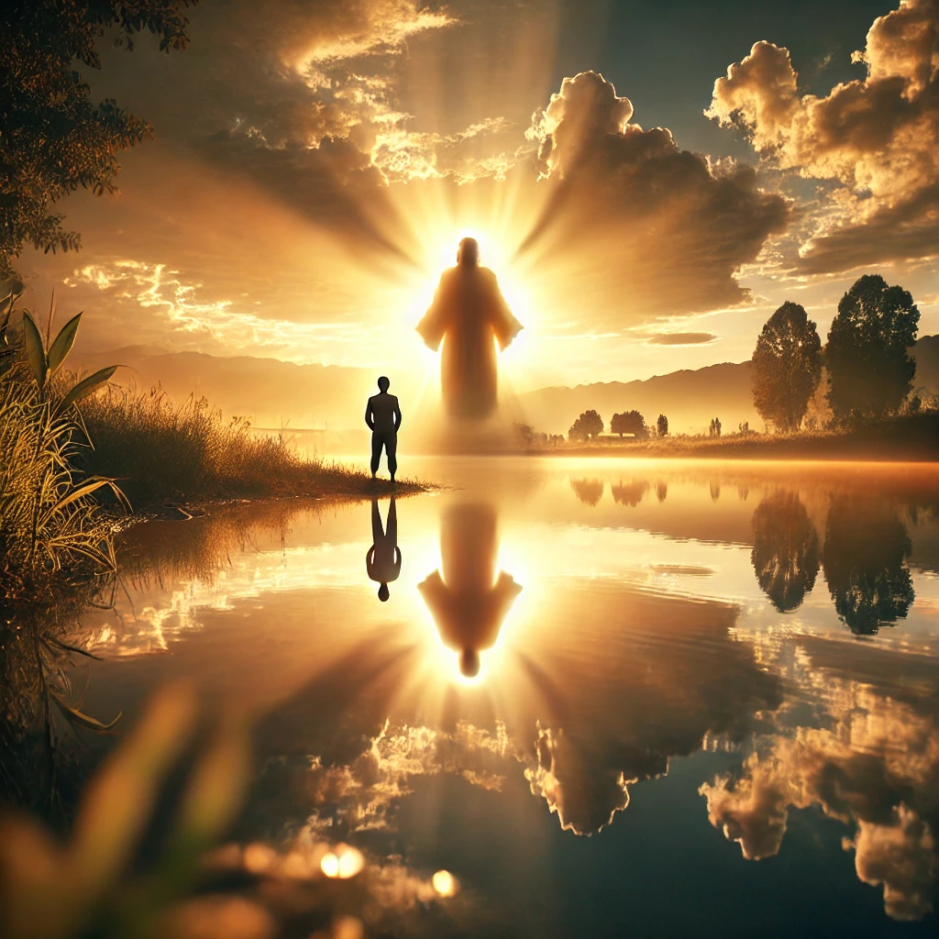
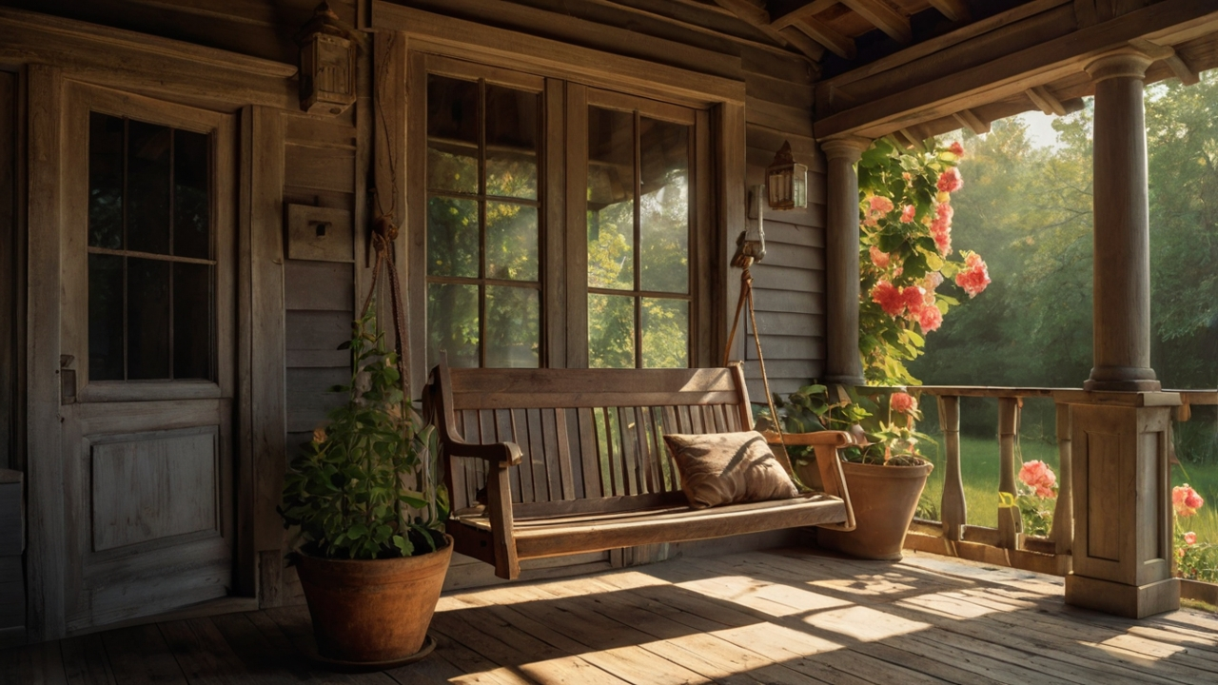
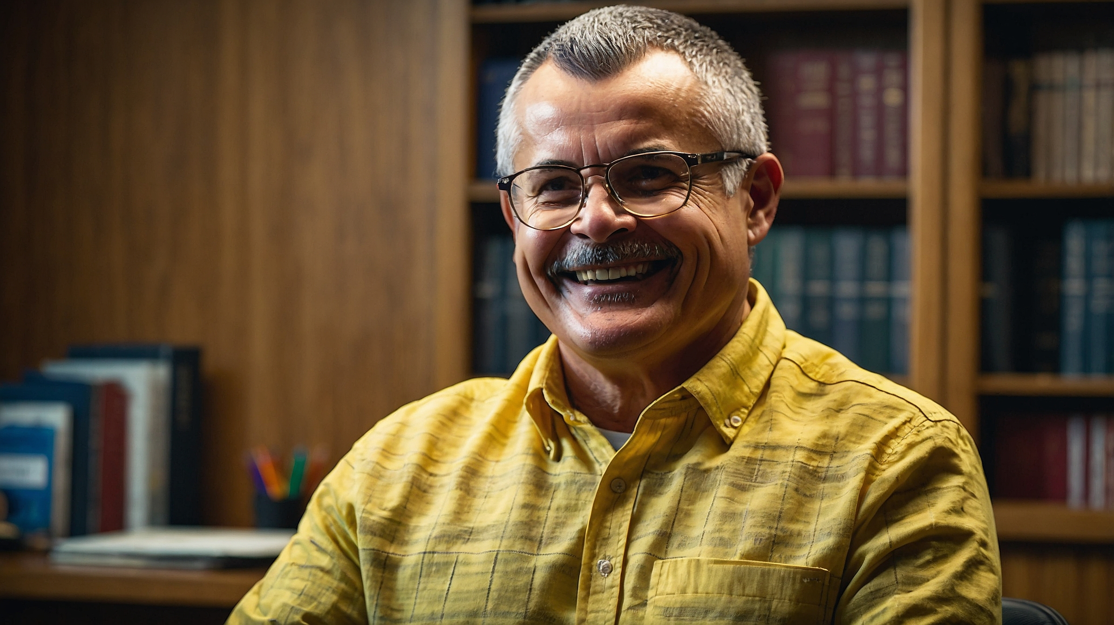
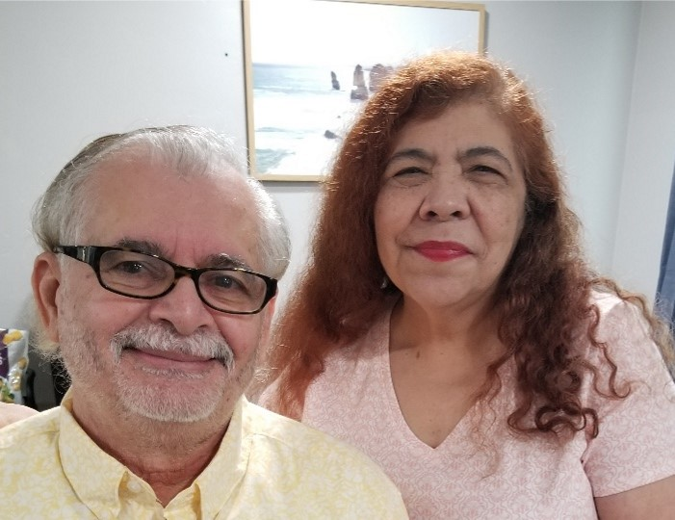
Remember, God's work is internal, that is, of the heart. From a justified and clean heart come good intentions and good thoughts.
That is why the Bible shows us that out of a clean heart flows life that pleases God. What it should reflect is God's love through our actions.

Slide 10
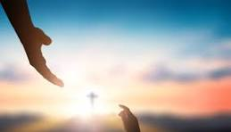
Remember God loves you and so do we, you can visit us at Sanger Naz, Church of the Nazarene at 815 Jensen, Sanger, California
You can find us on Facebook under Sanger Naz or you can call us
(559) 349-2590 Don't forget to see other studies in the Bible Dialogues
www.SangerNaz.com

