Slide 1
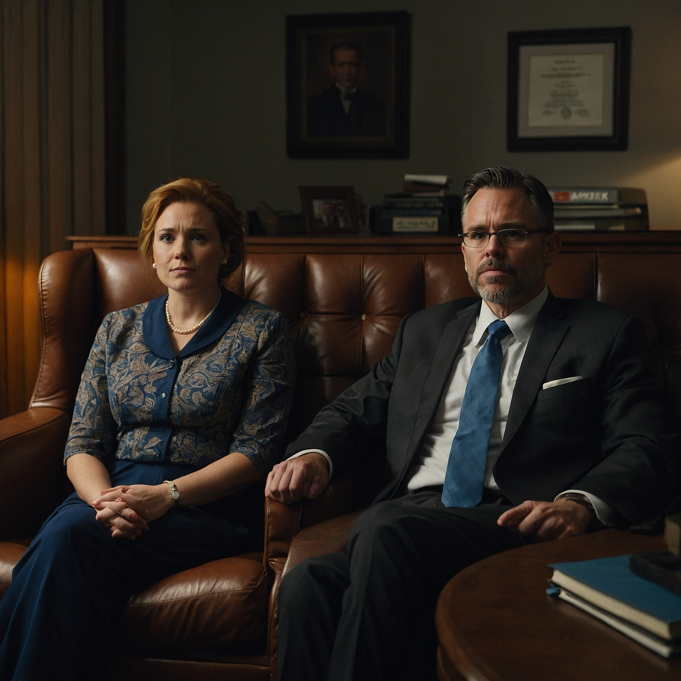
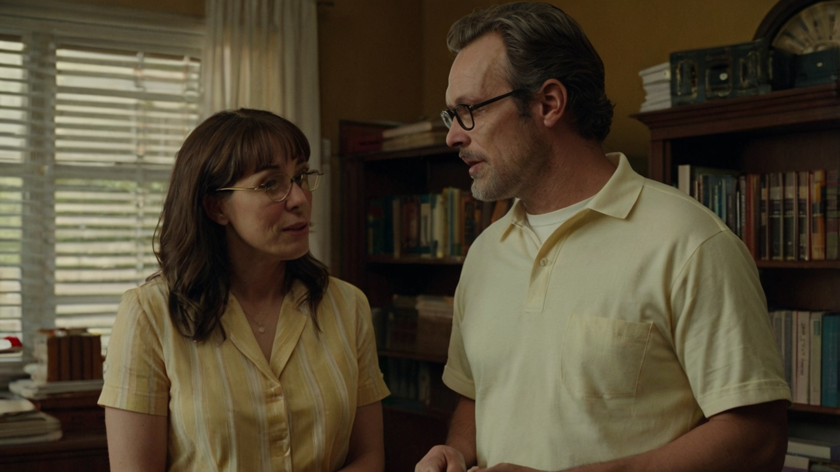
COMMITMENT OF MARRIAGE
BIBLICAL DIALOGUE BY
DR. DANIEL DEIDA
WWW.SANGERNAZ.COM

Slide 2
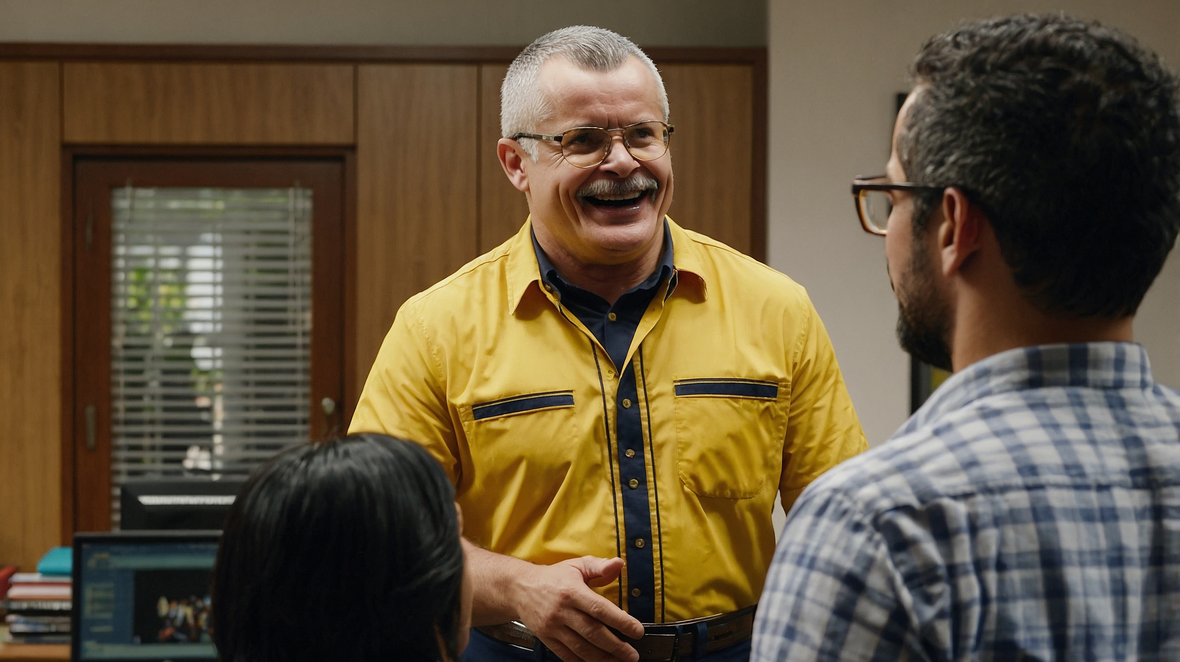



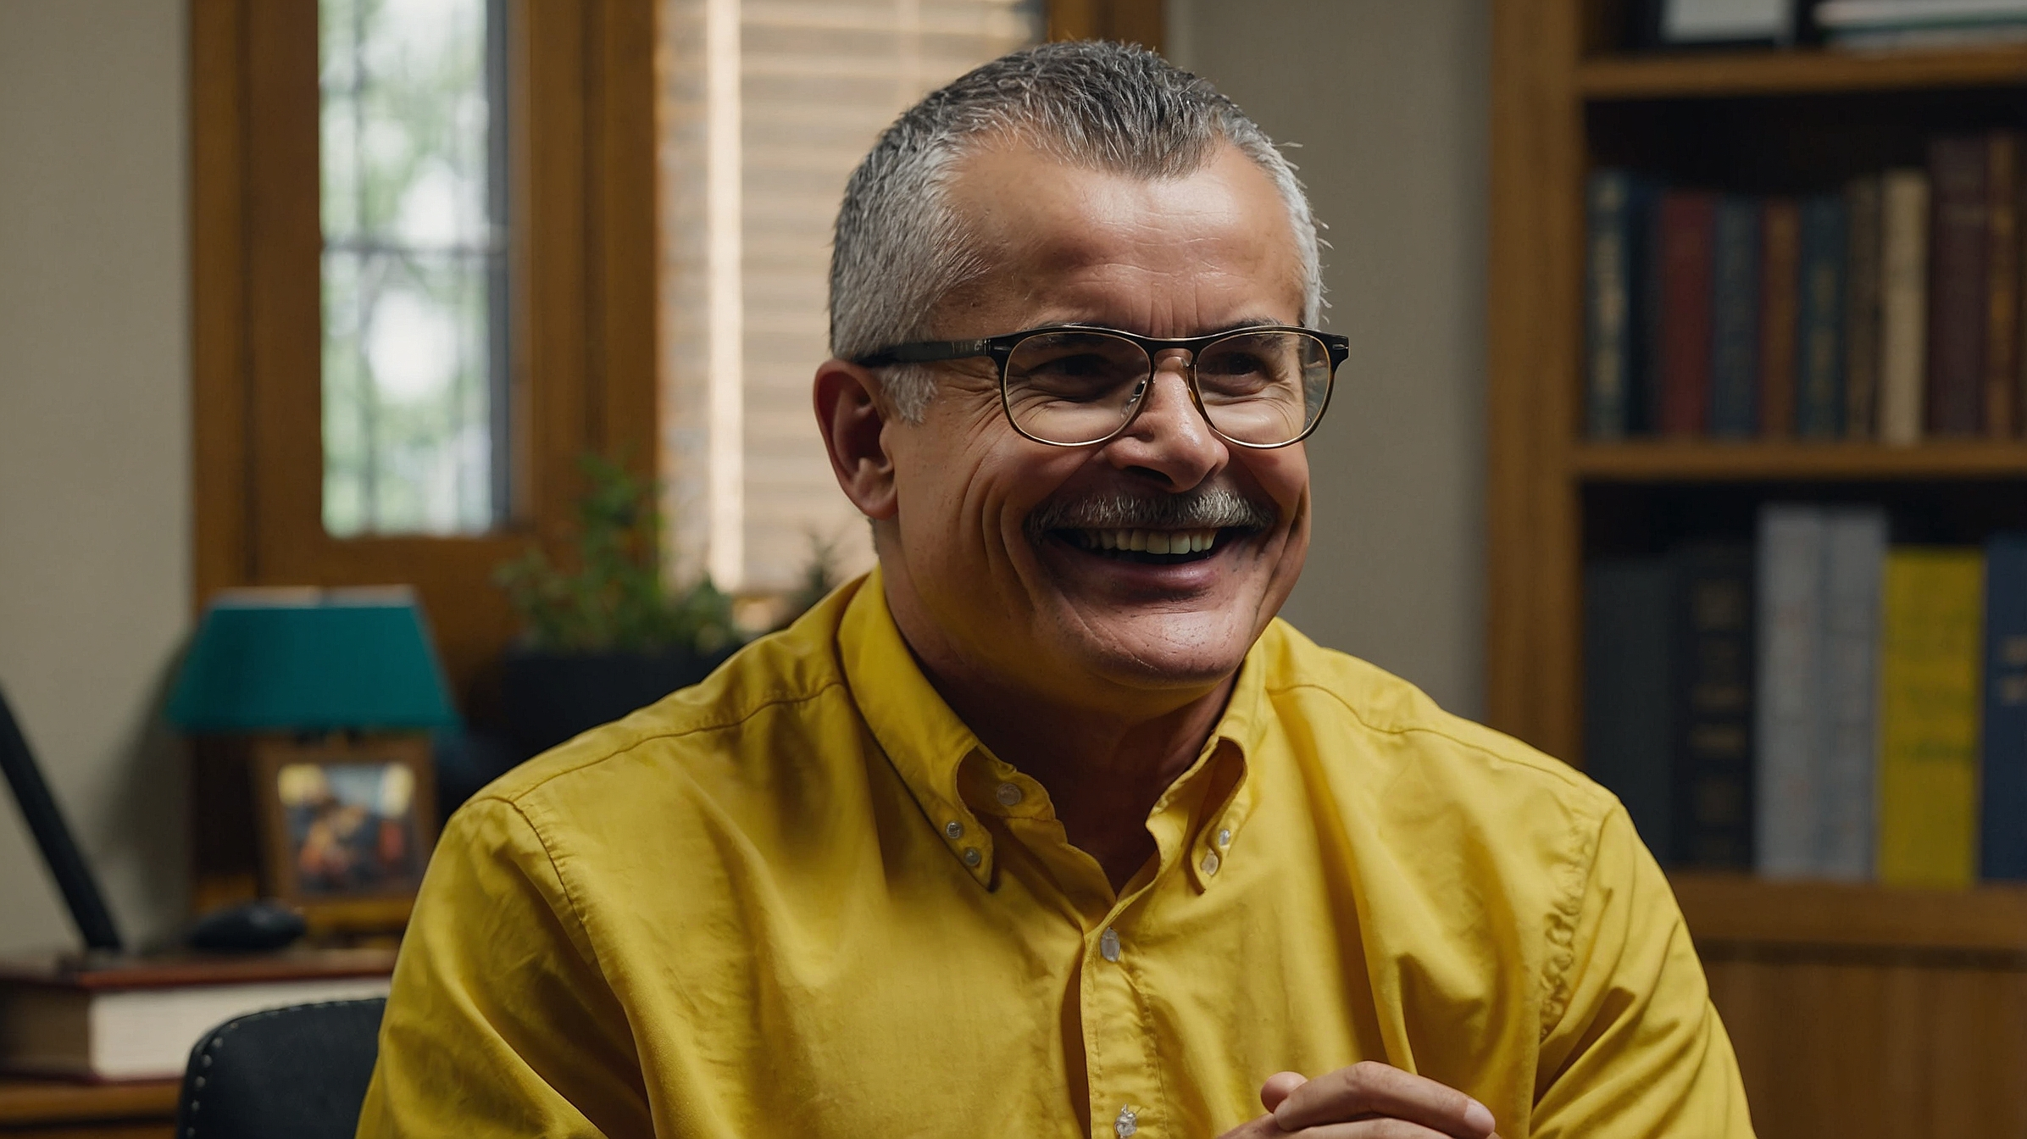
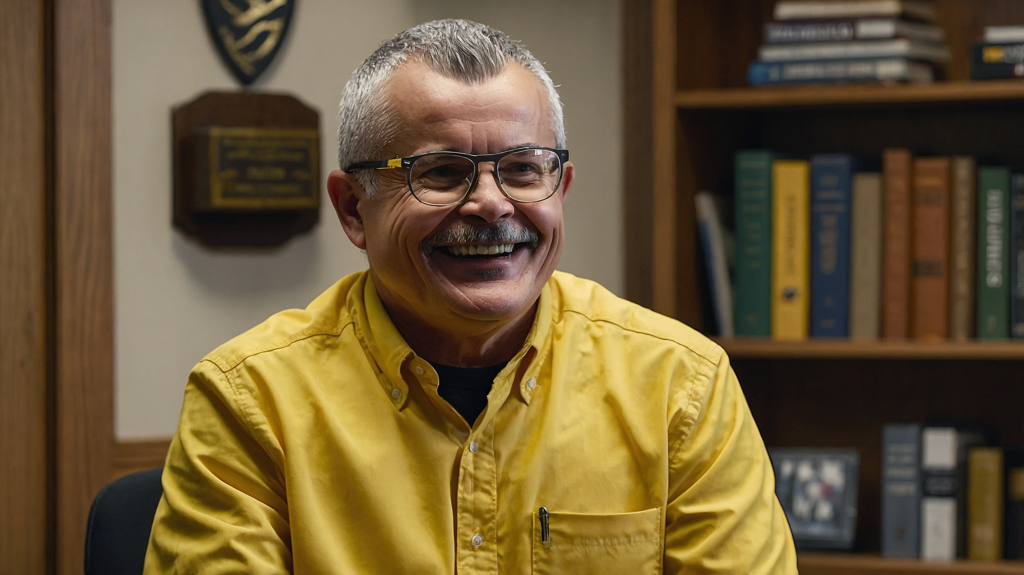
Welcome, Jorge and Jane. I understand you’re here to discuss your marriage and some of the challenges you’re facing. How can I help you today?
Yes, Pastor. We argue more often, and sometimes I feel like we don’t understand each other anymore. We’ve even thought about divorce as a possible option.
We’ve been struggling lately. I feel like we’re just not connecting the way we used to. It’s like we’re growing apart, and we don’t know how to fix it.
I hear you both, and I want you to know that what you’re going through is something many couples face. Marriage is a unique relationship, unlike any other you’ve experienced before, and it’s normal to have moments of difficulty. The key is understanding the nature of your relationship and the commitment it requires.

Slide 3
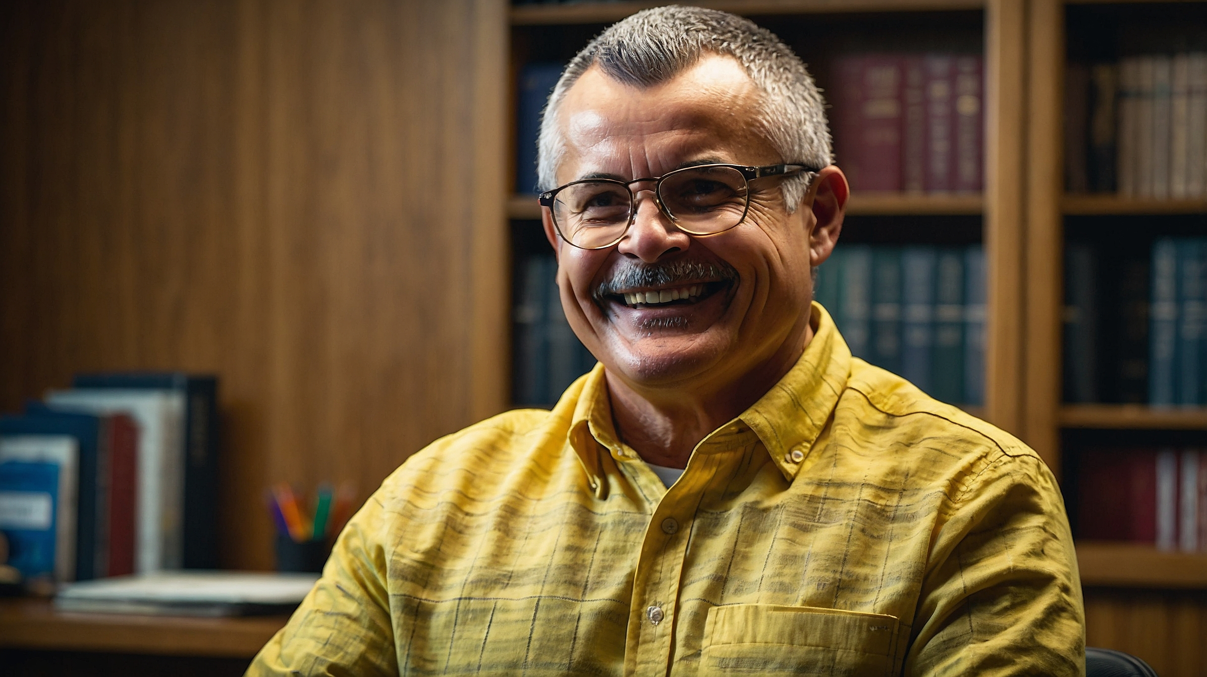
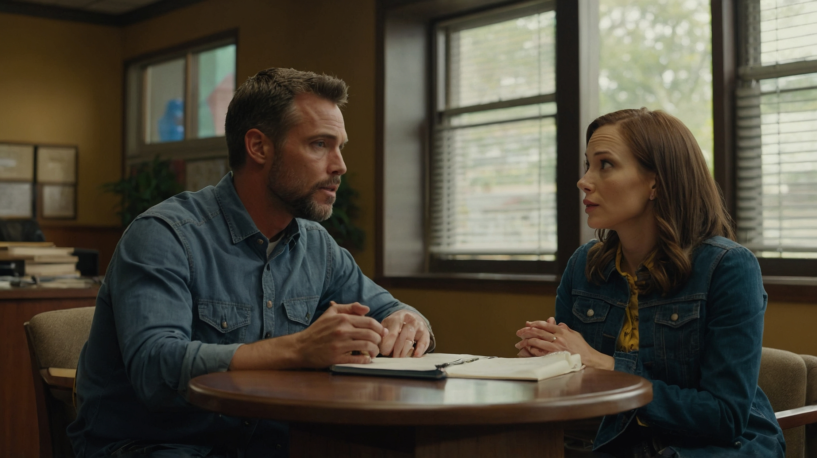
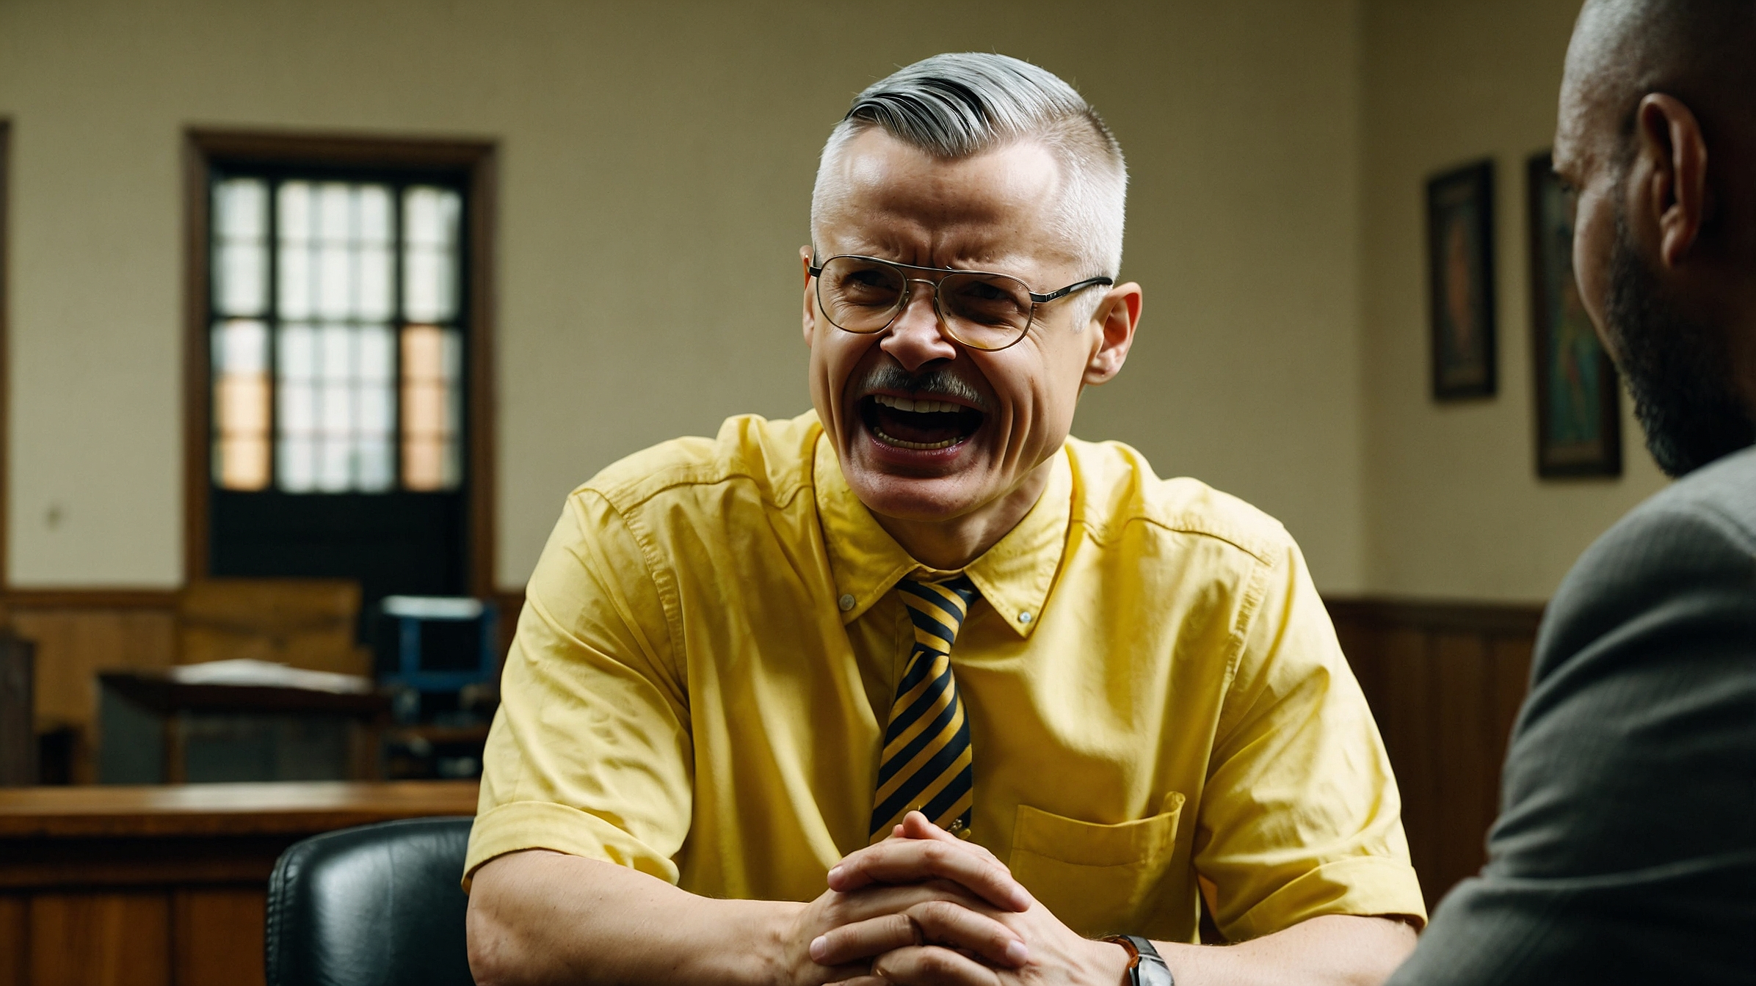
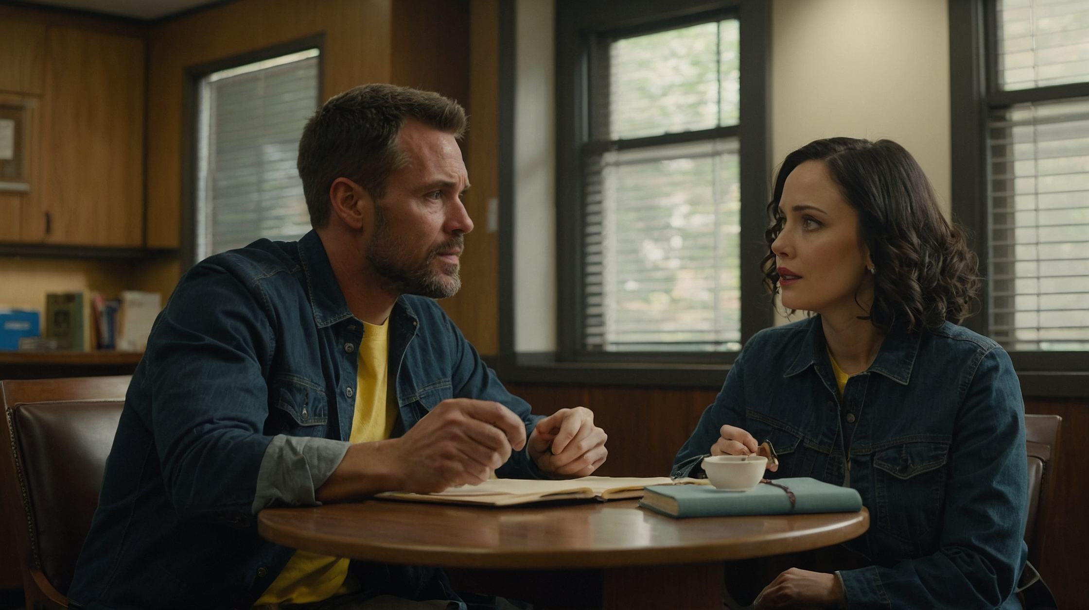
One of the most important things to realize is that marriage is a covenant, not just a contract. It’s a bond that should be rooted in commitment, not just between you two but also before God. This covenant is designed to hold you together even when times are tough.
A covenant? You mean it’s more than just living together and trying to get along?
Exactly, Jorge. A covenant is a deeper commitment. In today’s world, relationships are often based on convenience or feelings, but a marriage covenant goes beyond that.

Slide 4
It involves promises made before God, with the understanding that you’ll stick together through thick and thin. It’s about dedicating yourselves to each other with a commitment that lasts a lifetime.
Unfortunately, many couples enter marriage with little understanding of this covenant. It’s like having an amazing tool but not knowing how to use it because you haven’t read the manual.
That makes sense. But how do we learn to live that way? We’ve tried to work things out, but sometimes it feels like we’re just too different.
Your differences are part of what makes your relationship special, but they can also lead to conflicts if not managed well. What helps is knowing that God's design for marriage gives us a framework for handling these differences in a way that benefits both of you.

Slide 5
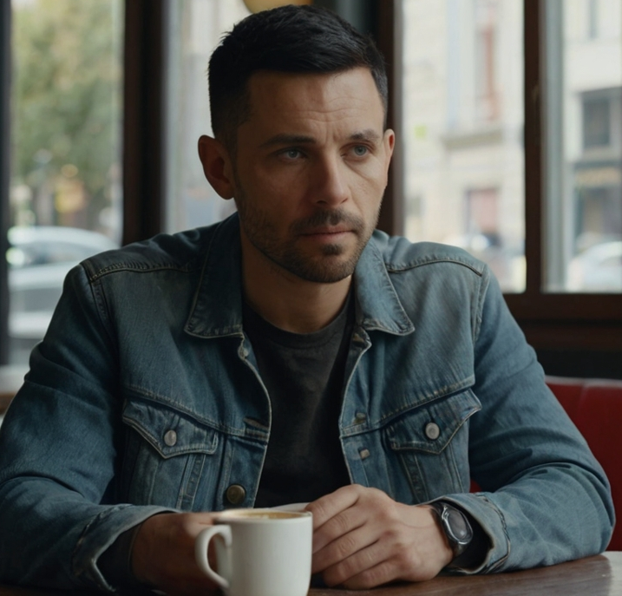
The Bible tells us that God created marriage when He said, “It is not good for man to be alone; I will make a helper suitable for him” (Genesis 2:18). Marriage is designed as a partnership where both of you complement each other. God’s instructions for marriage help you navigate challenges so you can experience joy and stability, not just for yourselves but also for your children.
So, you’re saying that our problems might come from not following God’s plan for marriage?
Exactly. Many of the issues we see in marriages today stem from ignoring God’s principles. When we don’t involve Him in our relationship, we rely only on our own strength, which often leads to frustration. God’s way of doing things, when followed, brings peace and harmony into the marriage.
Marriage isn’t just about love and emotions—it’s about a commitment to love, even when it’s hard, and following the principles that God laid out. This includes learning to forgive, to be patient, and to work together toward the same goals.

Slide 6
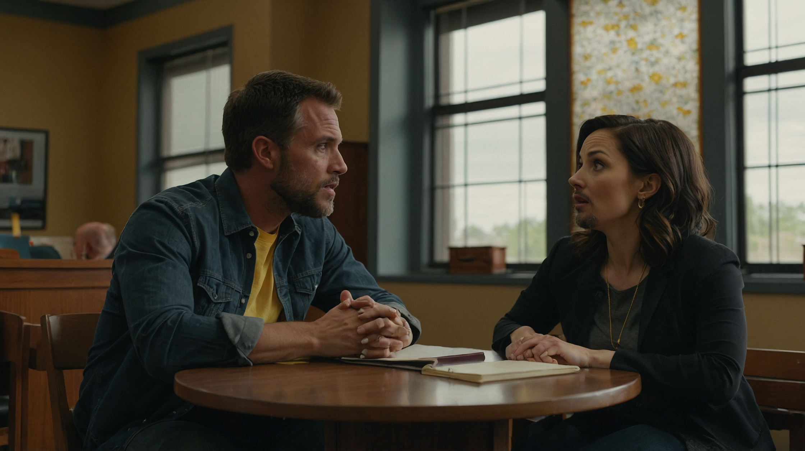
But what if we’ve already made mistakes? Can we really turn things around at this point?
Absolutely. It’s never too late to restore your marriage. You see, God’s design for marriage includes grace. He knows we’ll face difficulties and make mistakes, but through His grace, we can find healing and restoration. The key is deciding to recommit to each other and to the covenant you made before God.

Slide 7
This means working through the issues together, with patience and understanding, rather than focusing on blame or thinking of divorce as the only option.
That’s encouraging to hear. I guess we’ve been focusing too much on our problems instead of trying to find solutions.
That’s encouraging to hear. I guess we’ve been focusing too much on our problems instead of trying to find solutions.
It’s easy to do that, Jorge, but if you shift your perspective to see your marriage as a covenant, it changes everything. It means you’re in this together, no matter what. And when challenges arise, you work through them, not against each other.

Slide 8
It’s easy to do that, Jorge, but if you shift your perspective to see your marriage as a covenant, it changes everything. It means you’re in this together, no matter what. And when challenges arise, you work through them, not against each other.
I
Marriage requires tolerance, respect, and the willingness to grow together. God’s principles help guide you in this process, but both of you need to be willing to follow those principles for your marriage to thrive.
So, what’s the next step? How do we start putting this into practice?
The first step is to commit to learning and applying God’s principles in your marriage. We can start by exploring how to communicate better, how to resolve conflicts without hurting each other, and how to forgive past mistakes. It’s about building a foundation of love, trust, and faith in God’s plan for your relationship.

Slide 9
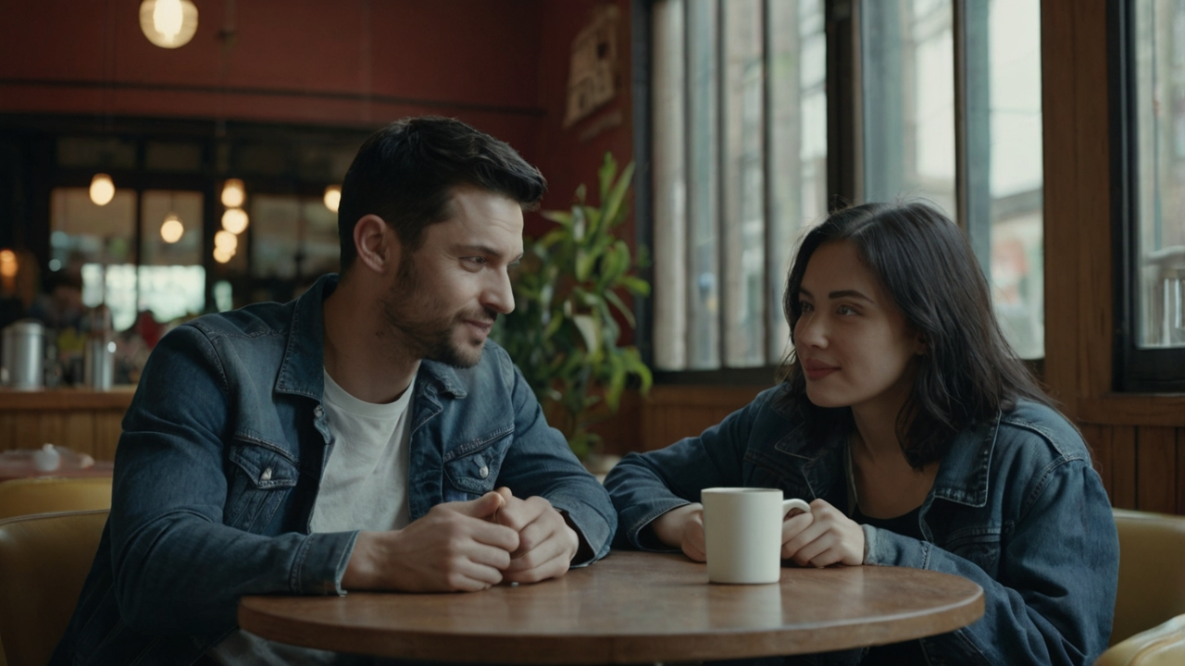
Also, remember that it’s important to stay connected spiritually. A strong spiritual life helps both of you soften your positions and be more willing to see things from the other’s perspective.
Does this sound like something you’re both ready to work on?
Yes, Pastor. We’re ready to start
Thank
Thank
Jorge and Jane have begun to understand the true nature of their marriage as a covenant before God. By focusing on God’s principles and working together, they are taking the first steps toward healing and restoring their relationship.

Slide 10
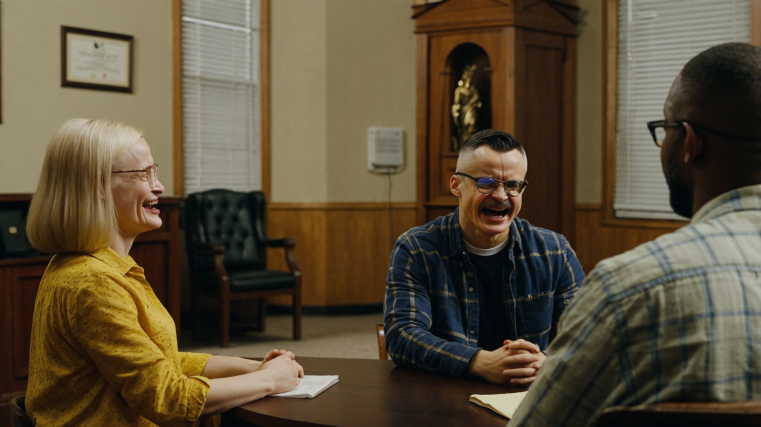
In our next session we will talk about the essential elements in marriage
More biblical dialogues www.sangernaz.com or Call us: (559) 349-2590
Visit Sanger Naz 815 Jensen Ave. Sanger, CA. 93657

