Slide 1

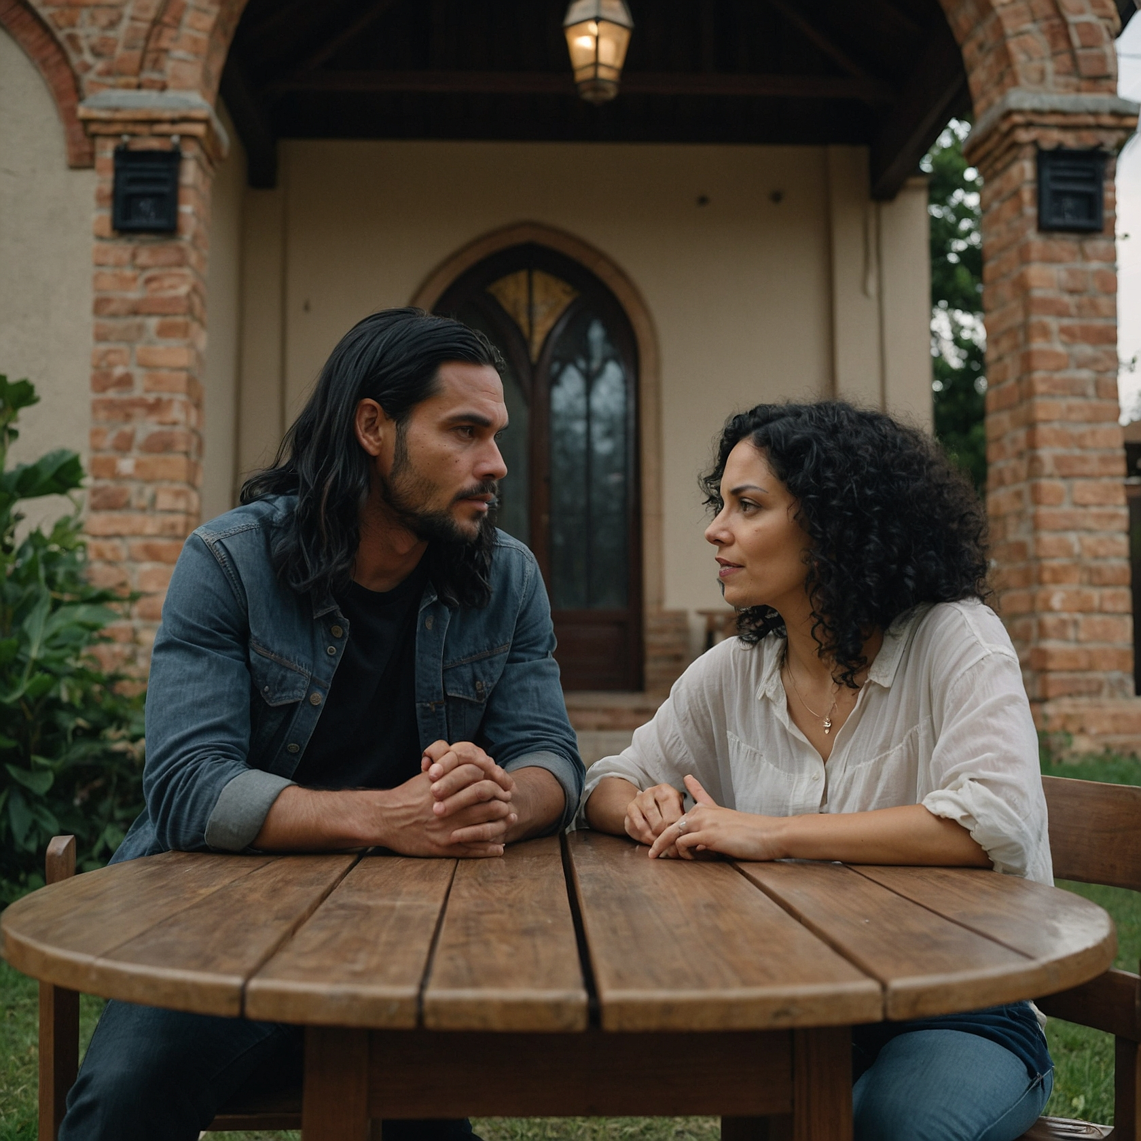

BIBLICAL DIALOGUE
BY
DR. DANIEL DEIDA
Welcome to the Bible Dialogues series by Dr. Deida. Bible stories and teachings are best understood and learned when they are presented through dialogue. In these dialogues, the characters represent some distinctive characteristic of ordinary people. So, our goal is that listeners can learn how Biblical Truth is combined with practical, ordinary Life.
¿Are you ready for your Bible learning journey?
Today we will see: Recipients of Grace

Slide 2
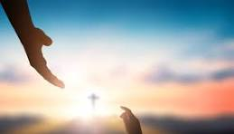

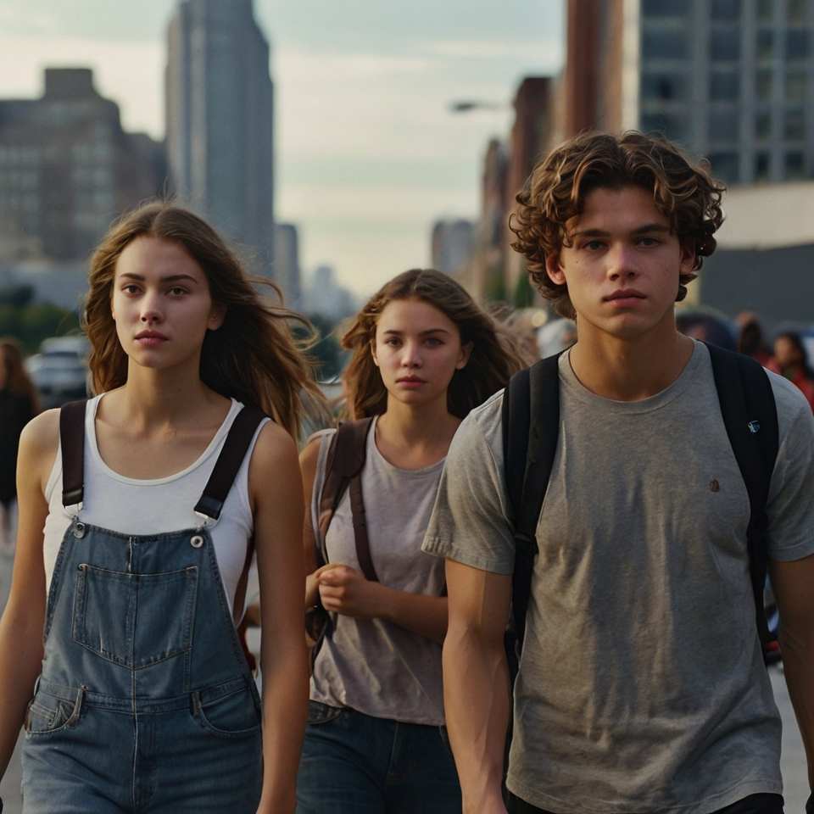
Scene 4
Recipients of Grace
They were talking about Jesus. For Christians, the word of God was not a book, but was made in a person: Jesus.
Did you know, that the first Christians did not talk about a religion or rules? They spoke of a Person.
Of a person? Who?
Jesus was just like you and me, but He was also God. He lived, died, and then rose again to show us what new life is. The early Christians did not give their lives for ideas or rules, but to follow Jesus, who really was here on Earth.

Slide 3
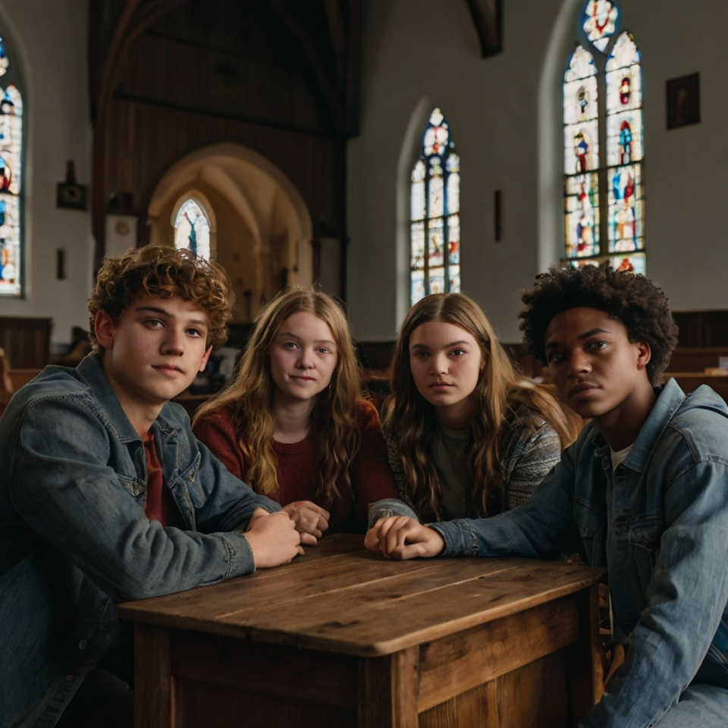

That's right. As a wise man named Dietrich Bonhoeffer said, if we only follow ideas, we are not really following someone. Christianity without a living Jesus makes no sense.
Wow! So, they followed Jesus because He was a real person, right?
So, when we talk about the grace or love of God, it's not about following rules, but about following and loving Jesus

Slide 4
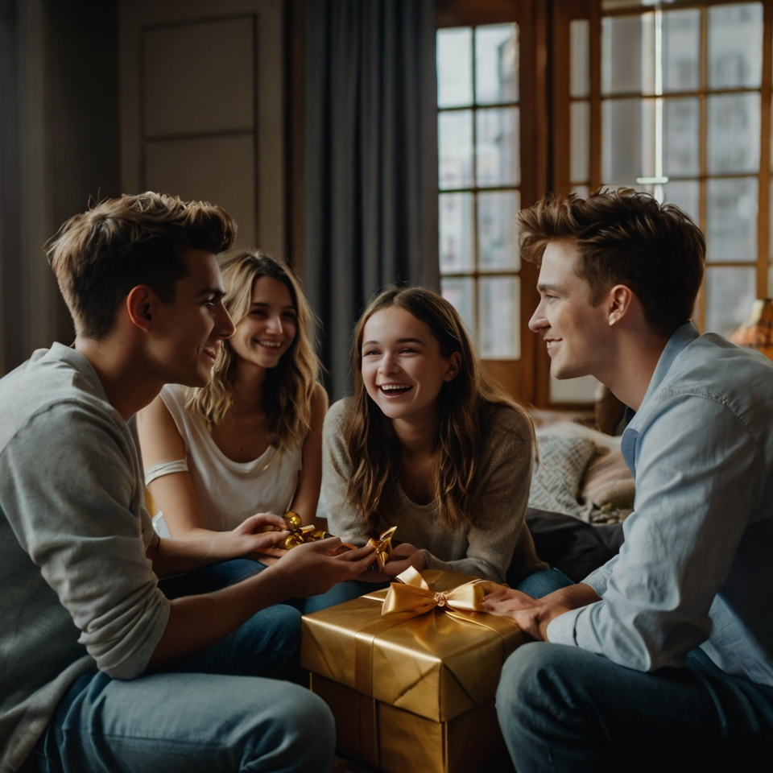
scene 5
Jesus’ Grace
Grace is like a very special gift that God gives us through Jesus. It is not just an idea, but something we receive from Jesus Himself. And each person receives it in a unique way, depending on what they need.
what is grace?
It's like when you have different friends, and you show them affection in different ways. God does the same with us.

Slide 5
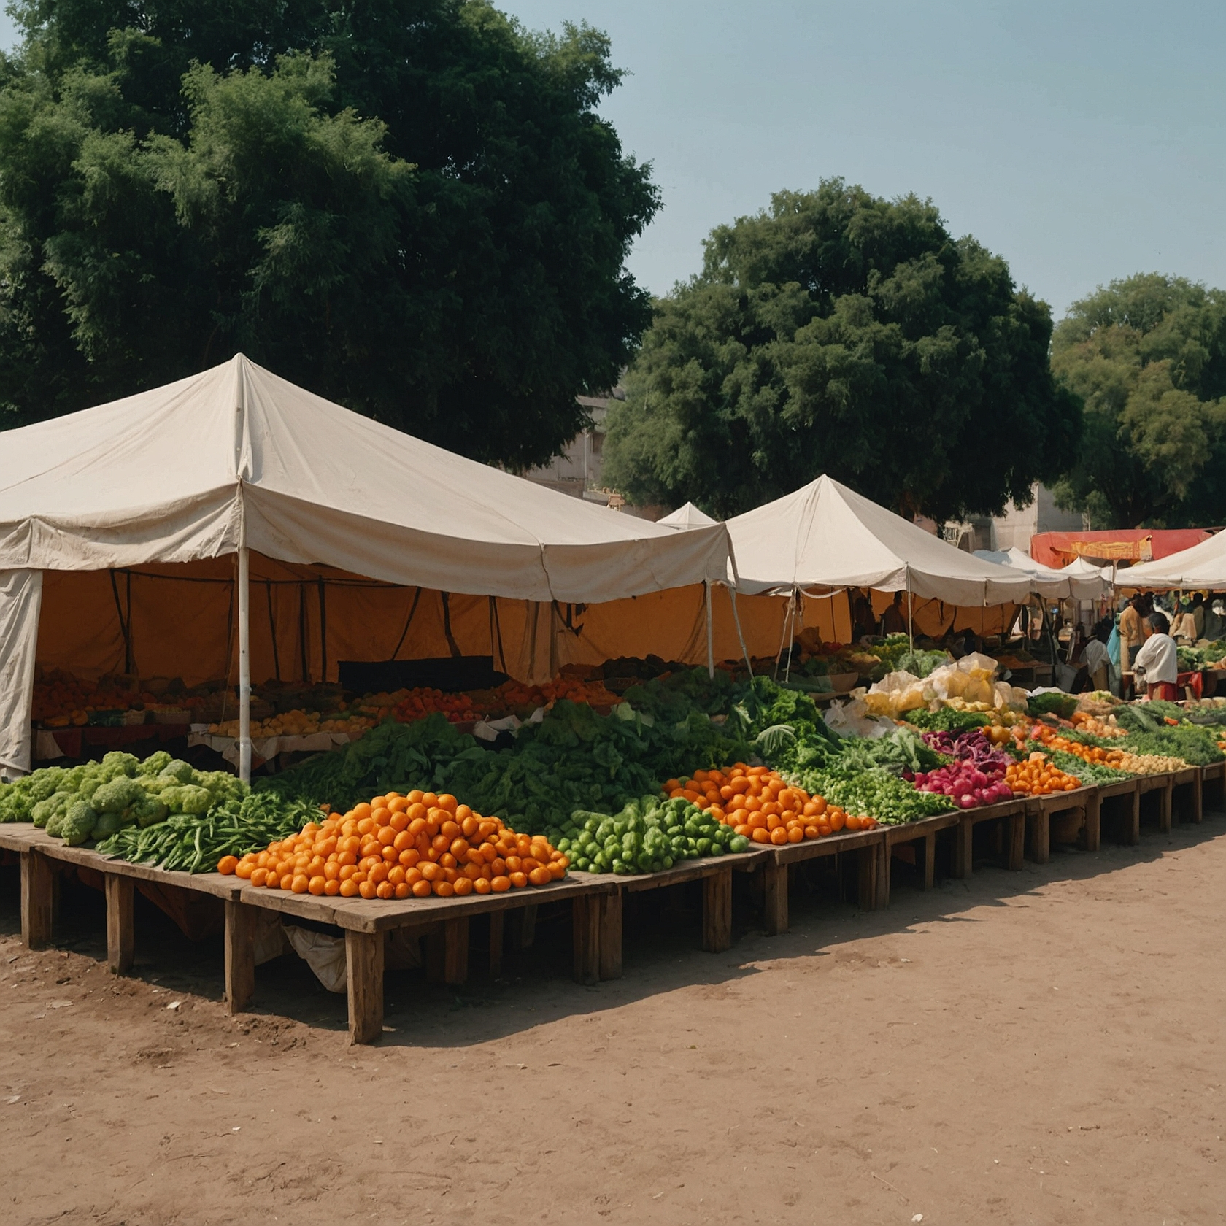
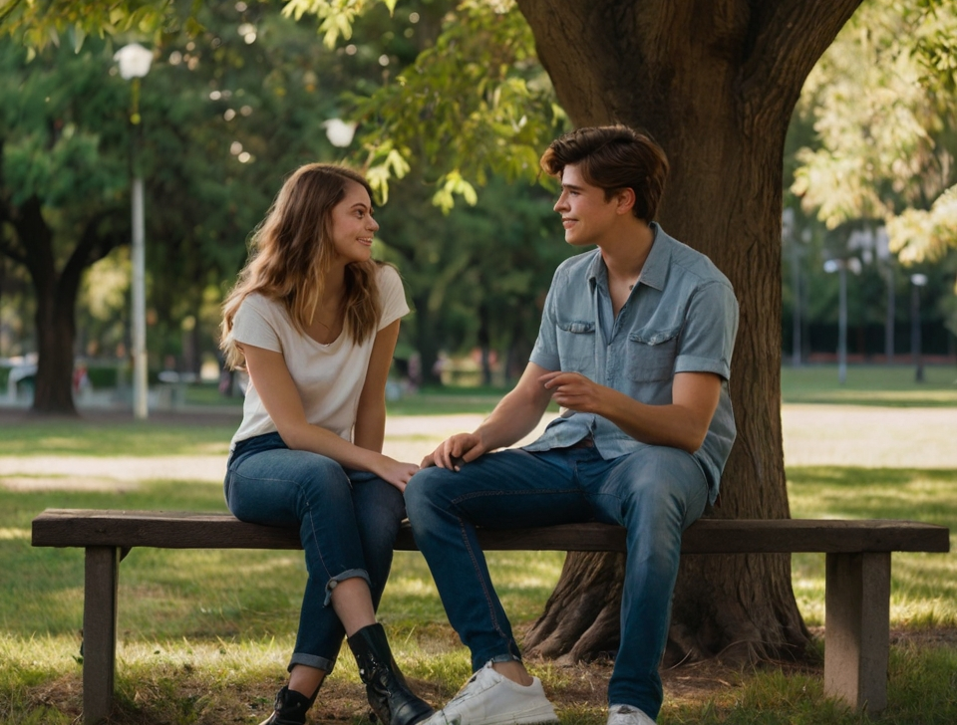

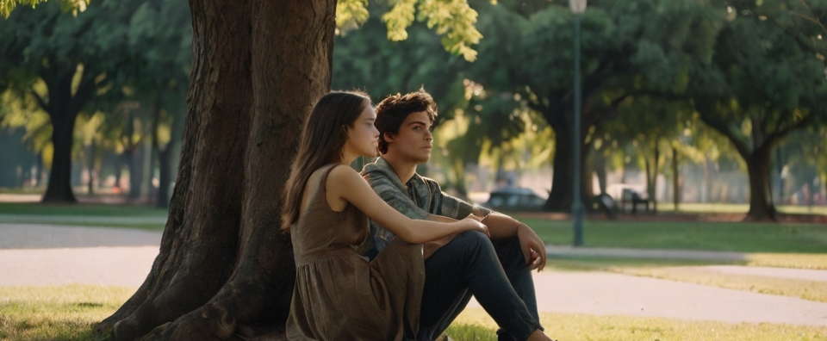
I understand! Like when you help me with homework, and you give my brother a hug when he's sad.
Exactly! God loves us all, but He does so in a way that adapts to what each one of us needs.
And everything we know about God is clearer in the life and teachings of Jesus. Therefore, following Jesus helps us to better understand this gift of grace.

Slide 6
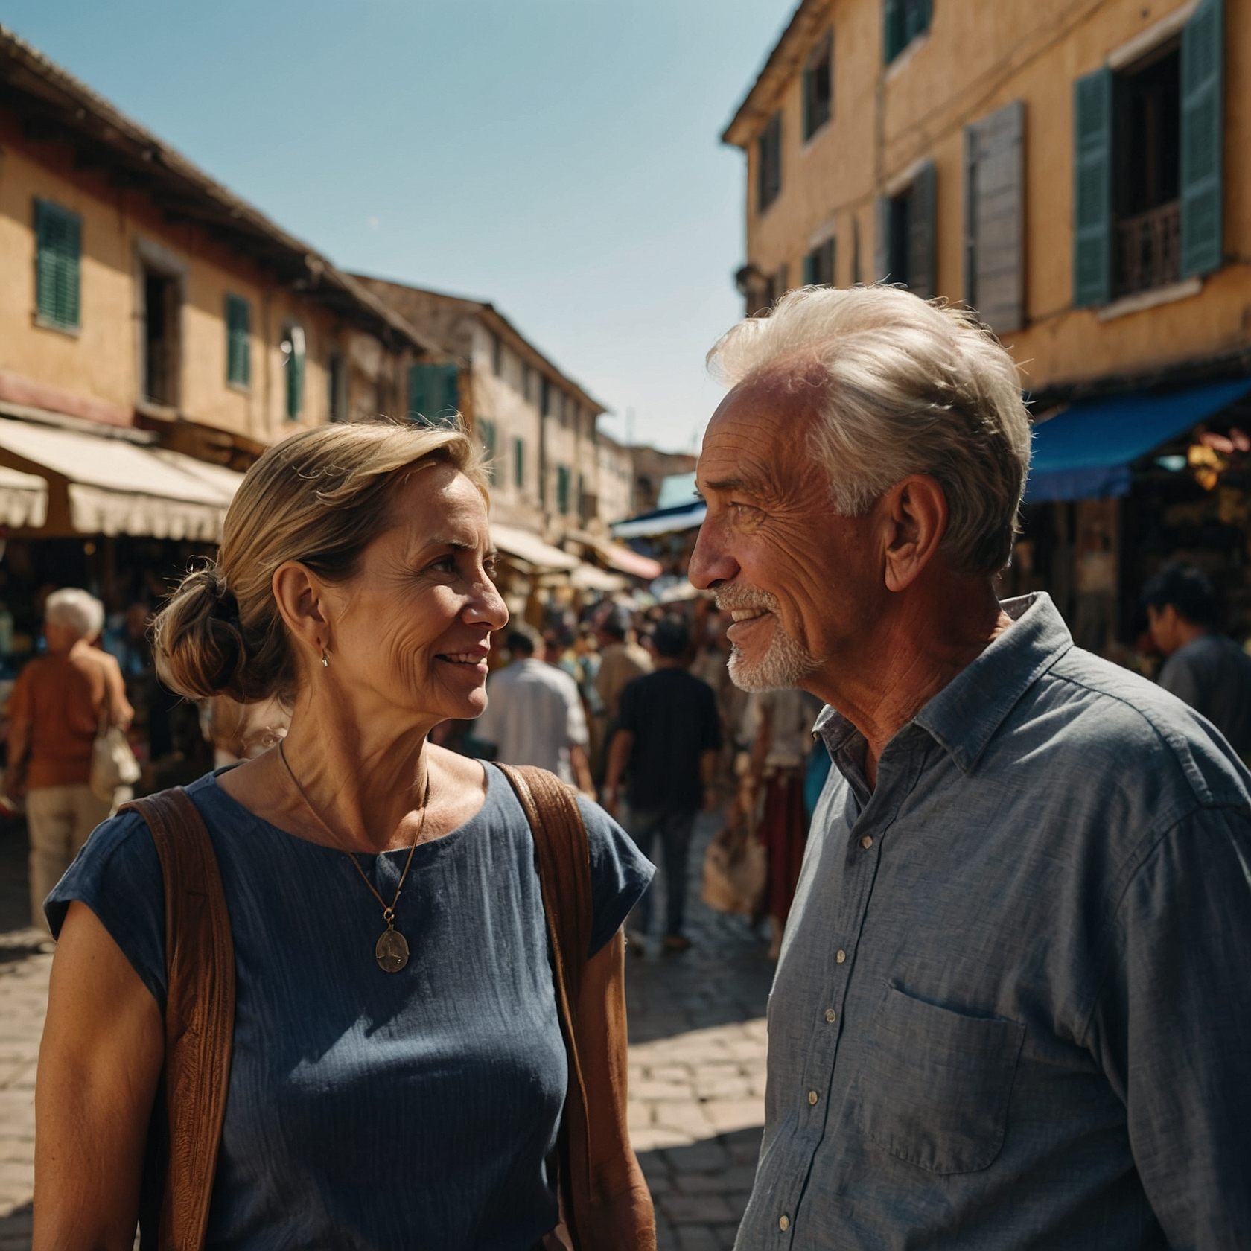

scene 6
Grace has a price
So, grace is free?
Yes, it's a gift we can't buy. But, as Bonhoeffer says, although it's free, it comes at a price. It is not cheap to follow Jesus.

Slide 7

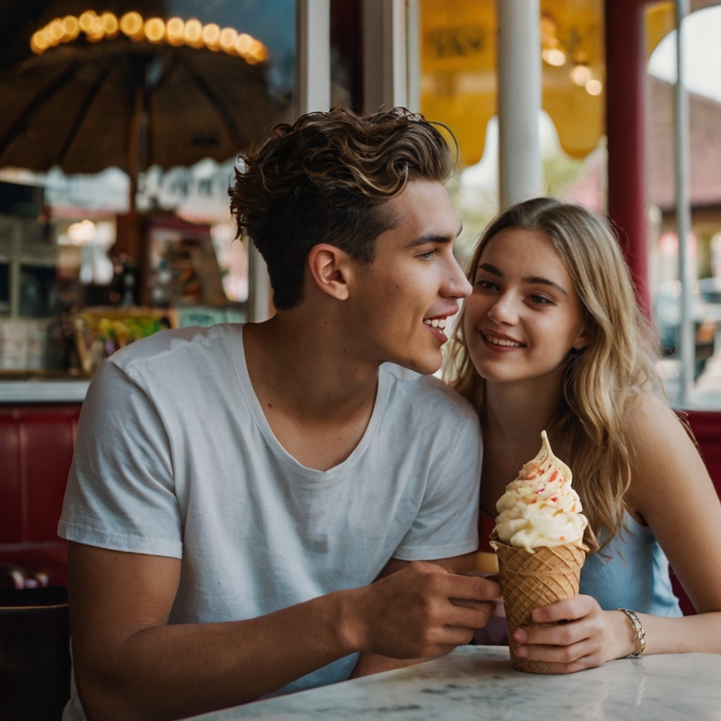
Grace doesn't mean we can do whatever we want without thinking about
Jesus. He calls us to truly follow Him.
Why?
Because when we follow Jesus, we are accepting his love and also his way. It costs us, because it means we must leave things behind and obey what He teaches us.
Exactly! God loves us all, but He does so in a way that adapts to what each one of us needs.
Grace is expensive because Jesus gave his life for us, and what cost God so much, can't be cheap for us.

Slide 8


But it's a cost worth it, Lucy, because although it asks a lot of us, it also gives us the most beautiful life.
That's right! Grace gives us the strength to follow Jesus and live as He wants, with love and kindness.
So, following Jesus is like receiving a gift, but also being responsible to him.
Let us remember, that grace begins, grows, and accompanies us all the way as we follow Jesus. Now, we know why Jesus’s grace is so important.

Slide 9
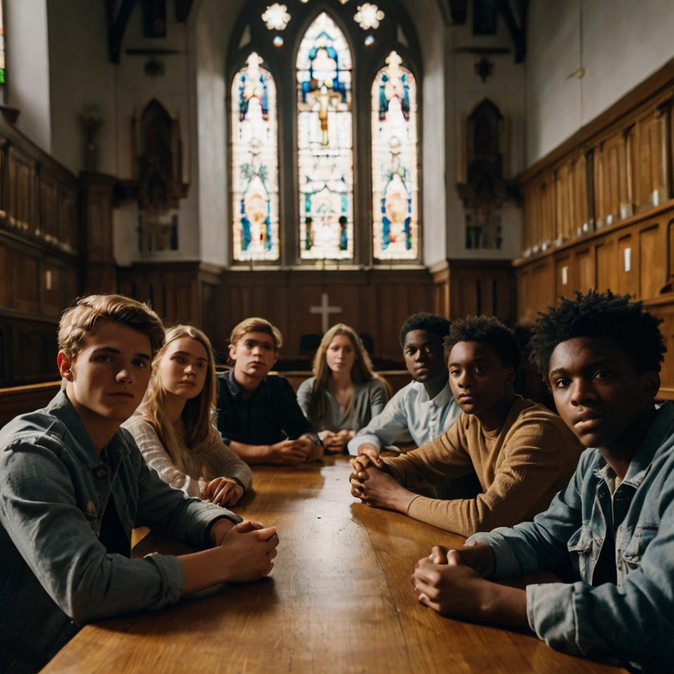
section for interaction in the group
F
During the interaction time you can do section by pausing the video and establish a conversation about the important and relevant things you learned from the video. Going scene by scene may be very beneficial. Or perhaps you can watch the video from beginning to end and have a conversation afterward.

Slide 10

Prayer Time
Facilitator invites group members to pray for each other. Each person will choose one person from the group to pray for.
Have in mind that during this section is for our own benefit and for our special needs that we may have.
In which area of your life, you need God's grace to work the most?

