Slide 1


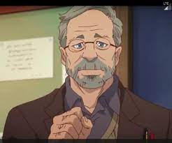
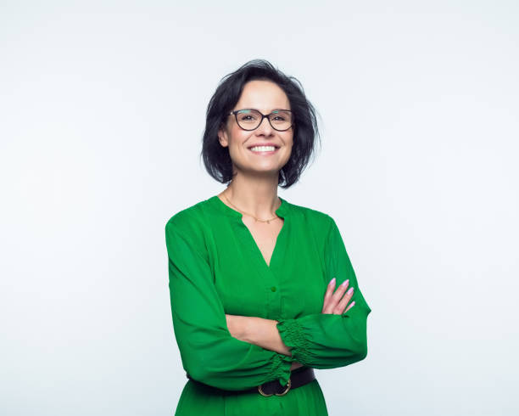
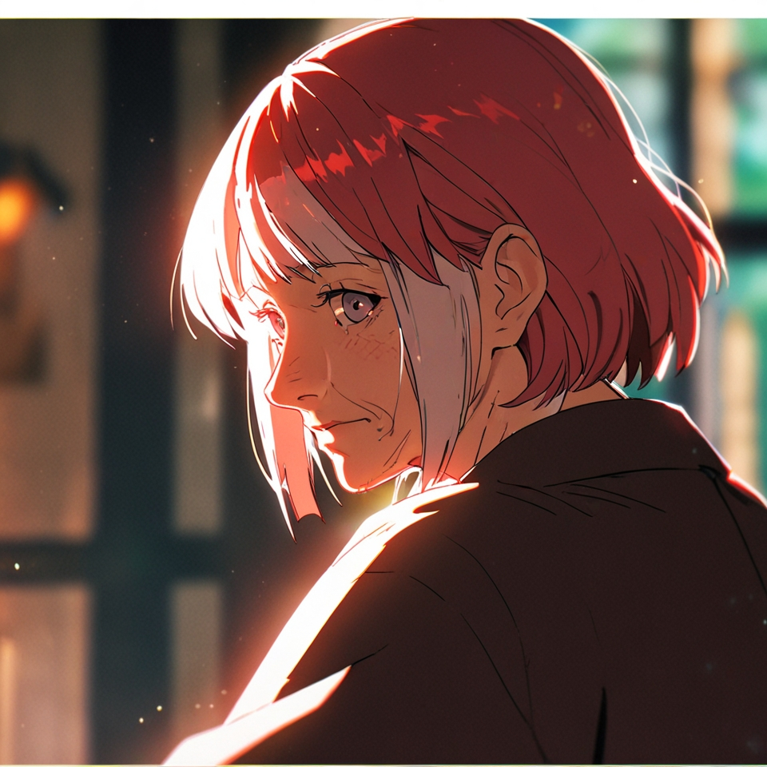
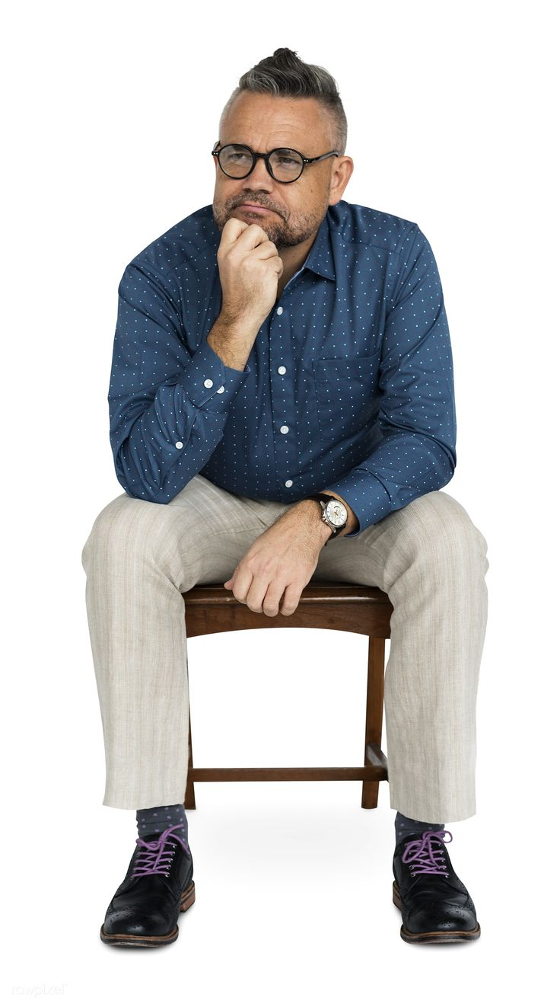
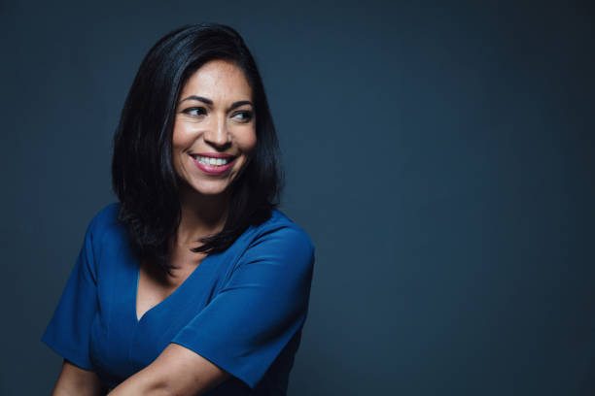
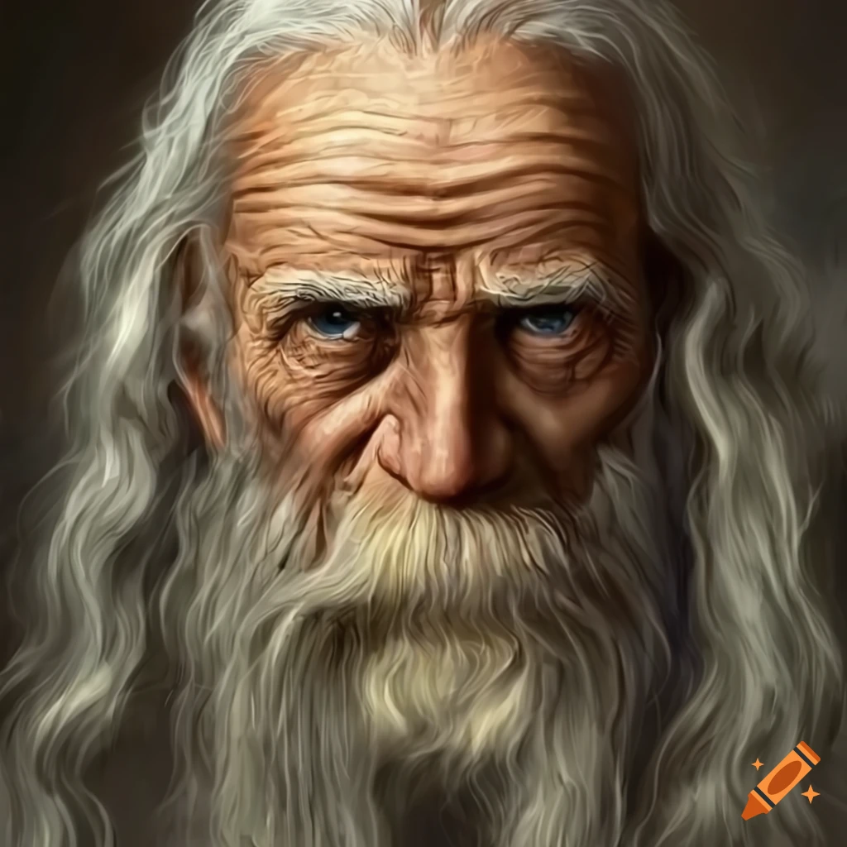
I SAW the FACE OF AN ANGEL
There was a meeting in a small church during the Wednesday service. The church runs with about 35 people. Most of them are young people between the ages of 16 and 45. Meet the characters:
Hi
Add Photo/illustration here
Add Photo/illustration here

Slide 2

scene 1
Preparing the church
Hello my brothers and sisters, you know the holiday season is around the corner, I want our church to get involved in our community. It's time for our community to know that we are here to help and assist them in anything we can do. I have made some flyers for you all to pass out through the neighborhood to invite them to church.
Yes indeed, Pastor strategic, we love people but sometimes we do not take a moment to go out and introduce ourselves and our ministries to them.

Slide 3

Remember this is a way how we serve God, by doing this simple exercise, passing out 200 flyers. Let’s bear in mind, sometimes the weather is not on our side, but still, we want to make the effort to do it. This coming Saturday at 10:00 a.m. will be a good day to do it. We are doing this to let people know we are here with open arms and open doors.
Let’s have in mind that people usually don't come to church unless they are invited to a special service or celebration.

Slide 4

I love the idea pastor, but isn’t it a bit too cold outside?
Yea, can we switch the day or maybe when it gets a little warmer?
That would be good , but the weather could be on our side as well, for most people might be in their homes. And anyway, a little sacrifice on our part can show them of the love we have for God and our community.
A young lady in the back of the crowd changes the atmosphere by his comment

Slide 5
I’ll go, I do not mind the weather.
Ok, ok, if she is going, I will go too.
All together, there were 12 people. Most of them were young men and young women in total that were willing to pass flyers.

Slide 6
scene 2
Getting ready to go out
The day came, it was cold and wind blowing, all twelve people made it as planned. They went in two by two; each couple took a block around the church to pass out flyers.
Finally, we have passed all the flyers! Hopefully someone will show up to church so our effort can pay off. Let’s get out of this weather. Wait, where are the other two at?
Ok let’s meet back here when we are done with all the flyers.
After one hour, they finished with their flyers but were missing two more people… Vigilant and Thinker.

Slide 7
scene 3
The experience: the face of an angel
Still in the neighborhood, Vigilant and Thinker approach the last house on the block.
Ok this is my last flyer, and I want to make this one count. I’m going to give this one
out with a special note, for this is what I feel in my heart I must do.
She walks up to the last house on the block. Knocks on door… but no answer

Slide 8
Ok, vigilant, you should go and knock again, I’m not good with talking to others. If they don’t answer, let's just go. We gave all our other flyers already. We have done our job, right?
Still, no one responded, but Vigilant was determined to wait until someone answers the door. After waiting for a while she said,
If no one answers we go back to the group, they probably are waiting for us.
She knocks on the door one last time with all her might. Inside the house, an old man from his room sad and quietly walks out to see who was at the door.

Slide 9
Hello, who is there?
Hi there Sir, I’m sorry to bother you. This is my last flyer, and I wanted to make this one very special and important to me. I don’t know what it is, but something told me not to skip this house and wait regardless.
The man grabs the flyer.
Thank you, young lady, I appreciate it.
The man closes the door..
Did you see that? We are glad that we waited a little longer until someone responded.

Slide 10
scene 4
At the church: testimonies time
The Next morning at church during the testimonies time, the church was full of people, there stands the old man ready to give his testimony.
Yesterday afternoon I saw an angel of God. For quite some time now, I have been depressed and thought there was nothing else for me in this world… I was determined to take my own life yesterday. Then, I heard a loud knock at my door. I thought to myself, before I go through with this, at least I want to know who was at my door. When I opened my front door, I saw an angel standing there in front of me. I couldn’t believe if God was telling me something. But this angel saved my life.

Slide 11
A young person sitting somewhere in the middle of the congregation turns around already with tears in their eyes to find that the old man who was given the last flyer was the one giving his testimony. The old man did not recognize the person at first until they locked eyes and smiled at one another.
Yes, indeed, that experience served as the connecting point for this man’s life and ours. This man saw an angel sent by God, to interfere in his life for this man was feeling disconnected with everyone in this world, including family members and society.
Yes, my friends I was the one who God used to deliver the last flyer as the touching moment for this special individual.
Add Photo/illustration here
Add Photo/illustration here
From now on, I will turn to God, and promise to come here, for this is the place God has connected me with. I thank God, that he uses different ways to talk to people. If it wasn’t for this young lady who stood at my door at the proper and perfect time, I would not be here.

Slide 12
Yes, my friends I was the one who God used to deliver the last flyer as the touching moment for this special individual.
Like this man there are many people around us who are living lonely lives and are desperately waiting for someone to keep them company. When they feel they have no one, they may turn to drugs, bad habits, or perhaps suicide. We will never know who is by our side, or how they are unless we take the initiative and go to the rescue of their souls. For remember, souls are precious to the Lord Jesus, it must also be valuable to us. All souls must also remember that Christ has made our salvation possible, and you will never again find yourself alone, helpless or disconnected. There is a beautiful family, which is called the family of faith, that is, the church. To which you can belong.
www.SANGERNAZ.com

Slide 13
What is the natural condition of the soul? First, the soul is dead in trespasses and sins. Since all human beings are descendants of Adam and Eve, we have inherited spiritual death. That is, man is born spiritually dead because he is born in sin, he is born a sinner. The Bible says in
Romans 5:12 "Therefore, as through one man sin entered into the world, and death through sin, so death passed on to all men, because all have sinned." And also in Ephesians 2:1 "And he gave life to you when you were dead in your trespasses and sins."
Second, the soul is separated from God. Since man is born a sinner, he sins; and since he sins, he is condemned to live far from the holy God. And that is a dangerous risk that we do not want to take. Look what the Bible says in Psalm 51:5 "Behold, I have been formed in iniquity, and my mother conceived me in sin." And in Romans 3:23 "For all have sinned and fall short of the glory of God."
Let’s all pray together to thank God for He reached someone who needed his love and God sent this man to us, someone who, we have the privilege to love, help, and take him in our family.
815 JENSEN AVE
SANGER, CA
www.SANGERNAZ.com
559-349-2590

