Slide 1



BIBLICAL DIALOGUE BY
DR. DANIEL DEIDA
Welcome to the Bible Dialogues series by Dr. Deida. Bible stories and teachings are best understood and learned when they are presented through dialogue. In these dialogues, the characters represent some distinctive characteristic of ordinary people. So, our goal is that listeners can learn how Biblical Truth is combined with practical, ordinary Life.
¿Are you ready for your Bible learning journey?
Today we will see: A new way of teaching

Slide 2




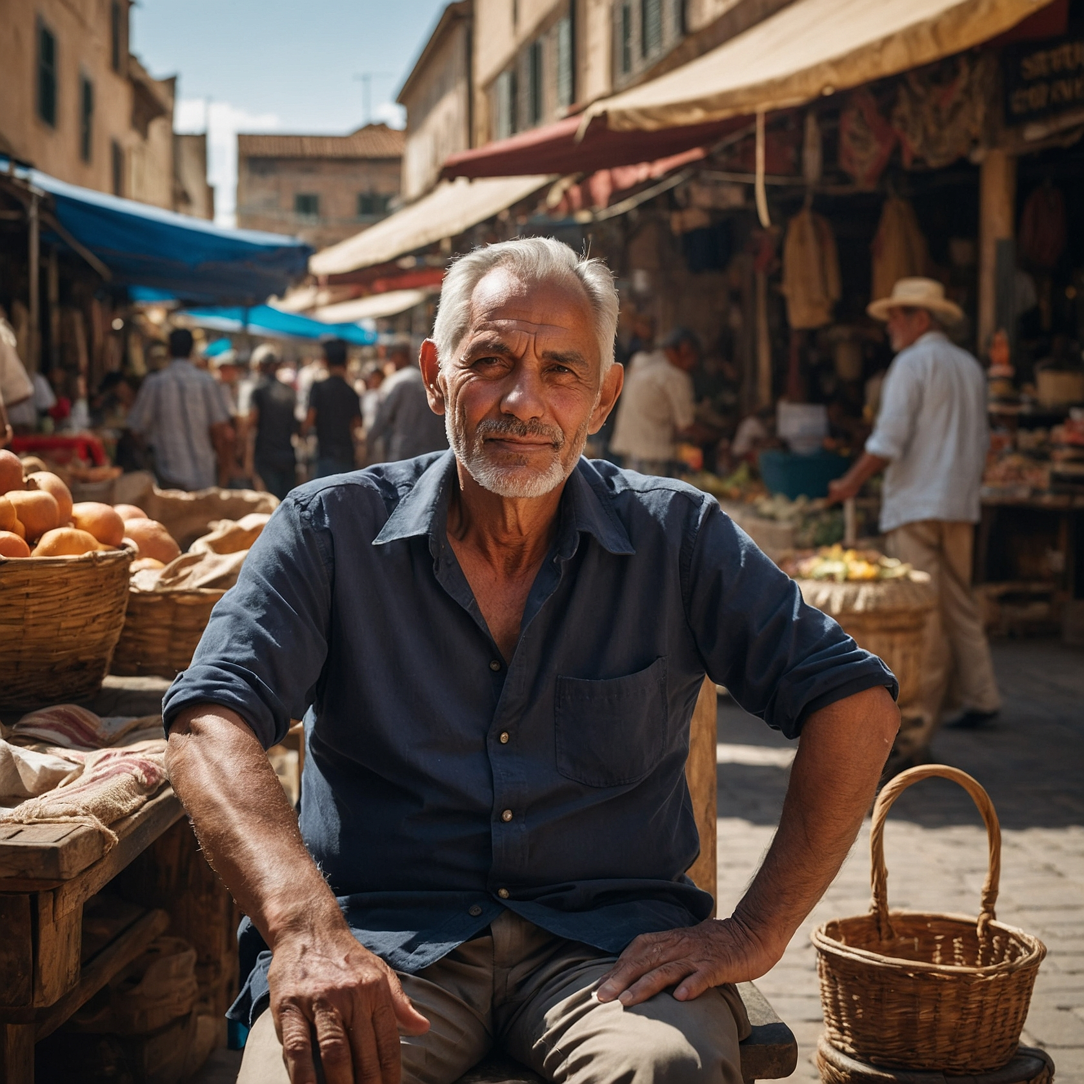
Scene 1
Jesus' Parables:
Stories About God’s Grace
A long time ago, Jesus told special stories called parables to help people understand important lessons about life and God. These stories showed us how to see things from God’s point of view. Let’s look at a few of these wonderful parables.
Jesus told a story about a shepherd who had 100 sheep. One day, one of the sheep wandered off and got lost. Instead of staying with the 99 sheep that were safe, the shepherd went out to find the one lost sheep.
When he finally found it, he was so happy that he carried it home on his shoulders and threw a big party to celebrate!

Slide 3
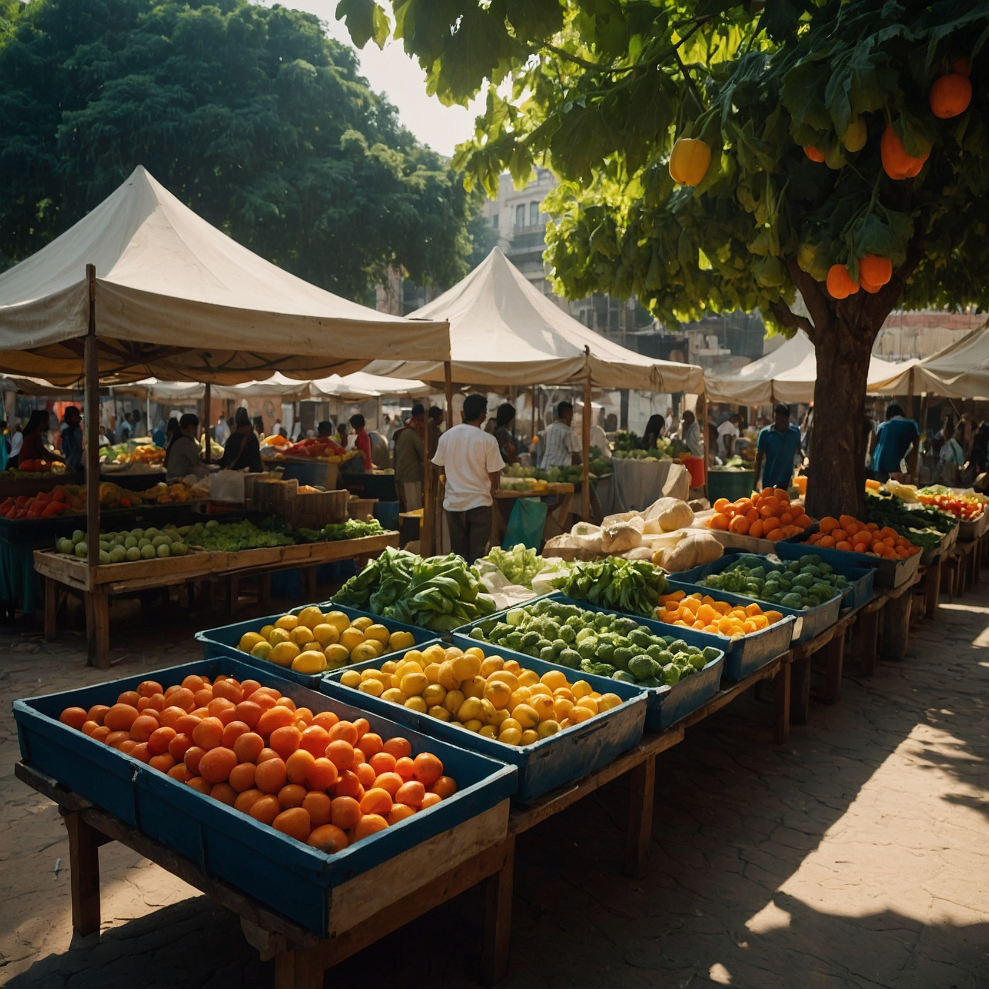




This story shows us that God is like the shepherd, always happy when someone who is lost finds their way back to Him.
Jesus also told a story about a woman who had ten coins but lost one. She lit a lamp and swept the entire house, looking carefully for her lost coin. When she found it, she was so excited that she called her friends and neighbors to celebrate with her!
This story shows us that God is like the woman, rejoicing when something precious is found.
Another story Jesus told was about a father with two sons.

Slide 4
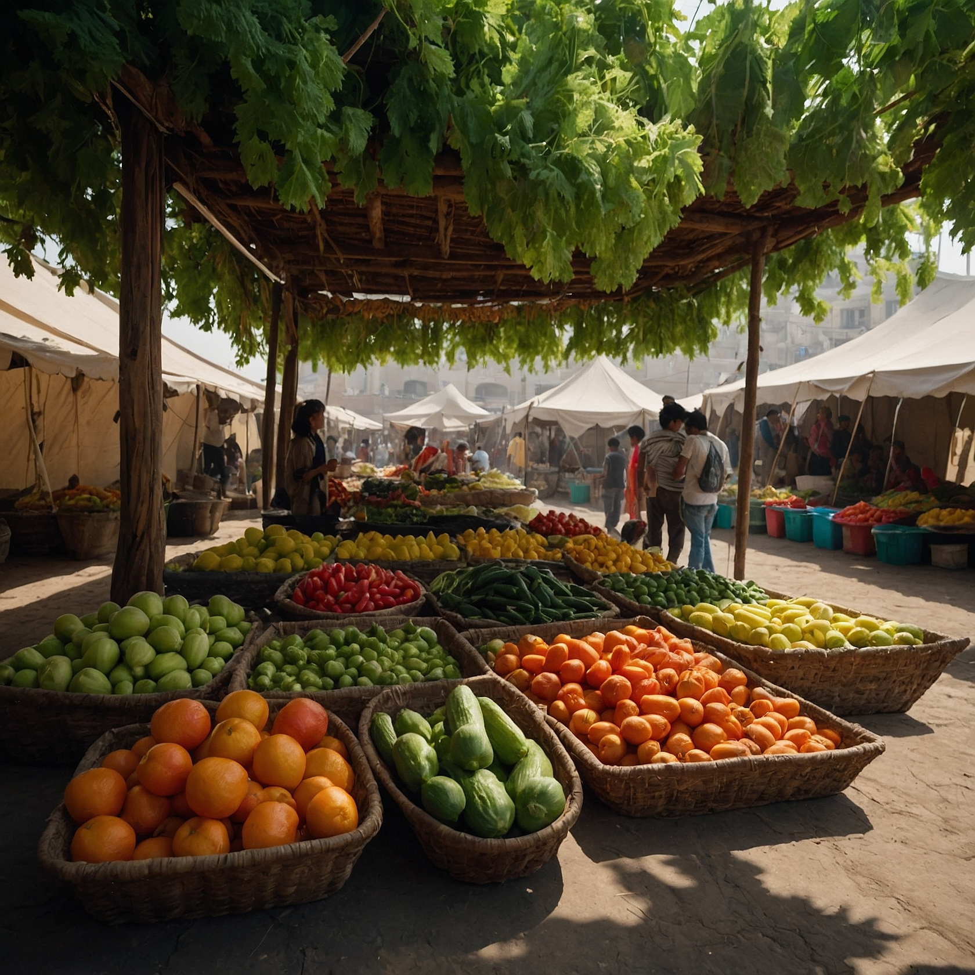
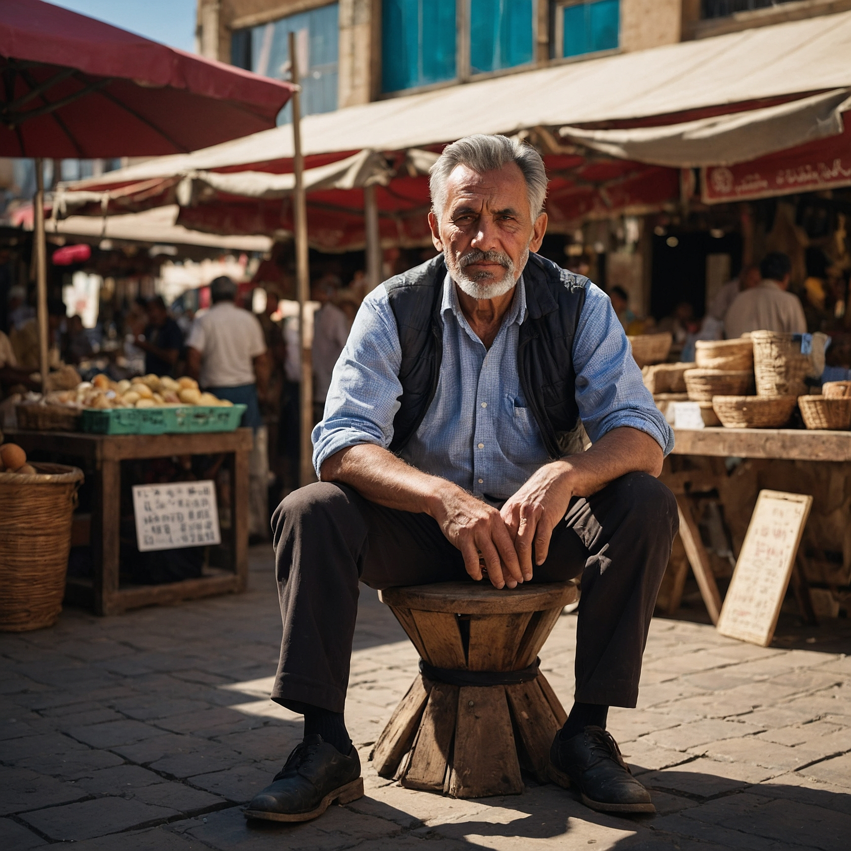
One day, the younger son decided to leave home and spent all his money on things that didn’t matter. After losing everything, he decided to go back home and ask his father for forgiveness.
While he was still far away, his father saw him, ran to him, hugged him, and threw a big party to celebrate his return! This story shows us that God is like the father, always ready to welcome us back with open arms.
m
These parables help us understand how much God loves us and celebrates when we return to Him.

Slide 5
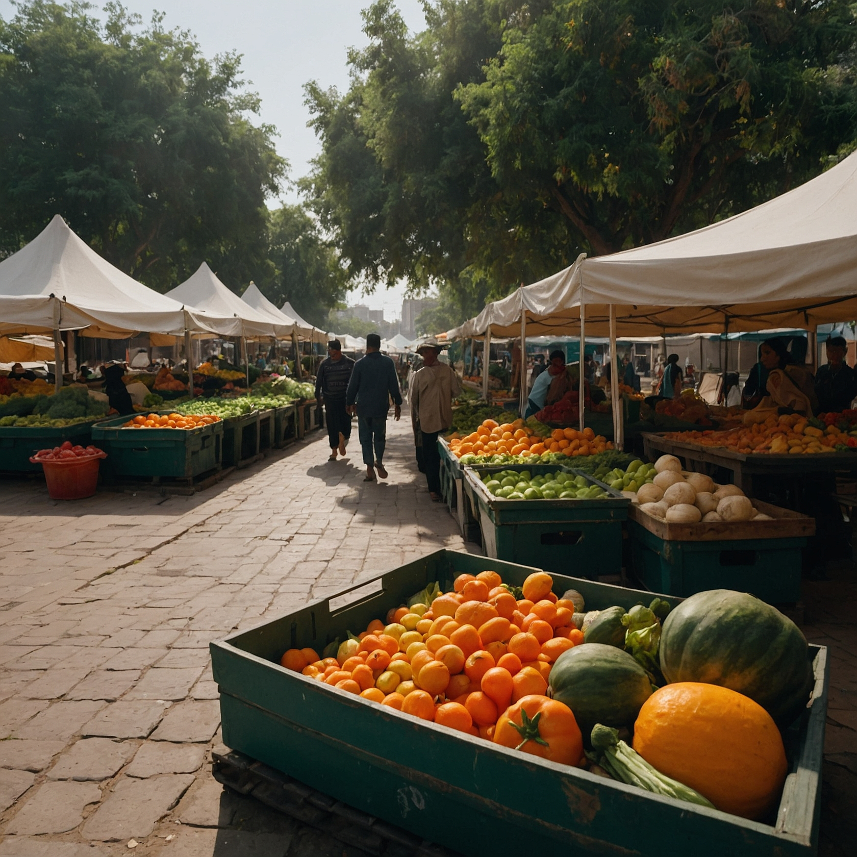
Jesus told another story about a man who owned a vineyard, a place where grapes grow.
He hired workers to help pick the grapes. Some workers started early in the morning, and others started later in the day.
m
But at the end of the day, he paid all the workers the same amount, even though some worked longer than others. This might seem unfair, but Jesus was showing us that God’s grace and kindness are given to everyone, not based on what we do but because He loves us all equally.

Slide 6
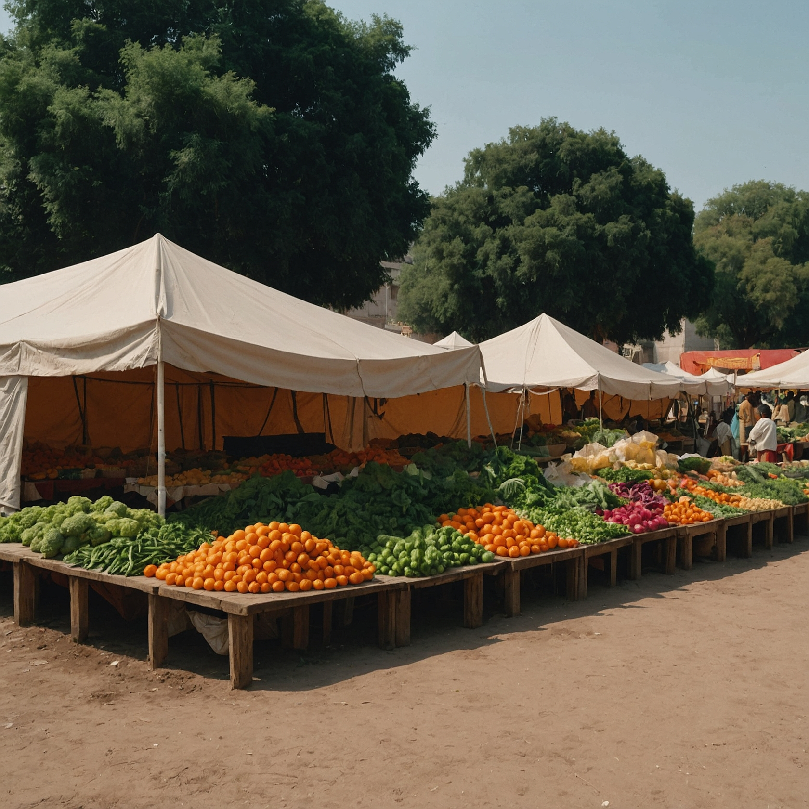

scene 2
Grace is a gift
Grace is a special kind of love that God gives us, It’s not something we can earn or buy; it’s a gift.
Grace is personal because it comes to us through Jesus, who loves us and wants to be our friend.
Jesus said, "I am the way, the truth, and the
life." Grace means that God is always with
us, helping us, and loving us, no matter what.

Slide 7

So, remember, whenever you hear these parables, think about how much God loves you and wants to be close to you
Just like the shepherd with his lost sheep, the woman with her lost coin, and the father with his lost son, God is always happy when you come back to Him.

Slide 8
scene 3
Grace is personal
Finally, Jesus taught that grace isn’t just a thing or a reward for being good. Grace is personal because it comes to us through Jesus Himself. Jesus is like a friend who is always there for us, showing us the way to live and helping us when we need it. Grace is like God’s presence with us, guiding us and loving us no matter what.
So, whenever we hear these stories, we can remember that God’s heart is full of joy when He finds us, and His grace is a special gift that is always there for us.
God’s love is bigger than we can imagine, and it’s something we can always count on, just like we can count on the sun to rise every morning.

Slide 9
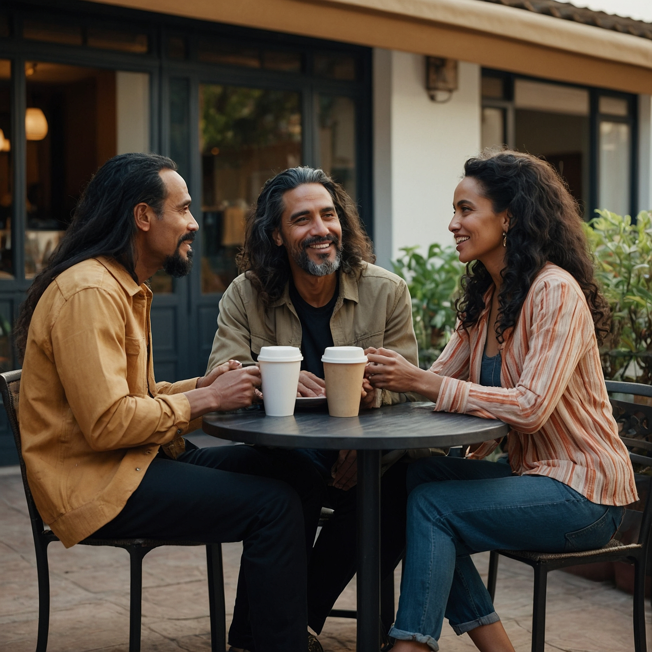
section for interaction in the group
Remember, we want this day to be able to confidently articulate or talk about what we have learned. Are you ready to share what you learned? Jesus told many parables to help us reimagine life under God’s grace. Parables were not only moral stories that were told to show us a better way to live, but they help us to better understand and correct our concept of nature in the parables of the lost sheep, the lost coin, and the lost sons (Luke 15).
Grace is personal - We can speak of the experience of grace because it is deeply personal and relational. Grace is personal for two important reasons. First, grace is not a thing. It is not a good or commodity. It is not a sacred substance poured into us as some kind of "Christian motor oil" to help the "engine" of our discipleship run more efficiently. Grace is personal because it comes to us in the person of Jesus Christ, who said, "I am the way, the truth, and the life."

Slide 10

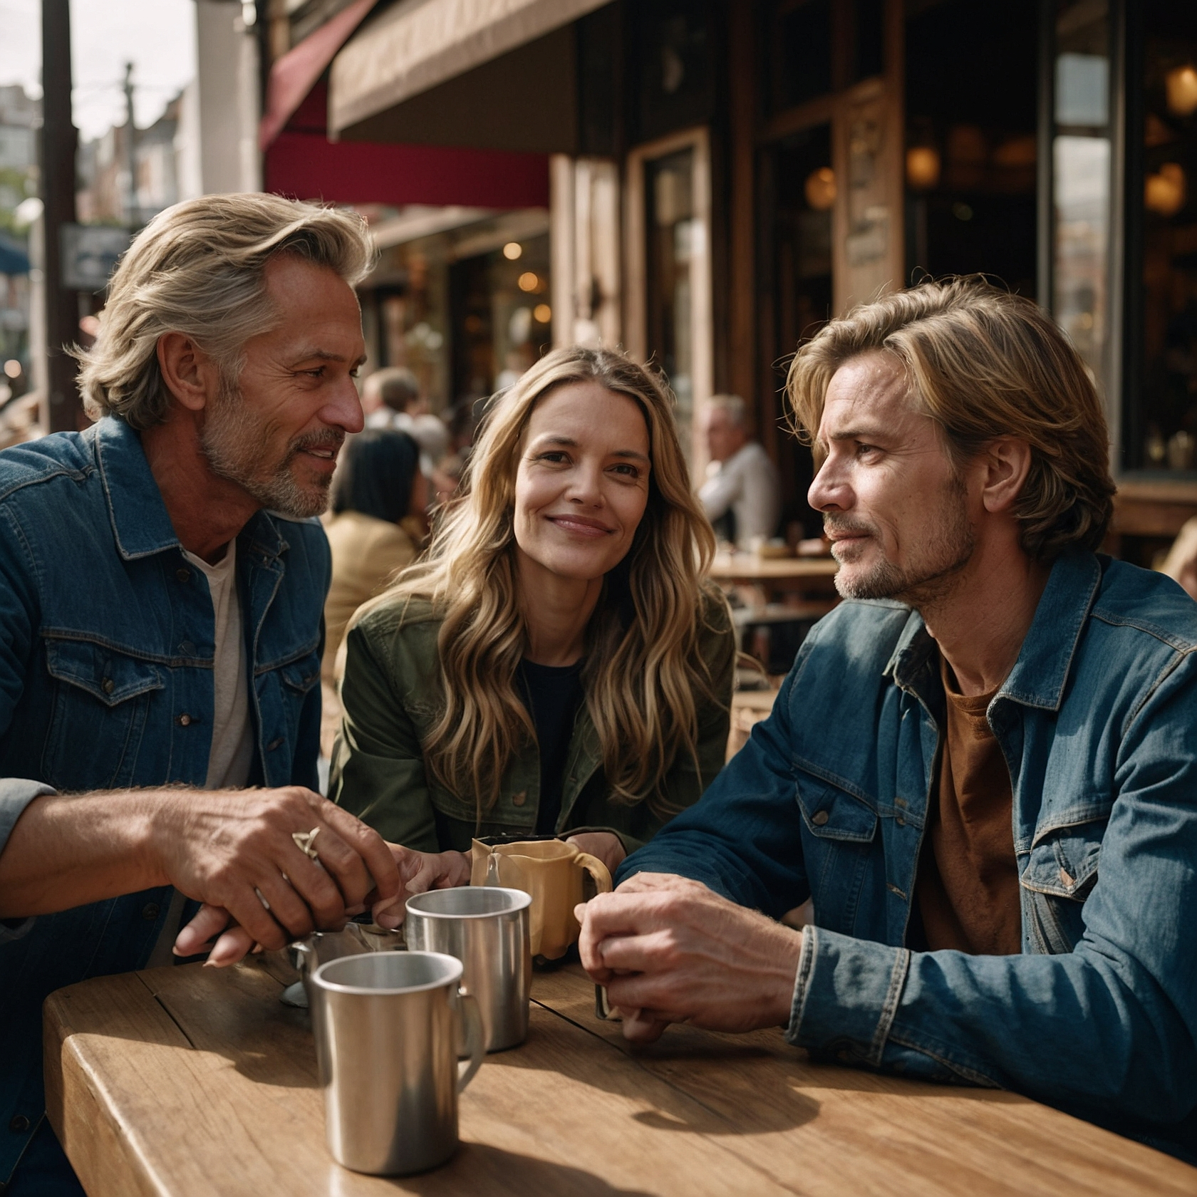
Prayer Time
Facilitator invites group members to pray for each other. Each person will choose one person from the group to pray for.
In which area of your life, you need God's grace to work the most?
What things can I pray for you?

